Slide 1
Office of Education: Internship Final Presentation
Actuator Model of the Sample Transfer Arm in Mars Sample Return
Austin Kwon (347G-Affiliate) Jet Propulsion Laboratory austin.kwon@utexas.edu

Slide 2
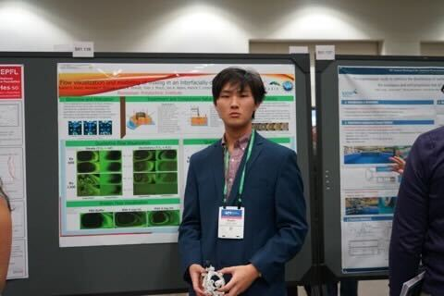
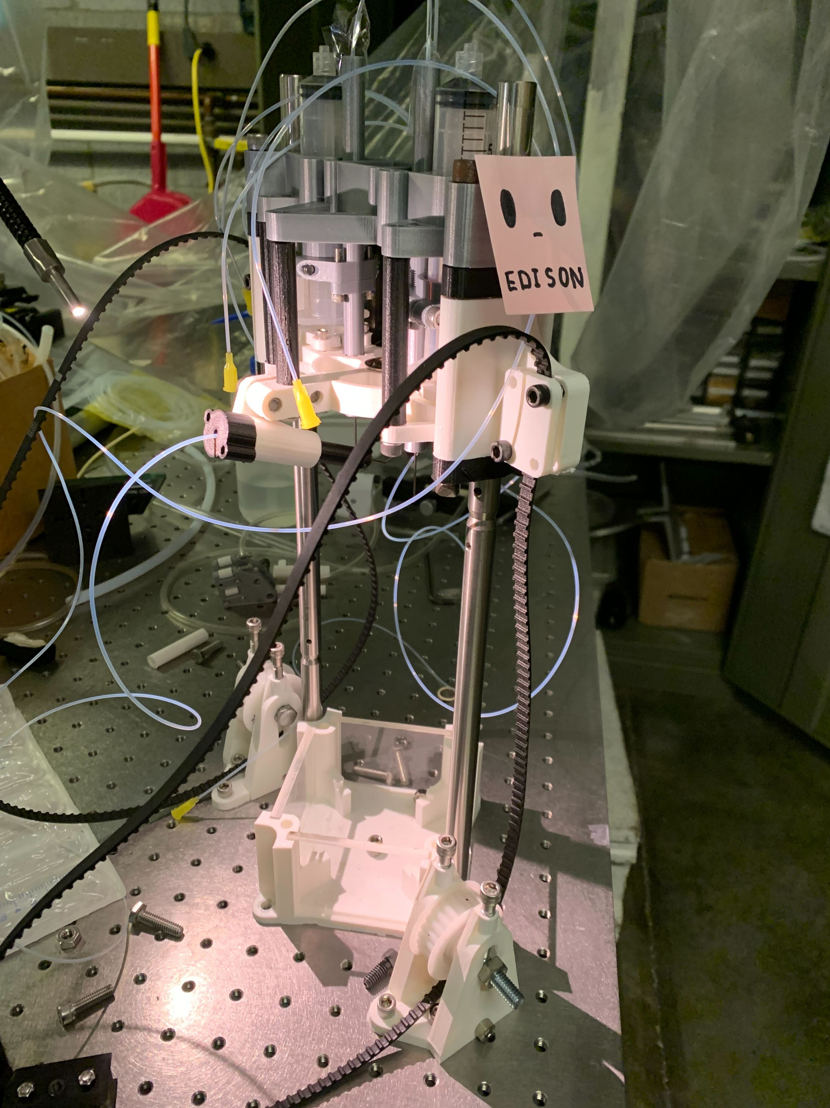
Brief Introduction
Data Driven Actuator Model of the Sample Transfer Arm in Mars Sample Return
Bio
May 2024 BS graduate from Rensselaer Polytechnic Institute (RPI) in Troy, NY in Aerospace and Mechanical Engineering.
Previously at Sikorsky Aircraft for ground test engineering co-op.
Did research at RPI where I developed numerical tools to process experimental data and designed test hardware.

Slide 3
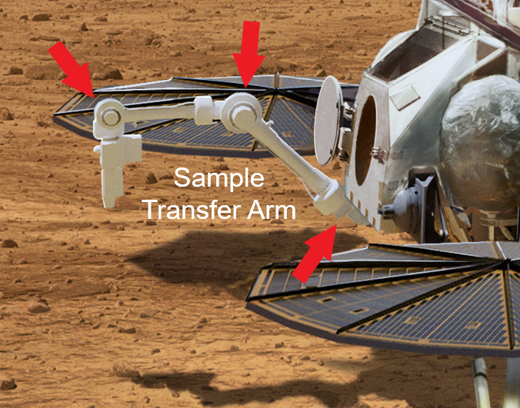
Project Background
Perseverance Mars Rover:
Data Driven Actuator Model of the Sample Transfer Arm in Mars Sample Return
Introduction
JPL/NASA/ESA are planning to retrieve the mars regolith (dirt) samples that the Perseverance Rover has collected
The baseline Sample Retrieval Lander (SRL) has 7 degree of freedom (DOF) Sample Transfer Arm (STA) that retrieves Mars sample tubes (including potential evidence of biosignatures).
STA would use BLDC (brushless DC) motor actuators (red arrows).
Rendition of MSL STA and STA Actuators:

Slide 4
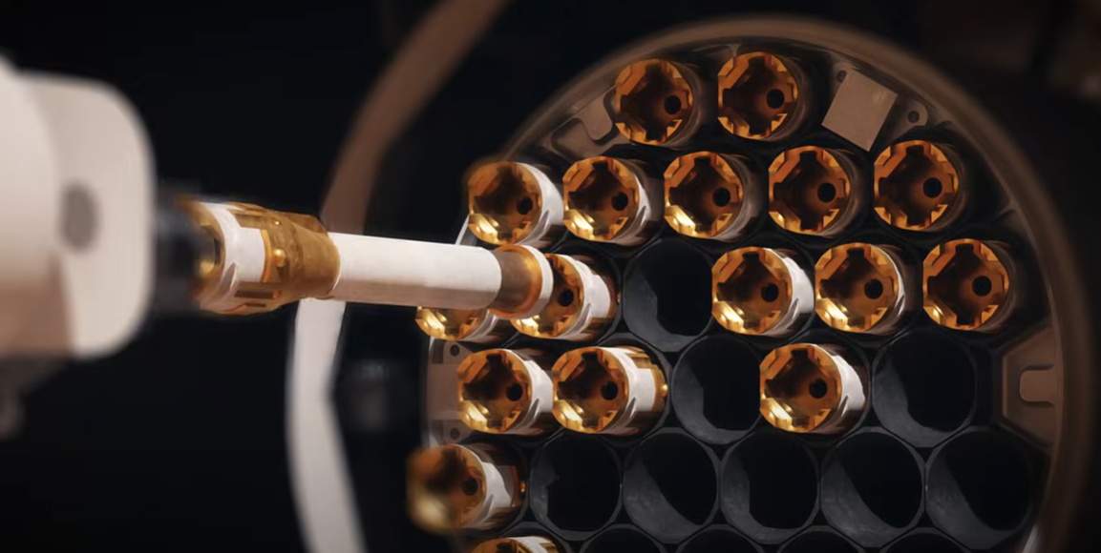
Project Background [cont. 1]
Data Driven Actuator Model of the Sample Transfer Arm in Mars Sample Return
Introduction
STA needs to insert mars regolith sample tubes.
Uses force control algorithm (FCA) to delicately insert tube into the MAV tube bay.
FCA requires accurate actuator models to successfully implement
STA End Effector
Sample tube
MAV tube bay

Slide 5
STA Actuator Types
Data Driven Actuator Model of the Sample Transfer Arm in Mars Sample Return
Introduction
STA uses three motor families (F1, F2, and F3)
Three types of motors need to be modeled and an accurate low-level simulation model is necessary to understand behavior of STA arm

Slide 6
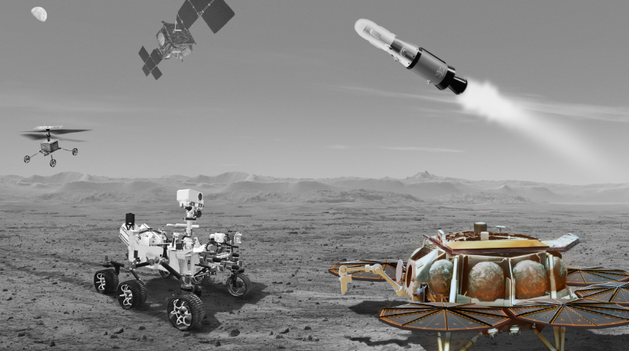
Internship Objectives
Data Driven Actuator Model of the Sample Transfer Arm in Mars Sample Return
Introduction
Artist’s Concept
Develop numerical tools and process experimental data in support of validating and improving Simulink actuator model
Notes:
Picture of STA and point to joints
Maybe bio abt myself
System that is modeled and why – after: short contents page (list of contributions) or table of contents (of technical content)

Slide 7
Presentation Overview
Data Driven Actuator Model of the Sample Transfer Arm in Mars Sample Return
Table of Technical Contents
1) Motor control law
1.a) Simplified control law
2) Simulink model enhancement 2.a) Backlash implementation 2.b) Phantom torque
3) Supplemental numerical tools 3.a) HDF5 data extraction 3.b) Test data as simulation input 3.c) Numerically determining frequency response (bode plots) 4) Motor model validation

Slide 8
Simplified Control Law
Data Driven Actuator Model of the Sample Transfer Arm in Mars Sample Return
Simulink Modeling
Cascading control (position P-control and velocity PI-control)
I documented breakdown of control law for educational purposes
Notes:
Sample tube inserton force control during insertion output of force control is motor torque setpoint
What robotic arm is (7 dof arm)
Different actuator sizes (different parameters)
Why care abt backlash
Screenshot of actuators

Slide 9
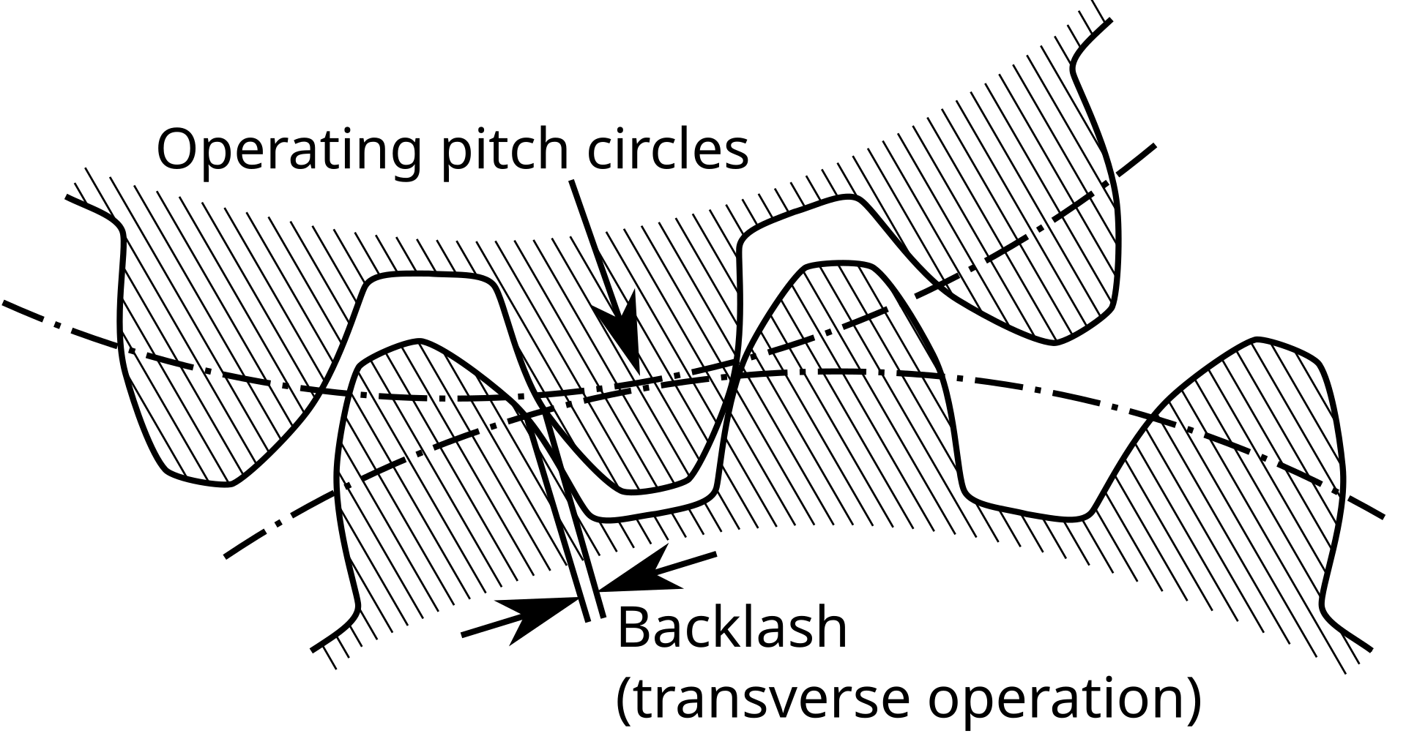
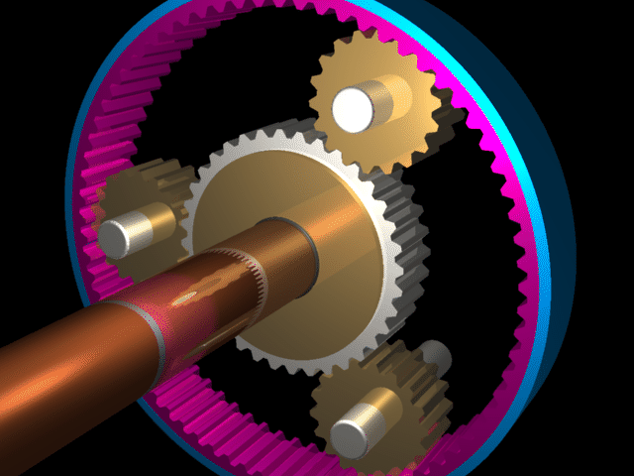
Gear Backlash
Data Driven Actuator Model of the Sample Transfer Arm in Mars Sample Return
Backlash and its importance
Gear backlash is the angular play (also called “slop”) between two meshing gears.
Backlash is necessary to have a power-efficient geartrain.
STA actuator uses a planetary gearbox which introduces backlash.
Backlash introduces nonlinear behavior that must be accounted for in simulation to capture real behavior of actuators.

Slide 10
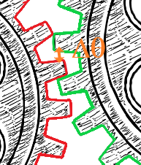
Without Backlash
Data Driven Actuator Model of the Sample Transfer Arm in Mars Sample Return
Simulink Modeling (Shields)
let$∆θ= \frac{θ_{motor}}{g_{r}} − θ_{out}$
let$∆ω= \frac{{\dot{θ}}_{motor}}{g_{r}} − {\dot{θ}}_{out}$
$$T_{out, nobacklash}= K∆θ+B∆ω$$
*where K is the rotational stiffness coefficient of the shaft, B is the rotational dampening coefficient of the shaft, and $g_{r}$ is gear ratio

Slide 11
Simulink Block Diagram Without Backlash
Data Driven Actuator Model of the Sample Transfer Arm in Mars Sample Return
Simulink Modeling (Shields)

Slide 12
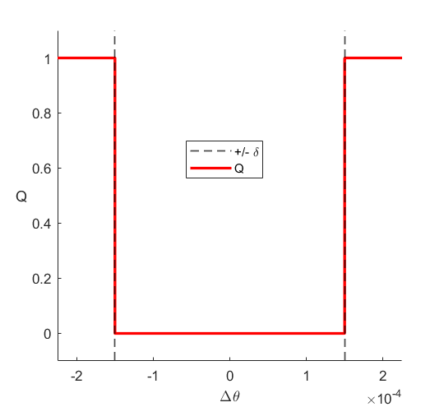
Leonardo Robotics Backlash Equation
Data Driven Actuator Model of the Sample Transfer Arm in Mars Sample Return
Simulink Modeling
Q is a band-stop filter approximation:
let $Q= \frac{π − \operatorname{atan}\left(α\left(∆θ+ δ/2\right)\right) + \operatorname{atan}\left(α\left(∆θ− δ/2\right)\right)}{π}$
let $H=K∆θ+B∆ω − \frac{Kδ}{2}∗sign\left(∆θ\right)$
$=T_{out, nobacklash}−\frac{Kδ}{2}∗sign\left(∆θ\right)$
$T_{out, backlash}=QH= \left\{\begin{aligned}H, \left|∆θ\right|≥ \frac{δ}{2} \\ 0, \left|∆θ\right|< \frac{δ}{2}\end{aligned}\right.$
$$±δ/2$$
Q

Slide 13
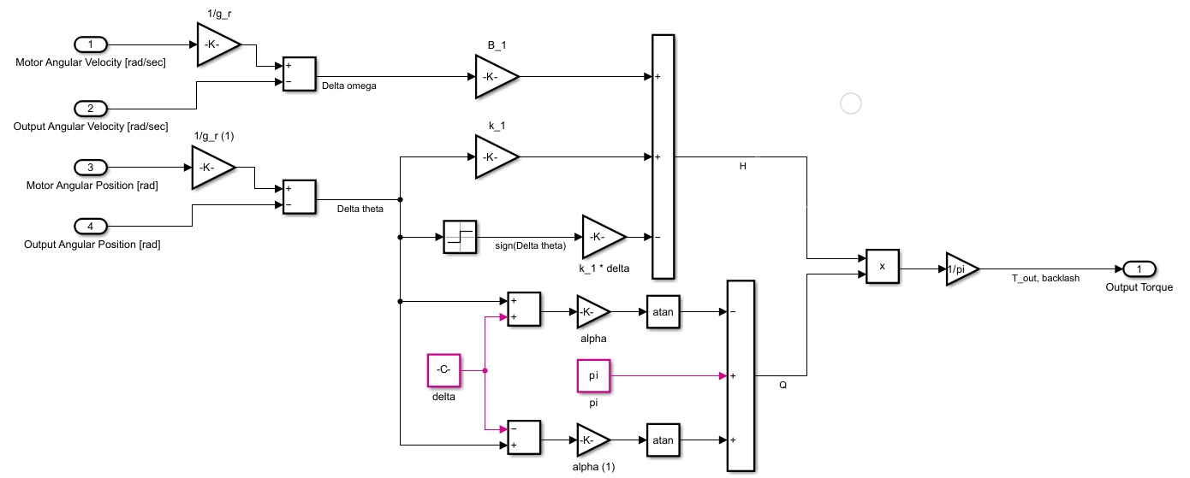
Simulink Block Diagram With Backlash
Data Driven Actuator Model of the Sample Transfer Arm in Mars Sample Return
Simulink Modeling (Shields)

Slide 14
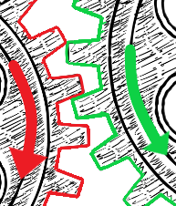
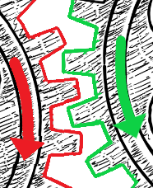
Phantom Torque
Data Driven Actuator Model of the Sample Transfer Arm in Mars Sample Return
Simulink Modeling (Shields)
Output shaft angular velocity would steeply change when the motor and output gears are not meshing (no torque transmitted).
engaged
disengaged
driving | driven gear

Slide 15
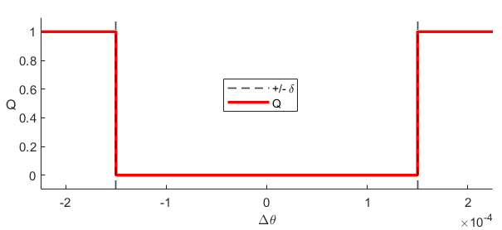
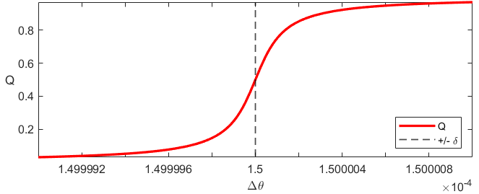
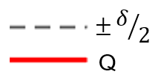
Phantom Torque [cont. 1]
Data Driven Actuator Model of the Sample Transfer Arm in Mars Sample Return
Simulink Modeling (Shields)
Discovered that Q-function is causing this artifact.
Likely reason is that “gray zone” between Q = 0 1 transition of Q-function effects the velocity of output shaft
Gray zone:
Notes:
Other alternatives

Slide 16
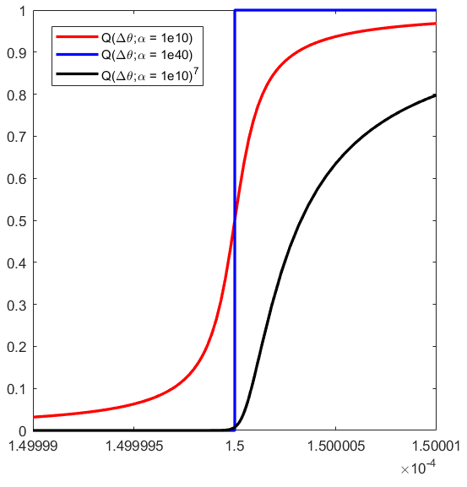
Phantom Torque [cont. 2]
Data Driven Actuator Model of the Sample Transfer Arm in Mars Sample Return
Simulink Model (Shields)
Two potential solutions were explored:
1) boosting the backlash gain ($α$)
2) taking 7th power of Q (number 7 is arbitrarily chosen)

Slide 17
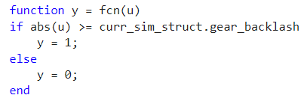
Phantom Torque [cont. 3]
Data Driven Actuator Model of the Sample Transfer Arm in Mars Sample Return
Non-feasible Potential Solutions
Simulink Bandstop Filter block will be removed https://www.mathworks.com/help/dsp/ref/bandstopfilter.html:
MATLAB function block with an if statement takes long time to run simulation:

Slide 18
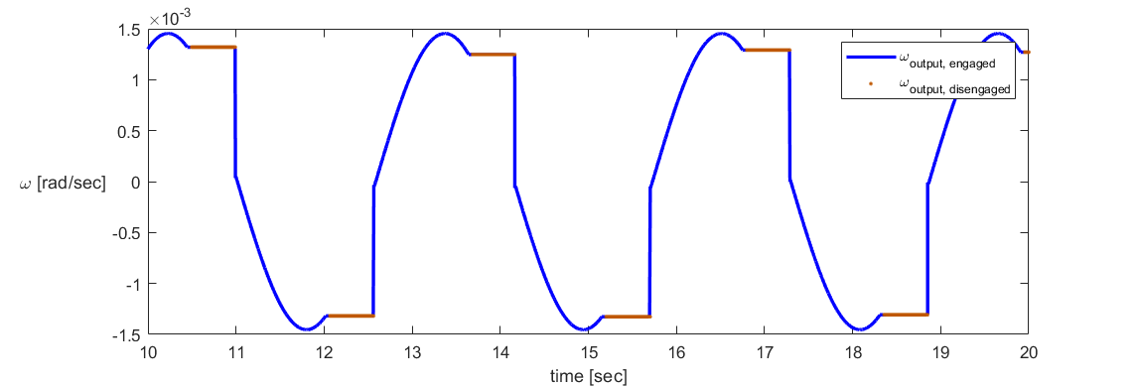
Phantom Torque [cont. 4]
Data Driven Actuator Model of the Sample Transfer Arm in Mars Sample Return
Simulink Modeling (Shields)
$α$ = 1e10 (original)
$α$ = 1e40 (solution 1)
$Q^{7}, α$ = 1e10 (solution 2)

Slide 19
Phantom Torque [cont. 5]
Data Driven Actuator Model of the Sample Transfer Arm in Mars Sample Return
Simulink Modeling (Shields)
The $Q^{7}$ solution appears to most closely capture the motor behavior that is seen testbed experiments
$Q^{7}$ solution (Simulink):
Experiment (testbed data):

Slide 20
Phantom Torque [cont. 6]
Data Driven Actuator Model of the Sample Transfer Arm in Mars Sample Return
Simulink Modeling (Shields)
By the time that motor and output gear hit each other, the motor gear already switched directions

Slide 21
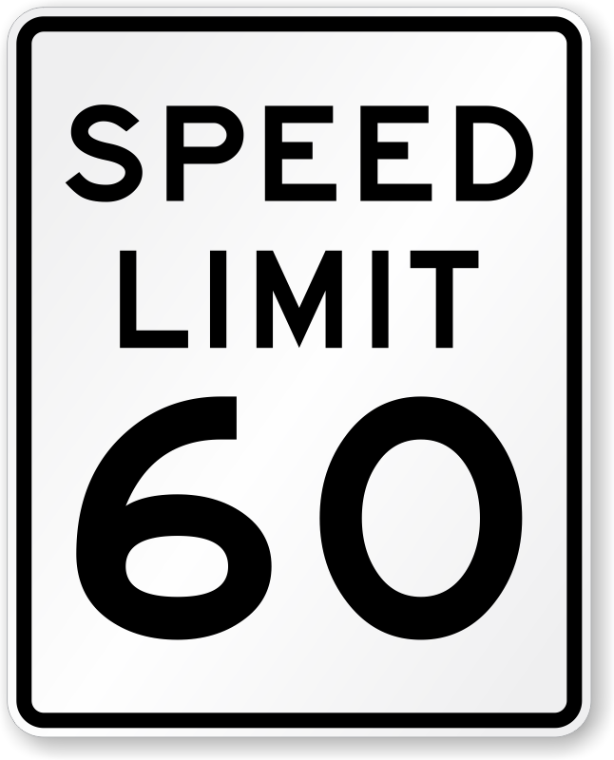
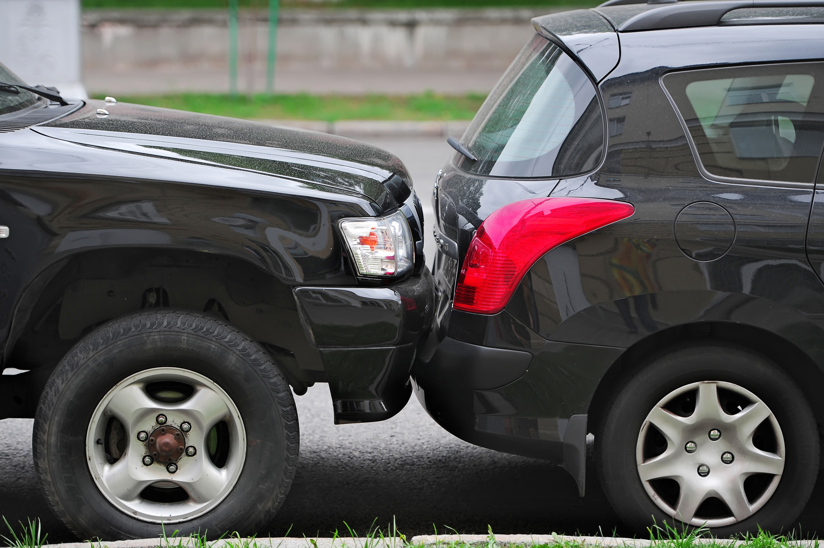
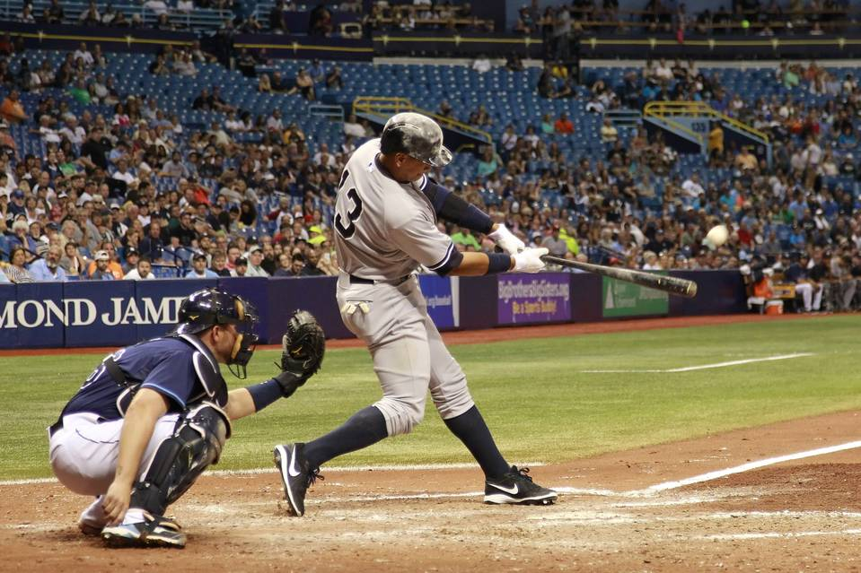
Phantom Torque [cont. 7]
Data Driven Actuator Model of the Sample Transfer Arm in Mars Sample Return
Simulink Modeling (Shields)
Not this (velocity in same direction):
But this (velocity in opposite direction):

Slide 22
Objectives of Experiment/Simulation Comparison
Data Driven Actuator Model of the Sample Transfer Arm in Mars Sample Return
High Level Summary
If simulation data matches experimental data: actuator behavior is properly captured in model
Ways to determine “match” between experiment and simulation: 1) bode plot (magnitude gain and phase shift - frequency domain) 2) transient plot (time series comparison)

Slide 23
Bode Plots
Data Driven Actuator Model of the Sample Transfer Arm in Mars Sample Return
Bode plots show the frequency response (change in magnitude and phase of system relative to the sinusoidal attenuating force) as a function of frequency
Magnitude Gain [dB] = $20∗\log_{10}\left(\frac{A_{out}}{A_{in}}\right)$
Phase shift [rad] = $\frac{−2π∗∆t}{T}$

Slide 24
Testbed Information
Data Driven Actuator Model of the Sample Transfer Arm in Mars Sample Return
Motor Specs
Motors used in testbed are different from those of STA.
Likewise with the STA, testbed has three “families” or sizes of motors (designated as sizes 17, 32, and 40 because of the different harmonic drives used).
Even though motors are different, the lessons learned and the models and numerical tools developed during work on testbed motors will give insight into STA actuator behavior which can directly translate over to help model the STA actuators

Slide 25
Testbed Information [cont. 1]
Data Driven Actuator Model of the Sample Transfer Arm in Mars Sample Return
Testbed Diagram
Speed reduction by gearmotor (has backlash) and harmonic (no backlash)
Hall sensors read motor angular position
Output resolver reads output shaft angular position

Slide 26
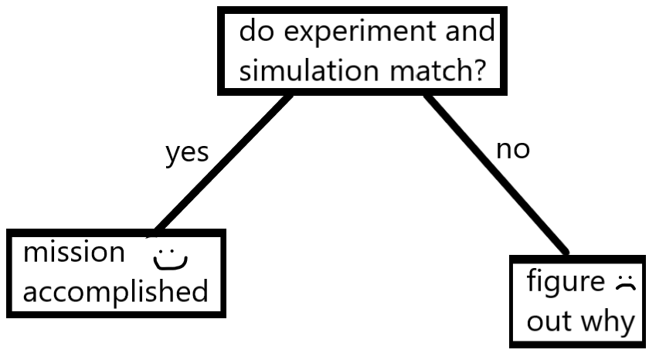
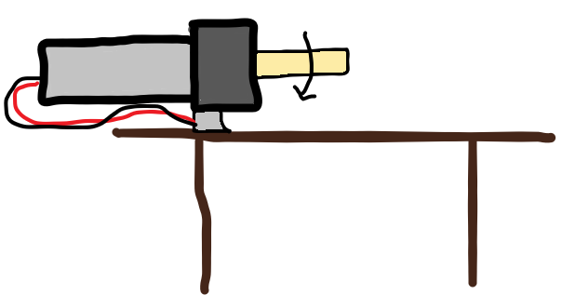
Experiment/Simulation Action Cycle
Data Driven Actuator Model of the Sample Transfer Arm in Mars Sample Return
Simulation results
Experimental data in form of HDF5 file
Motor sizes 17, 32, 40
If “no”

Slide 27
Simulink Simulation-Running Script
Data Driven Actuator Model of the Sample Transfer Arm in Mars Sample Return
MATLAB Numerical Tools
1) Extracting data of interest from HDF5 file
2) Use of command position from experimental data as the command input for Simulink simulation (togglable)
3) Numerically determining frequency response for experimental data and simulation data
Notes:
Compare exp data from testbed vs Simulink (big picture)

Slide 28
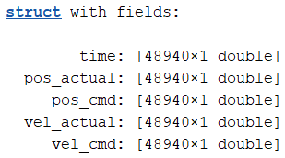
Extracting Data of Interest from HDF5 File
Data Driven Actuator Model of the Sample Transfer Arm in Mars Sample Return
MATLAB Numerical Tools
1) Directory name
2) Motor size
3) Waveform
4) Test number
extractPosVelDataFromHDF5.m

Slide 29
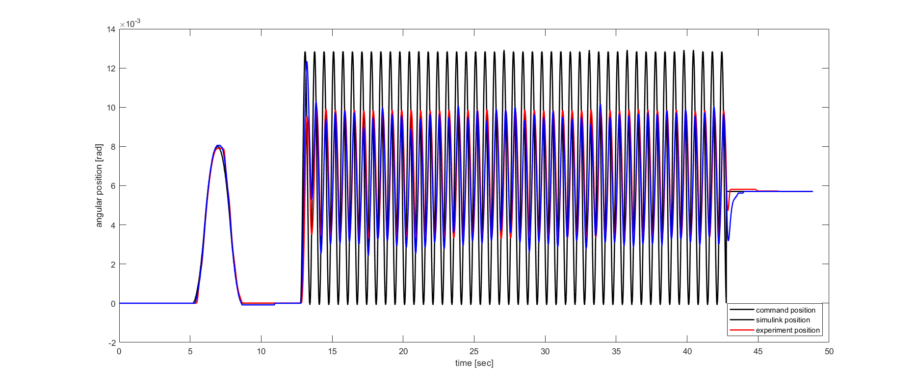
Use of Experimental Data Command Position in Simulation
Data Driven Actuator Model of the Sample Transfer Arm in Mars Sample Return
MATLAB Numerical Tools
Command Position (from experimental data)
Experiment Position
Simulink Position
This capability can help to validate Simulink model using experimental data
Notes:
Explain hump and plot from 0 to 20

Slide 30
Numerically Determining Frequency Response of Experimental Data
Data Driven Actuator Model of the Sample Transfer Arm in Mars Sample Return
MATLAB Numerical Tools
1) time array
2) actual position array
3) command position array
4) Time range
frequencyResponse.m

Slide 31
Numerically Determining Frequency Response of Experimental Data [cont. 1]
Data Driven Actuator Model of the Sample Transfer Arm in Mars Sample Return
MATLAB Numerical Tools
3 arrays of interest: time, command and actual position
Fit a sine curve to actual and command position using MATLAB curveFitter toolbox (finds A, B, and C coefficients)
Resulting sine curve has form: pos(t) = A*sin(B*t + C) vel(t) = A*B*cos(B*t + C)
Analytically find roots of velocity (peak/trough time values): roots of vel(t) = $\frac{π}{2B}+n\frac{π}{B}−\frac{C}{B}$ , $n∈𝕫^{m×1}$ for m roots
$$\frac{d}{dt}$$

Slide 32
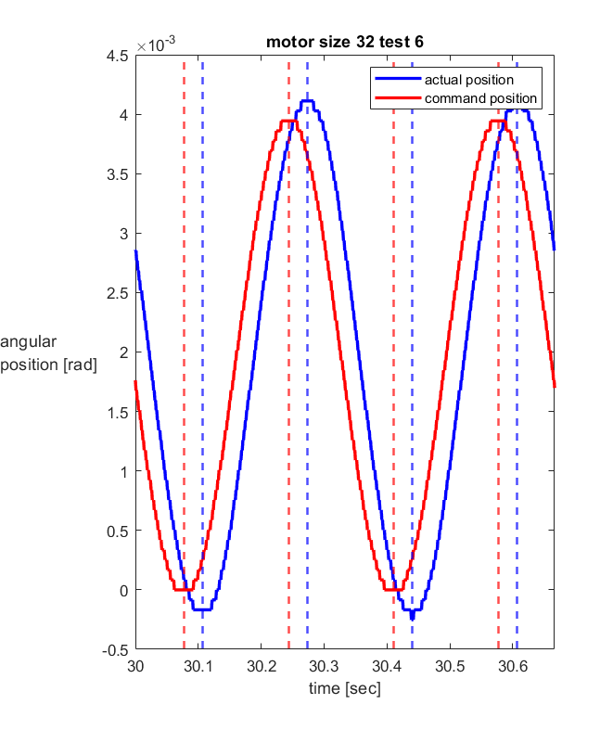
Numerically Determining Frequency Response of Experimental Data [cont. 2]
Data Driven Actuator Model of the Sample Transfer Arm in Mars Sample Return
MATLAB Numerical Tools
Fit sine curve for both actual and command position to determine their peak/trough times (dotted lines)
Peak/trough times: frequency, phase shift
Position values at peaks/troughs: oscillation amplitudes, magnitude gain
Can be seen in: C:\Users\agkwon\analyses\frequencyResponse.m

Slide 33
Numerically Determining Frequency Response of Experimental Data [cont. 3]
Data Driven Actuator Model of the Sample Transfer Arm in Mars Sample Return
MATLAB Numerical Tools
1) Directory name
2) Motor size
3) Waveform
4) Test number
extractPosVelDataFromHDF5.m
frequencyResponse.m

Slide 34
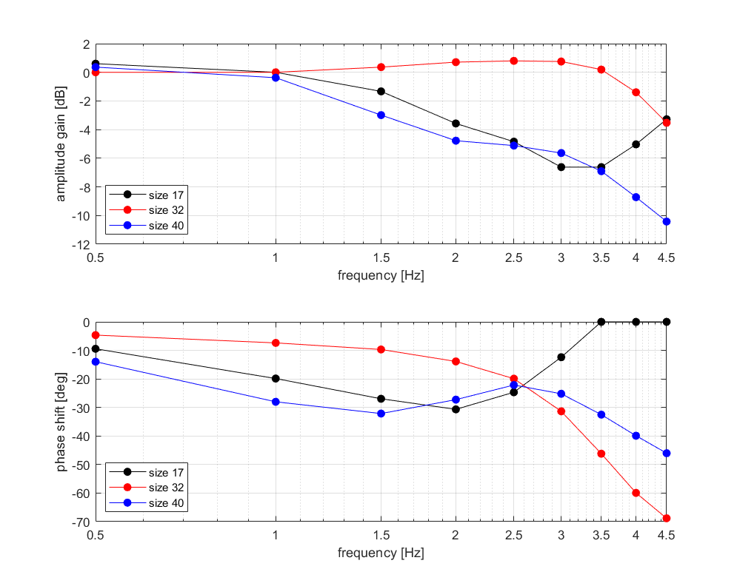
Numerically Determining Frequency Response of Experimental Data [cont. 4]
Data Driven Actuator Model of the Sample Transfer Arm in Mars Sample Return
MATLAB Numerical Tools
After being called in a loop for all 3 motor sizes for the experimental data:

Slide 35
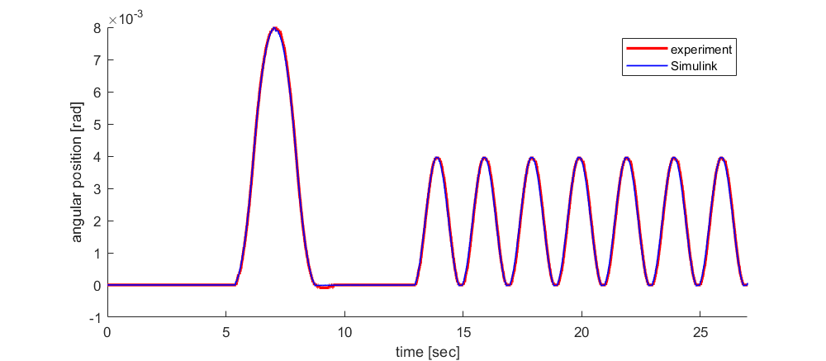
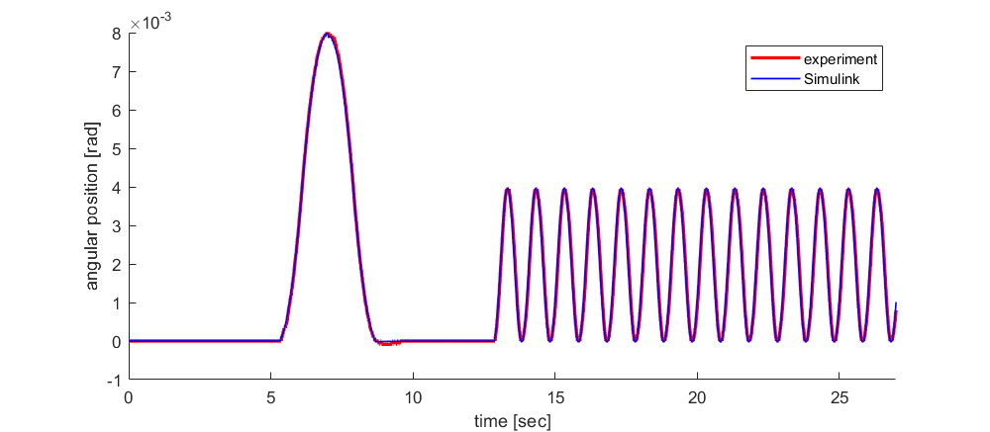
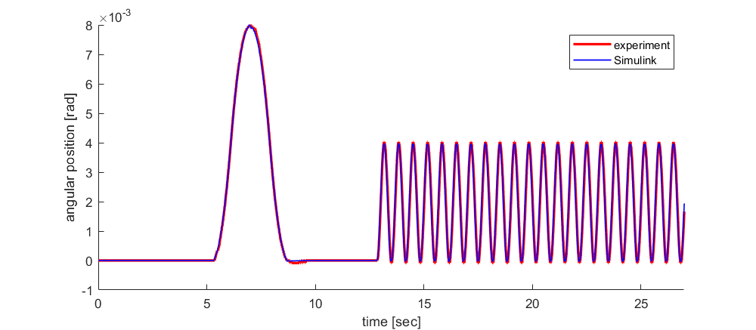
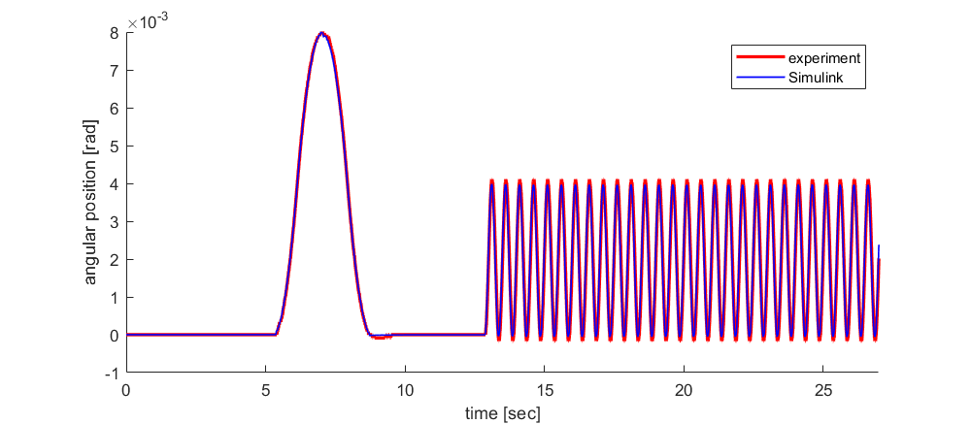
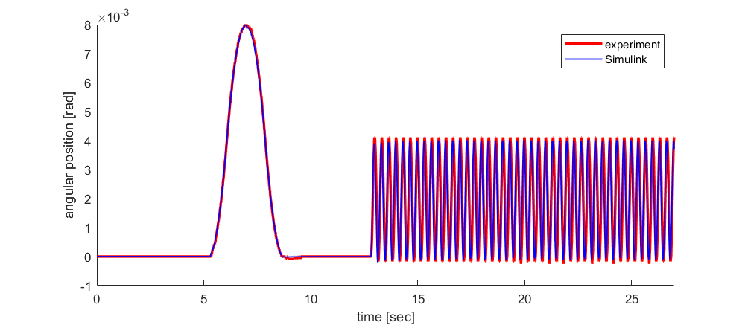
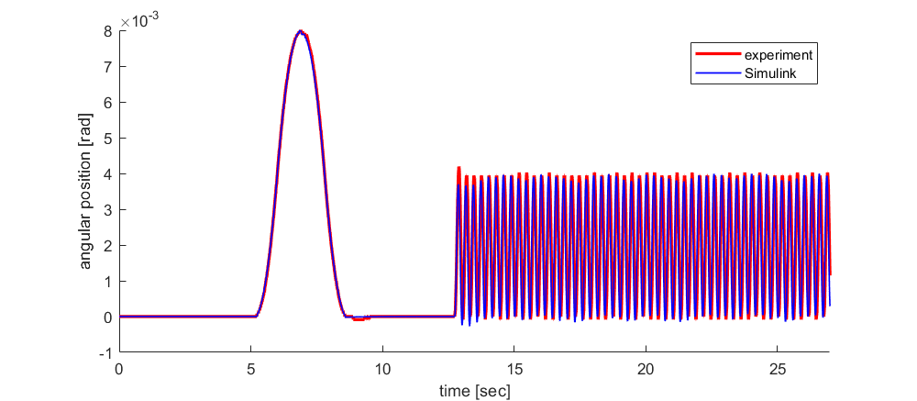
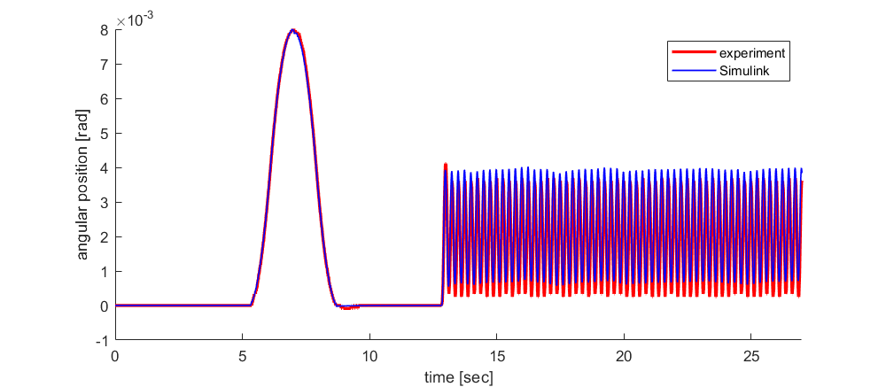
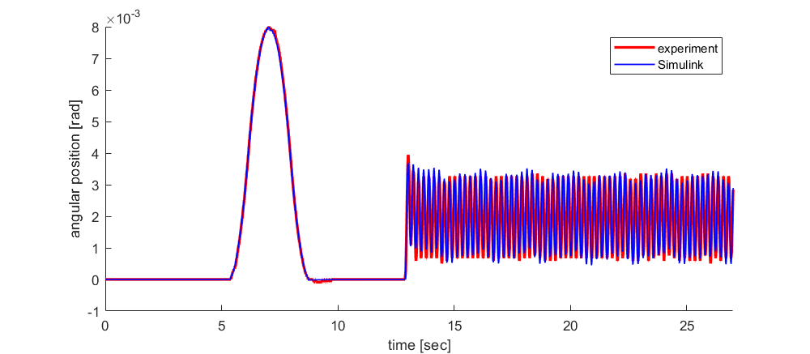
Motor Model Validation
Data Driven Actuator Model of the Sample Transfer Arm in Mars Sample Return
Experiment vs Simulink Transient Plot (Motor Size 32)
Test 1: 0.5 Hz
Test 2: 1.0 Hz
Test 3: 1.5 Hz
Test 4: 2.0 Hz
Test 5: 2.5 Hz
Test 6: 3.0 Hz
Test 7: 3.5 Hz
Test 8: 4.0 Hz
Test 9: 4.5 Hz

Slide 36
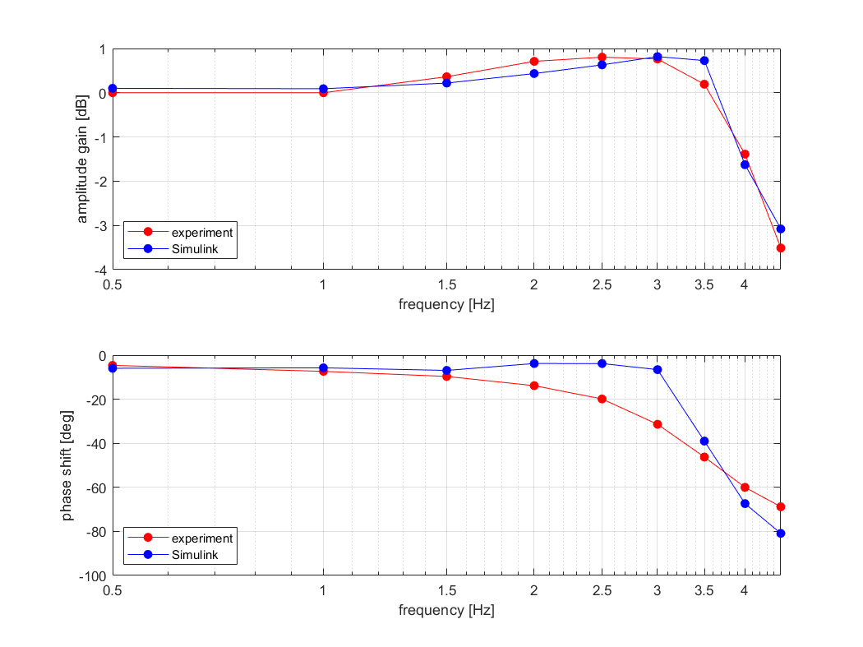
Motor Model Validation [cont. 1]
Data Driven Actuator Model of the Sample Transfer Arm in Mars Sample Return
Experiment vs Simulink Bode Plot (Motor Size 32)

Slide 37
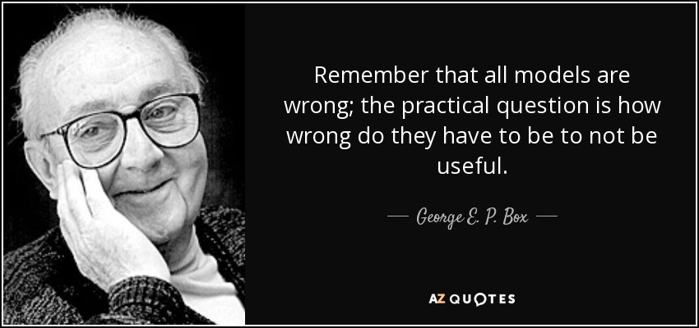
Motor Model Validation [cont. 2]
Data Driven Actuator Model of the Sample Transfer Arm in Mars Sample Return
Experiment vs Simulink Simulation

Slide 38
Motor Model Validation [cont. 2]
Data Driven Actuator Model of the Sample Transfer Arm in Mars Sample Return
Experiment vs Simulink Simulation

Slide 39
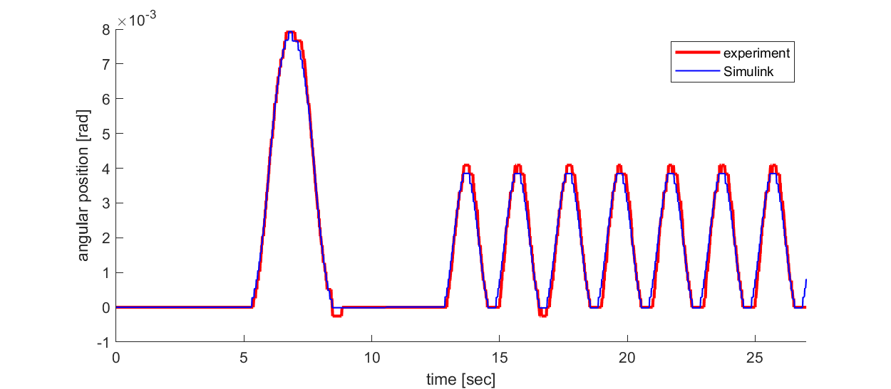
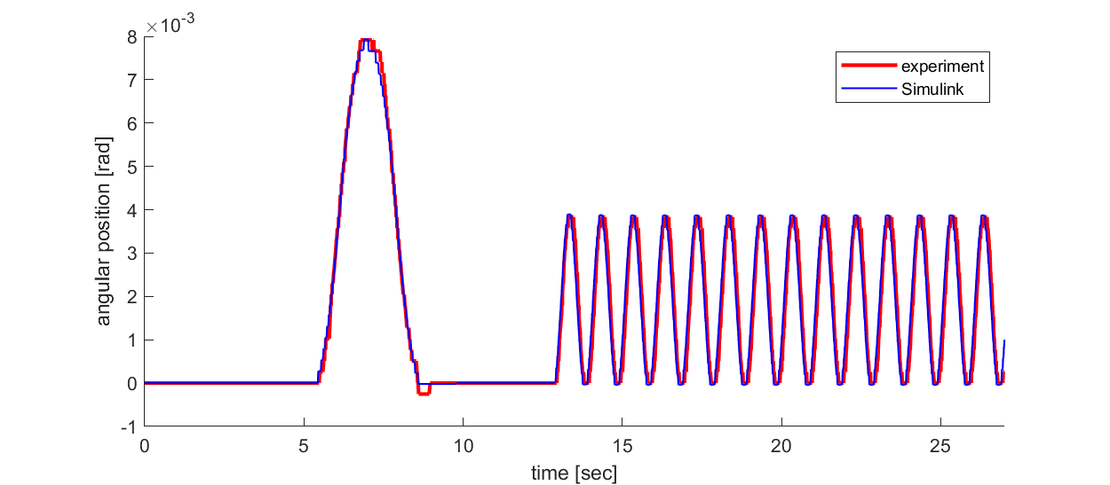
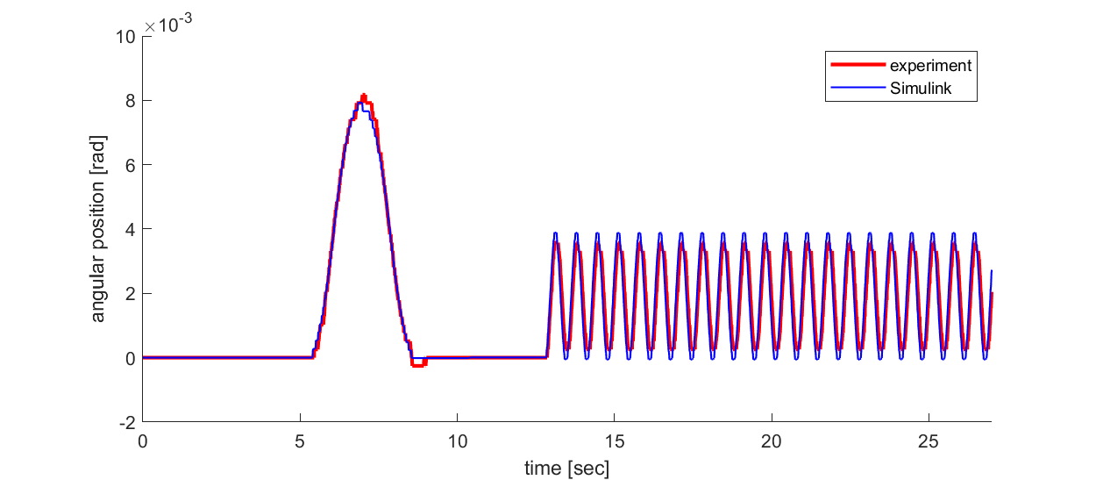
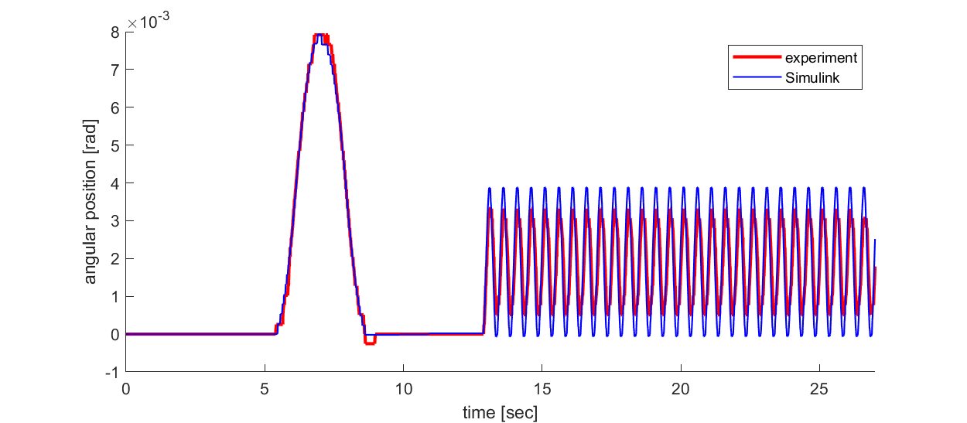
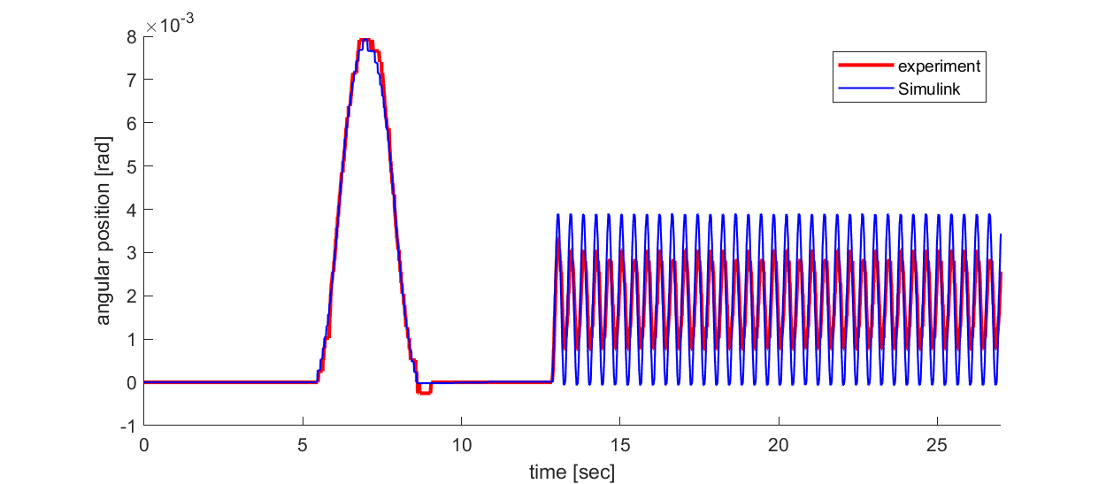
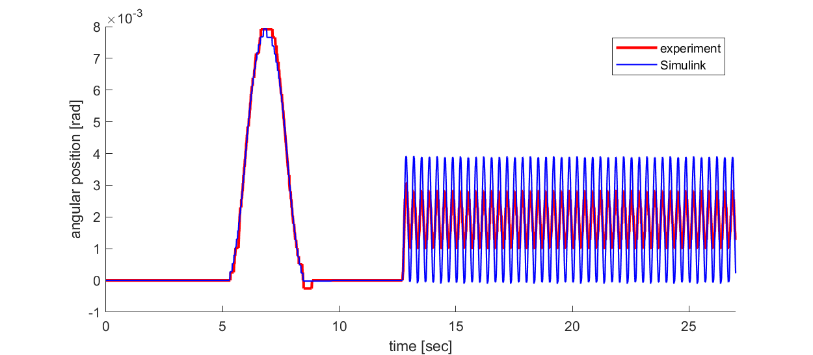
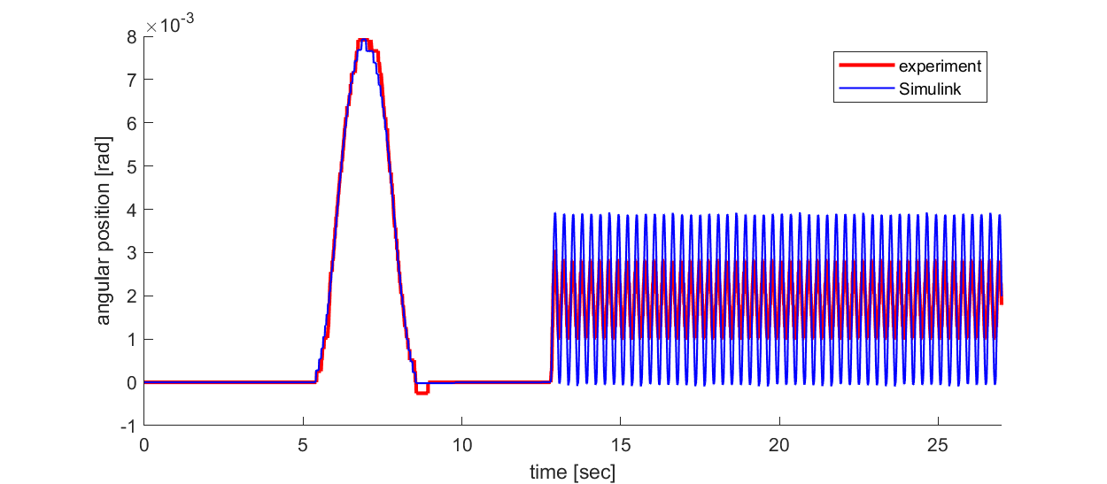
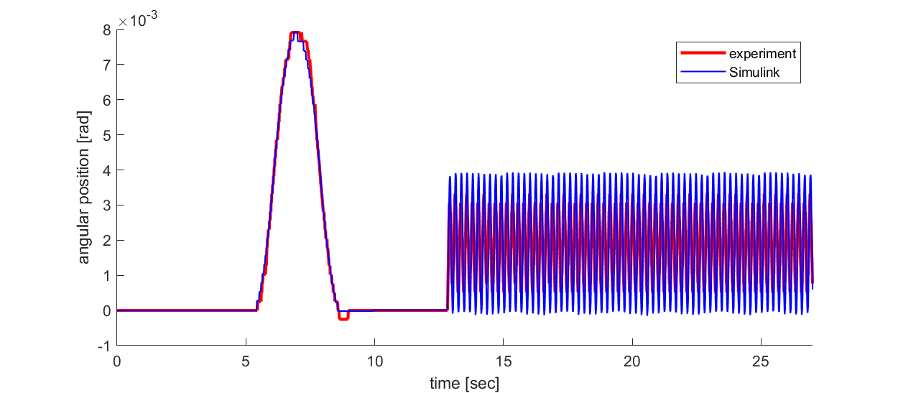
Motor Model Validation [cont. 3]
Data Driven Actuator Model of the Sample Transfer Arm in Mars Sample Return
Experiment vs Simulink Transient Plot (Motor Size 17)
Test 1: 0.5 Hz
Test 2: 1.0 Hz
Test 3: 1.5 Hz
Test 4: 2.0 Hz
Test 5: 2.5 Hz
Test 6: 3.0 Hz
Test 7: 3.5 Hz
Test 8: 4.0 Hz
Test 9: 4.5 Hz

Slide 40
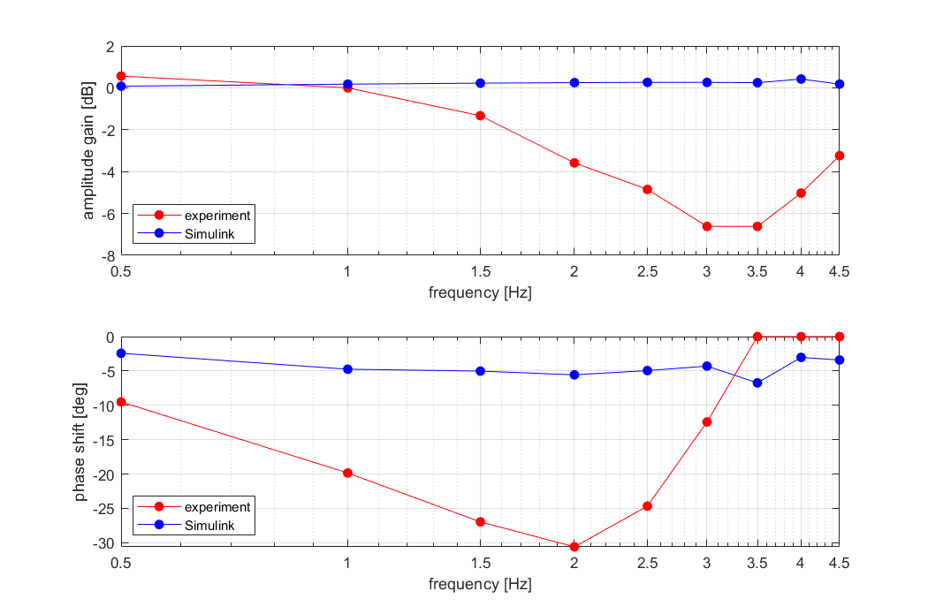
Motor Model Validation [cont. 4]
Data Driven Actuator Model of the Sample Transfer Arm in Mars Sample Return
Experiment vs Simulink Bode Plot (Motor Size 17)

Slide 41
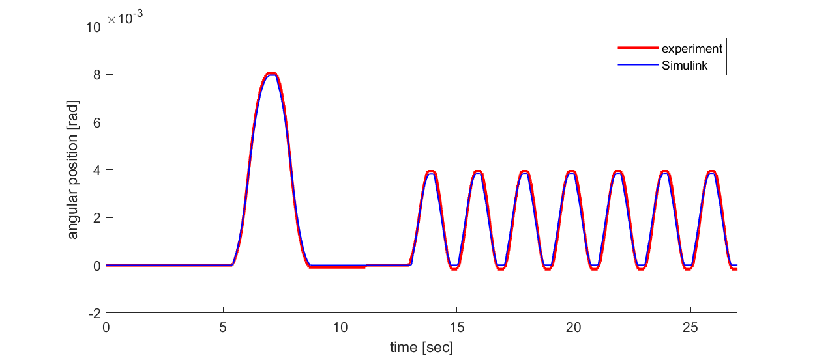
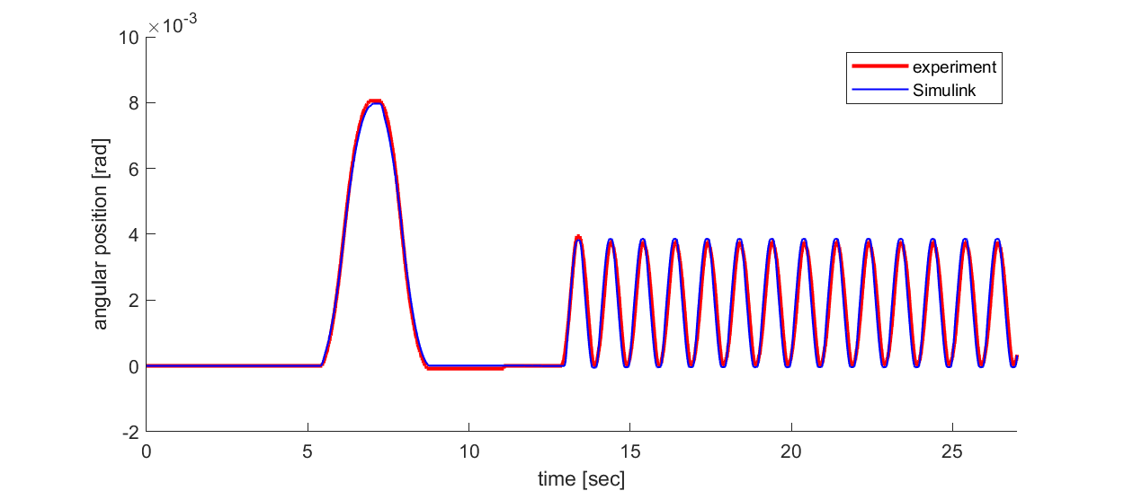
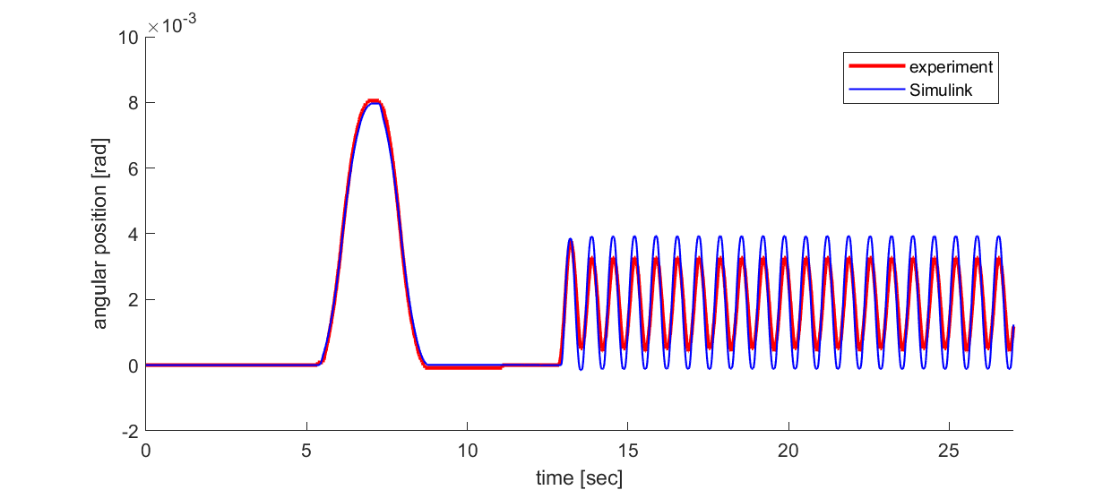
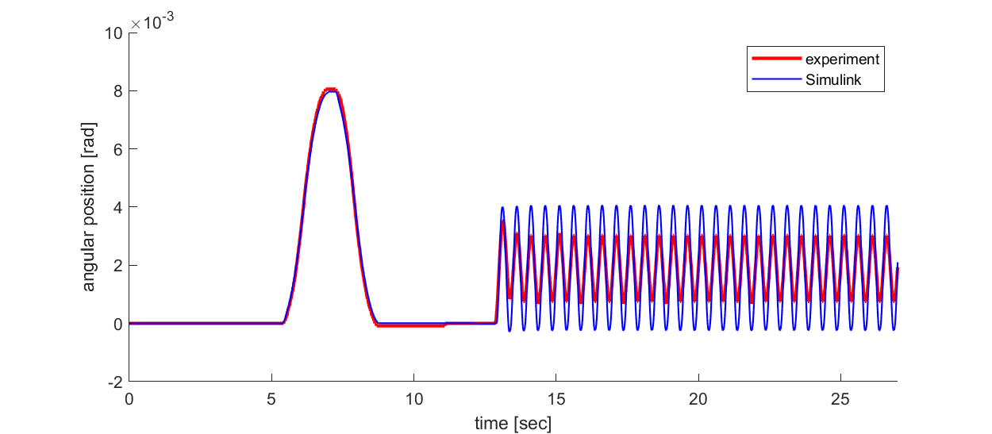
Motor Model Validation [cont. 5]
Data Driven Actuator Model of the Sample Transfer Arm in Mars Sample Return
Experiment vs Simulink Transient Plot (Motor Size 40)
Test 1: 0.5 Hz
Test 2: 1.0 Hz
Test 3: 1.5 Hz
Test 4: 2.0 Hz
Test 5: 2.5 Hz
Test 6: 3.0 Hz
Test 7: 3.5 Hz
Test 8: 4.0 Hz
Test 9: 4.5 Hz

Slide 42
Motor Model Validation [cont. 6]
Data Driven Actuator Model of the Sample Transfer Arm in Mars Sample Return
Experiment vs Simulink Bode Plot (Motor Size 40)

Slide 43
Motor Model Validation [cont. 7]
Data Driven Actuator Model of the Sample Transfer Arm in Mars Sample Return
Experiment vs Simulink Simulation
Potential reasons for mismatches between experiment and simulation for motor sizes 17 & 40: 1) No velocity filtering in Simulink, but experiments have velocity filtering 2) Incorrect parameters in .yaml file (file where motor parameters are stored) 3) Inconsistent conditions during experimentation 4) Poor or incorrect Simulink model
Notes:
Just began to compare so future work is figuring out what the difference is

Slide 44
Motor Model Validation [cont. 8]
Data Driven Actuator Model of the Sample Transfer Arm in Mars Sample Return
Experiment vs Simulink Simulation
Size 17 has 3x worse positional resolution.
Compensate for 3x coarseness of size 17 data relative to size 32 and 40 data by redoing size 17 tests with 3x amplitude.

Slide 45
Motor Model Validation [cont. 9]
Data Driven Actuator Model of the Sample Transfer Arm in Mars Sample Return
Experiment vs Simulink Transient Plot (Motor Size 17)
Test 1: 0.5 Hz
Test 2: 1.0 Hz
Test 3: 1.5 Hz
Test 4: 2.0 Hz
Test 5: 2.5 Hz
Test 6: 3.0 Hz
Test 7: 3.5 Hz
Test 8: 4.0 Hz
Test 9: 4.5 Hz

Slide 46
Motor Model Validation [cont. 10]
Data Driven Actuator Model of the Sample Transfer Arm in Mars Sample Return
Experiment vs Simulink Bode Plot (Motor Size 17)

Slide 47
If I had 10 more weeks
Data Driven Actuator Model of the Sample Transfer Arm in Mars Sample Return
Further improvements on Simulink model - implement togglable velocity filter in velocity feedback (VF present in experiment but not in Simulink) - explore unimplemented nonlinearities - remake a new actuator Simulink model from scratch with tight closed-feedback loop for referencing experimental testbed to maximize Simulink similarity to testbed
Explore reasons for disparity between experiment and Simulink - experimentally verify actuator parameters in sta.yaml and bradbury.yaml files - run more experiments to have more validation data

Slide 48
If I had 10 more weeks [cont. 1]
Data Driven Actuator Model of the Sample Transfer Arm in Mars Sample Return
Position P-controller
Velocity PI-controller
Motor rotor dynamics
Output shaft dynamics
Motor/output gear interaction (backlash)

Slide 49
JPL Lessons and Future Plans
Data Driven Actuator Model of the Sample Transfer Arm in Mars Sample Return
Lessons Learned:
Role of PhD’s in industry (compared to Sikorsky-LM)
In-depth experience in classical controls
Git version control (minimal)
Much more versed in Simulink and block diagrams
Learned about the level of detail required to model “simple” systems as robot actuator.
Future Plans:
Education: Start Ph.D. in Computational Science, Engineering, and Mathematics (CSEM) in August 2024 at the Oden Institute in The University of Texas at Austin
Career: Enter industry

Slide 50
Acknowledgements
Data Driven Actuator Model of the Sample Transfer Arm in Mars Sample Return
Mentor Joseph Bowkett Caltech Ph.D.
Co-mentor Preston Rogers Stanford University, M.S.
Group Supervisor Phillip Twu Georgia Tech, Ph.D.
Technical Staff Marco Dolci Politecnico di Torino Ph.D.
Former 343 Member Joel Shields UC Berkeley Ph.D.
Chief Engineer Avi Okon UC Los Angeles M.S.
Notes:
Joel shields 343

