Slide 1

Flight Software Case Study:
Spacecraft Telemetry
Joseph Carsten
Jet Propulsion Laboratory, California Institute of Technology
© 2024, California Institute of Technology. Government sponsorship acknowledged.

Slide 2
Background
Flight Software Development
Mars Exploration Rovers (MER)
  Extended mission autonomous driving upgrade
Mars Science Laboratory (MSL)
  Sample Processing and Acquisition Manager
  High Gain Antenna
  Activity Constraint Manager
  Contributed to autonomous navigation software
  Contributed to motor control unit tests
Mars 2020
  Robotic Arm
  Adaptive Cache Assembly
  High Gain Antenna
  Activity Constraint Manager
Mars Sample Return Lander
  Sample Transfer Arm
Operations
MER Rover Planner (2006-2011)
  Driving and robotic arm operations
Phoenix Robotic Arm Operator (2008)
MSL Rover Planner (2012-2020)
  Driving, robotic arm, and sampling operations
Mars 2020 Rover Planner (2021-)
  Driving and robotic arm operations

Slide 3
What is a Data Product?
Essentially a data product is just a file containing arbitrary data
  Images
  Instrument spectrometer data
  Temperature measurements
  CPU utilization data
Could be directly human readable (i.e. text), but almost always is binary data that requires decoding
Common metadata may be appended to every data product at the system level

Slide 4
Data Product Considerations
Data product size
  How much total downlink data volume does the mission have?
  How much decisional data volume does the mission have?
Data product contents
  Understand and monitor nominal activities
  Anomaly diagnosis and investigation
    Timeliness of diagnostic data
    Capturing unrecoverable data
    Collection of non-standard, more detailed telemetry

Slide 5
Optimizing Data Product Size
Pay careful attention to the data types used for reporting
  For example naively reporting a Boolean TRUE/FALSE value on MSL or Mars 2020 would take 32 bits even though there is only a single bit worth of information
  More important for records that are reported many, many times
Provide knobs to throttle the amount of data collected
  Allows for less data to be collected in the nominal case and more data for special activities or anomaly investigations
Create summary data to augment more detailed telemetry
  For instance average motor current for a given motion to complement high rate motor current collected during the motion

Slide 6
Compression
Compressing data products is a “free” way to reduce overall size
  Not really free as it requires CPU time to perform the compression
  Need to make sure there is ground support for uncompressing the data
  Should consider the ramifications of compression on partial data products (i.e. how much of the partial product is made unintelligible due to compression)
Both MSL and Mars 2020 provided data product compression as a standard service of the data product system
  On both missions it entailed significant effort to actually start using it in flight since very few teams had it enabled during V&V, and there were concerns about CPU utilization

Slide 7
Small Data Products
Be careful of generating many very small data products
  Each data product likely contains standard metadata. For very small products this may be a significant portion of the overall data product size
  Some systems have fairly small limits on the number of files that can be created
    MER could only store on the order of a couple thousand data products
  Many small products can have a negative impact on other aspects of system performance
    On Mars 2020 a slew of very small products would cause the data product packetizer to fall behind resulting in parts of the pass being wasted

Slide 8
Anomaly Diagnosis and Investigation
Getting relevant data quickly can allow faster recovery for simple faults
  Autonomously dump recent telemetry at higher priority in response to a fault
Capture unrecoverable data documenting the anomaly
  Use a ring buffer to continuously record high rate telemetry and dump the buffer in response to a fault
  Store data in fixed RAM locations so data can be recovered if the processor experiences a warm reset
Provide the ability to request verbose diagnostic data that is not nominally collected

Slide 9
Case Study: Mars 2020 Motor Control

Slide 10
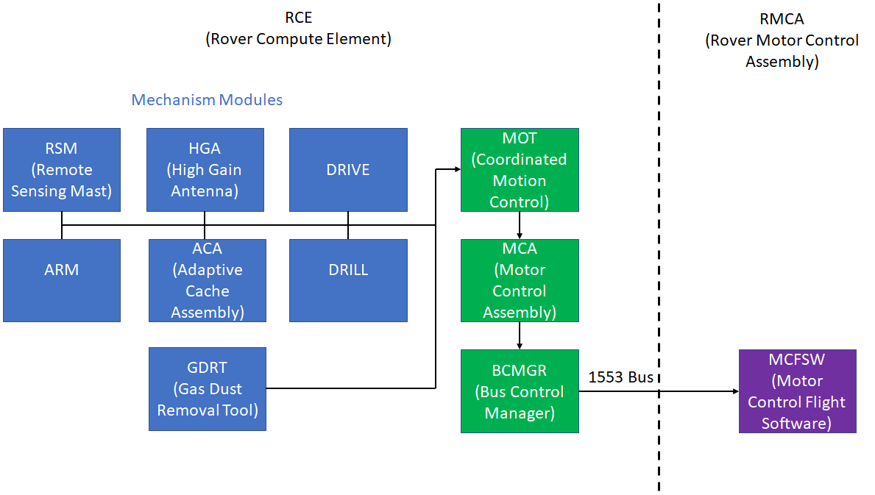
Mars 2020 Motor Control Architecture

Slide 11
Standard MOT Telemetry Logging
The MOT module provides standard motor telemetry recording
  Less code duplication - each higher level module does not have to define these records
  Consistency – one definition means all mechanisms report the same fields with the same naming and types
  Easier ground processing – records share the same format across mechanisms

Slide 12
Standard Motor Telemetry Records
Field | Type | Units | Description | Included in Brief Record
mid | 8-bit unsigned integer |  | Motor ID | Yes
field | 8-bit unsigned integer |  | Field position register | No
state | 8-bit unsigned integer |  | Motor/brake controller state | Yes
stopmode | 8-bit unsigned integer |  | Stop/fault response mode | No
cstatus | 16-bit unsigned integer |  | Current motor status | Yes
tripped | 16-bit unsigned integer |  | Bitwise-OR of tripped safety checks | Yes
enc_count | 32-bit signed integer | Counts | Encoder odometer | Yes
pos | 32-bit float | Radians | Joint position | Yes
rate | 32-bit float | Radians per second | Joint rate | No
cmotor | 16-bit unsigned integer | Milliamps | Motor current | Yes
cbus | 16-bit unsigned integer | Milliamps | Bus current | Yes
vavg | 16-bit signed integer | Millivolts | Motor voltage | Yes
tprt1 | 16-bit signed integer | Centi-degrees Celsius | Temperature measured by PRT 1 | No
tprt2 | 16-bit signed integer | Centi-degrees Celsius | Temperature measured by PRT 2 | No
cbrake | 16-bit signed integer |  | Brake current (raw DN) | No
pwmbrake | 16-bit unsigned integer |  | Brake duty cycle (raw DN) | No
home_err | 16-bit signed integer |  | Accumulated home pulse errors | No

Slide 13
Data Product Size Management
Field width optimization
  32 bit floating point values instead of standard 64 bit
  Using 8 or 16 bit integers instead of standard 32 bit
  Bit packing status flags
  Mapping some floating point values to 16 bit integers
User configurable brief (24 bytes/sample) or verbose (40 bytes/sample) data collection
Data collection rate - user selects number of 64 Hz records to skip between each record recorded (0 skip collects 64 Hz data, 1 skip collects 32 Hz data, 3 skip collects 16 Hz data, etc)

Slide 14
Detailed Telemetry Recording
Service provided by MCA module
Allows recording of up to 512 Hz motor telemetry
User has to manually sequence the start of each recording and the dump of the associated data product
  Data is written into a buffer split into user configurable log (stops recording when section is full) and ring (overwrites old data with new) sections
  Can easily select data volume that exceeds the available 1553 bandwidth
Useful for anomaly investigations and diagnostic data collections

Slide 15
Anomaly Ring Readout
MCFSW maintains a ring buffer that stores approximately the last 10 seconds worth of 512 Hz motion history data for each actuator
In the event of a motor related fault, the contents of this buffer are automatically transferred across the 1553 bus and written to a high priority data product
This data can be extremely useful for anomaly investigation
  Contains otherwise unrecoverable high rate data
  Is very likely to contain the event of interest

Slide 16
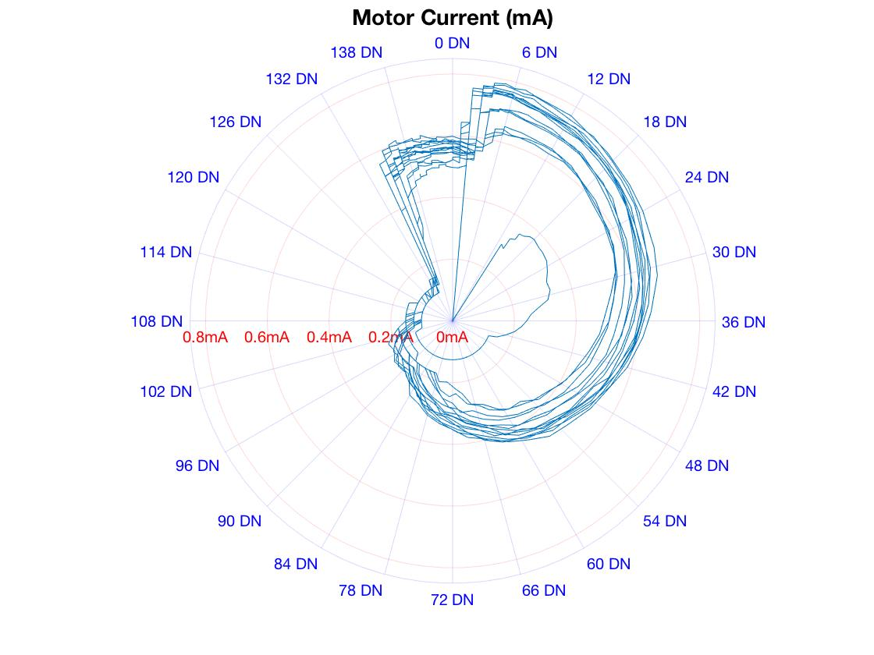
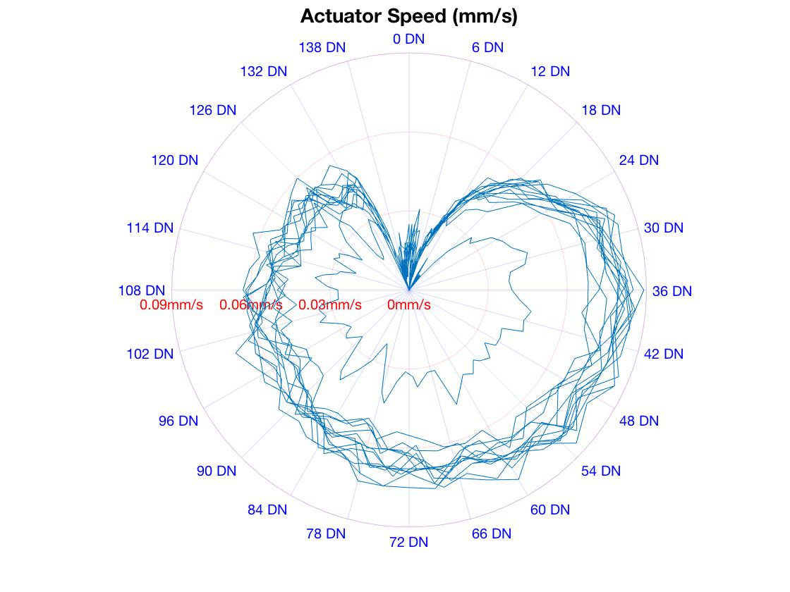
MSL Drill Feed Brake Anomaly (ISA 60503)
Once per motor revolution high friction zone
0.06 mm/s is 1350 DN/s at the motor
64 Hz data collection ~= 1 sample every 21 DN ~= 52.7 degrees/sample
512 Hz data collection ~= 1 sample every 2.6 DN ~= 6.6 degrees/sample
Notes:
Gear ratio = 650, pitch = 4 mm/rev, 144 counts per motor rev

Slide 17
Shared Buffer Implementation Idiosyncrasy
The Mars 2020 rover compute element has a relatively limited amount of RAM
A single buffer is used for both detailed telemetry recording and the anomaly ring readout
Detailed recording and anomaly ring readout cannot happen concurrently
If detailed recording is requested in the middle of an anomaly ring readout the detailed recording will fail
  Would have been better if the detailed recording simply waited for the anomaly ring readout to complete before starting recording

Slide 18
RCE Warm Reset
Unexpected reboot of the flight computer
  Could be triggered by one of the thousands of state assertion checks that are part of flight software
Warm reset mid-motion
  RCE will stop sending commands across the 1553 bus to the RMCA
  On the first 64 Hz control cycle where the RCE fails to communicate, the RMCA initiates a fault response that brings all actuators to a stop

Slide 19
History Buffer Recovery
During motion, motor telemetry is written into RAM buffers
  Supports faster data rates than the non-volatile filesystem
  Isolates any non-volatile storage performance issue to outside the high rate motor control loop
During a warm reset, power to the RCE is continuously maintained and thus data in RAM is not actually lost
  Motor telemetry is recorded at fixed RAM addresses
  During boot after a warm reset, the data at these addresses is examined
  Any data that matches the format of a known record is written out to a data product in non-volatile memory

Slide 20
RMCA Data Readout
RCE data buffers will not cover the very end of the motion or capture the final actuator positions
During a standard shutdown, the RMCA is always powered off
If the RMCA is on when the RCE boots that indicates there was likely to have been a warm reset, possibly during mechanism motion
  RMCA ring buffers are transferred to the RCE and written out to data products
  Captures the end of motion and final actuator positions

Slide 21
Active Hold Capability
Active hold keeps the brakes open and motor holding position for short period after the completion of motion
If a subsequent motion request occurs during the active hold period the system services that request and no brake cycle occurs
Active hold is managed at the MOT flight software level
  If a request occurs for an actuator that shares a driver card with an actuator in active hold, the brakes are closed on the holding actuator so that the new request can be serviced
Data collection is managed at the mechanism module level

Slide 22
Active Hold Data Collection
Cannot concurrently write into a history buffer and read it out for transcription into a data product in non-volatile memory
Mechanism module managing data collection is largely unaware of the details of the active hold period
Generating data products is generally done right after completion of motion (during the active hold period)
No high rate telemetry is nominally recorded during the active hold period
If a motor fault were to occur during active hold, the usual high rate ring buffer readout would cover the fault

Slide 23
Further Reading
MSL anomalies where high rate motor telemetry proved important to the investigation
  Drill percuss short - ISA 57835
  CHIMRA tunnel door stall - ISA 59287
  Drill feed brake anomaly - ISA 60503
  Drill chuck brake anomaly - ISA 60832
  Turret brake A failure - ISA 203137
  Wrist brake A failure - ISA 209103
  Fatal during arm hold - ISA 212950

Slide 24
Case Study: Mars 2020 Vision Compute Element

Slide 25
Mars 2020 Vision Compute Element
Set of avionics designed to perform high rate vision processing
  Stereo point cloud generation
  Visual odometry pose estimation
Communicates with Rover Compute Element (RCE) over the 1553 bus as well as a high speed serial line used to transfer images from the cameras
Stores 540 recently processed images (270 stereo pairs) in a non-volatile ring buffer
Allows ground operators to later retrieve images of interesting portions of the drive (for instance where the autonomous navigation system had to navigate around hazards)

Slide 26
Ring Buffer Image Transfer
Images selected by relative index
  Most recent image at index 0, next most recent at index 1, etc
Good for some use cases like getting the image pair likely to show terrain under the rover at the end of a drive
Effectively limits ground specified image retrieval to occur before the next drive as driving shifts all of the indices

Slide 27
Post Drive Image Retrievals
Image transfer can take a non-trivial duration
  Transfer rate of about four stereo pairs per minute
  Transferring all buffered images would take more than an hour
There are cases where it would have been useful to put off retrieving desired images until after a drive, at less constrained time of day
Could have been fairly easily supported by including an absolute indexing scheme
Ring buffer was a bonus capability that was not in the baseline specification
  Limited resources devoted to the implementation

Slide 28
Questions?

Slide 29
Acknowledgements
The research was carried out at the Jet Propulsion Laboratory, California Institute of Technology, under a contract with the National Aeronautics and Space Administration (80NM0018D0004).

