Slide 1
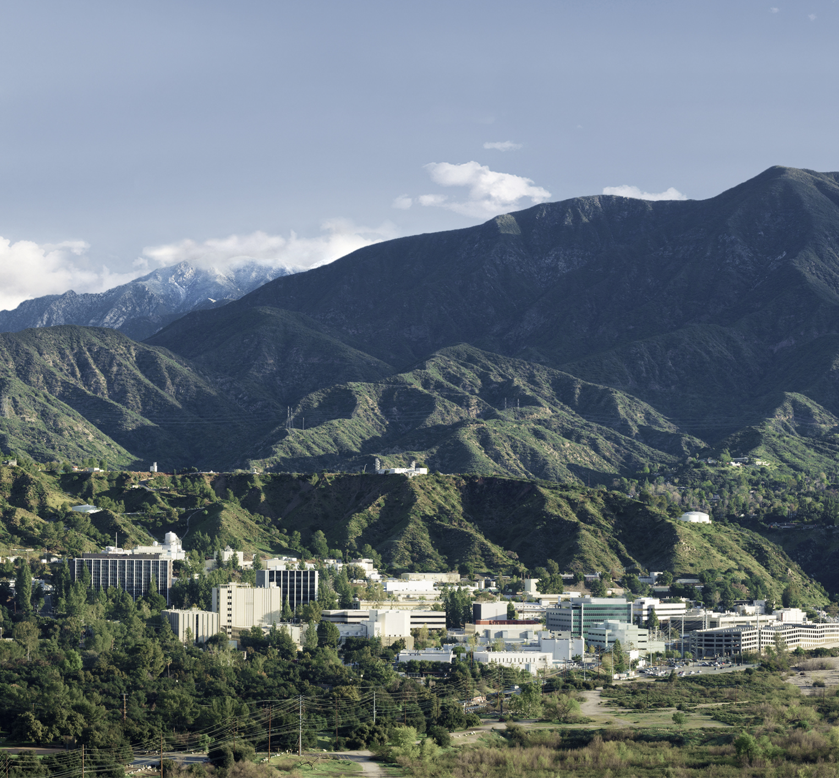
Autonomy in the Real-World: Autonomous Trajectory Planning for Asteroid Reconnaissance via Stochastic Optimization
Kazu Echigo
JVSRP 347F
University of Washington

Slide 2
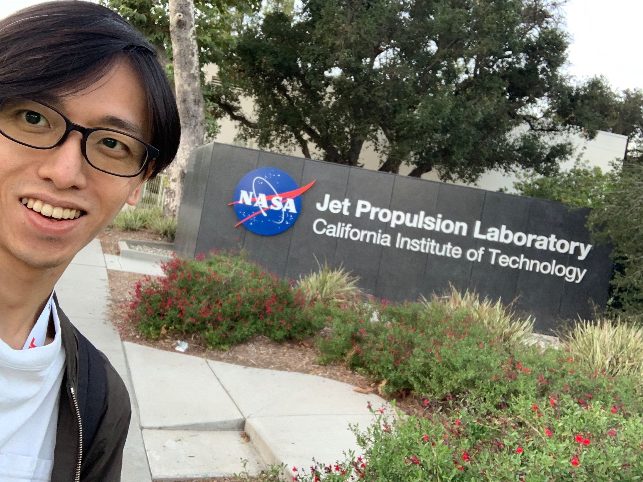





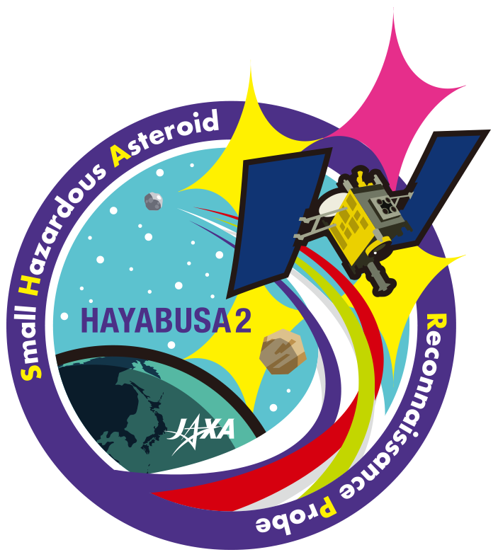


Kazu Echigo
Ph.D. candidate at the University of Washington (Advisor: Behçet Açıkmeşe, 4th year, Expected to graduate in Dec 2024)
Research Interests: Theoretical design for autonomous aerospace applications in the presence of nonlinearities, uncertainties, and realisticities.
Expertises : Convex optimization / Stochastic optimal control / Nonlinear optimization
Main mentors at JPL: Abhishek S Cauligi (347F) / Saptarshi Bandyopadhyay (347N) / Hiro Ono (347F)
2014
2019
2023
2024
Notes:
Let me quickly introduce myself.

Slide 3
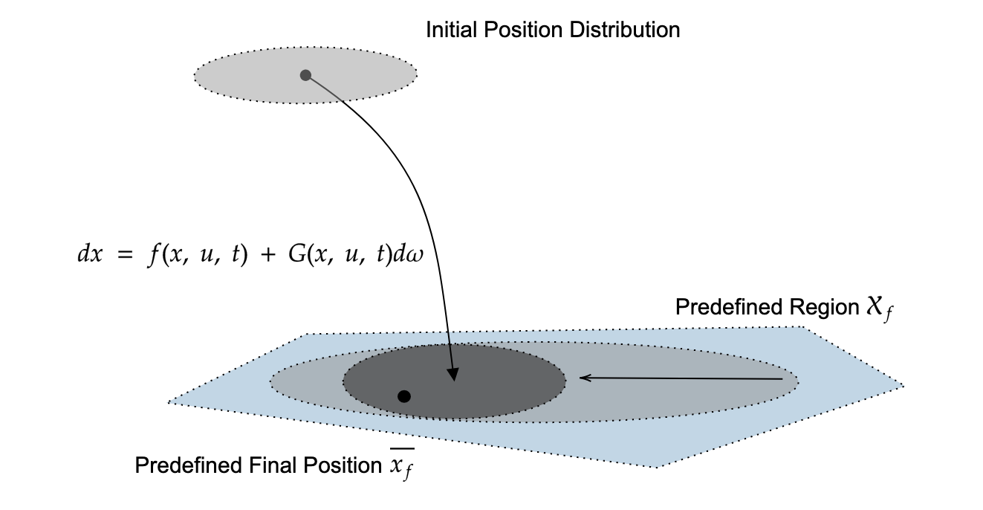


Kazu Echigo
Ph.D. candidate at the University of Washington (Advisor: Behçet Açıkmeşe, 4th year, Expected to graduate in Dec 2024)
Research Interests: Theoretical design for autonomous aerospace applications in the presence of nonlinearities, uncertainties, and realisticities.
Expertises : Convex optimization / Stochastic optimal control / Nonlinear optimization
Minimum Dispersion for Accurate EDL Missions [IEEE TCST 2024]
Stochastic Optimal Control for Asteroid Reconnaissance [JGCD 2024 (submitted)]
Expected Time Optimal Control for Lunar Rover [CDC 2024]
Notes:
On the left, you can see a trajectory planner for EDL missions with minimum dispersion. Landing site selection has been significantly constrained by dispersion.
In the aerospace application, where the safety at 3 sigma matters, just minimizing the mean of the dispersion does not work.
Otherwise you would overlook corner cases. For future accurate Mars landing, I believe we need to have a trajectory planner to deal with dispersion at 3 sigma.
I come up with a trajectory planner and corresponding solution approach with theoretical proof, which can be solved by off-the-shelf efficient nonlinear optimization solver, sequential convex programming.
On the right, you can see my another research project at JPL, which is a trajectory planner for CADRE, a multi lunar rover exploration mission. To maximize scientific returns with their limited life time, rovers have to get to a prescribed destination as soon as possible under localization uncertainty. I come up with a solution approach to transform this highly nonliner stochastic optimization problem into a deterministic optjmization problem with proof, which can be again solved by an onboard suitable optimization solver.
Among them, here is the project I’m gonna talk about today, which is a stochastic optimal control for asteroid reconnaissance.

Slide 4
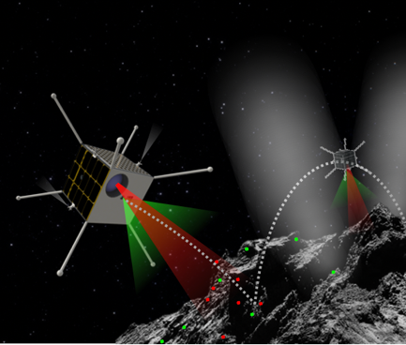



Content Overview
DARE, Kazu Echigo (347F)
DARE Concept
Trajectory Planner with Model V&V
Numerical Sims
Notes:
Here is the overview of today’s talk.
Throughout my JPL journey, I’ve been working at the GNC team of the DARE project, an asteroid landing mission concept using small satellites.
After providing an overview of the project, I will propose a method for an autonomous trajectory planner for the recon phase.
Then, I will demonstrate the capability of the proposed method through a numerical comparison between ours and the current practice at JPL using a data from OSIRIS-REx. I mean, I did an apple – to – apple comparison to demonstrate the proposed approach outperforms the current practice.

Slide 5



Content Overview
DARE, Kazu Echigo (347F)
DARE Concept
Trajectory Planner with Model V&V
Numerical Sims
Notes:
Text with cartoon

Slide 6
Deep-space Autonomous Robotic Explorer (DARE)
DARE, Kazu Echigo (347F)
Autonomy is the ability of a system to achieve goals while operating independently of external control
DARE opens the door for fully autonomous spacecraft missions under uncertainty
Reviewed and approved for public distribution via URS #329541.
Notes:
The DARE project is an asteroid landing mission concept with small satellite, driven by Issa Nesnas. Autonomy is essential for future space exploration, and this kinda low cost mission serves as excellent testbeds for introducing cutting-edge autonomous technologies
This figure illustrates the mission overview, I am focusing on this red- squared phase, close proximity operations.

Slide 7
Autonomous Trajectory Planner for Asteroid Reconnaissance
DARE, Kazu Echigo (347F)
Goal: Autonomous trajectory planner considering uncertainty
Reviewed and approved for public distribution via URS #329541.
Notes:
Among them, I’ve been working for GNC in the reconnaissance phase.
As you can see in this figure, a reconnaissance trajectory flies over the landing site to get detailed information.
In this procedure, we have to take a risk by getting close to the landing site under uncertainties coming from thrusters and state estimation.
Just so you know, in this reconnaissance phase you don’t have to consider model uncertainty. It is because there is no point to take such a risk when you don’t have enough knowledge about the dynamics. For example, O-REx did a bunch of fly-by to estimate a gravity before doing the reconnaissance phase.
The goal of my project is to create an autonomous trajectory planner that achieve a reconnaissance phase under such uncertainties and risk.

Slide 8



Why Autonomous Planner under Uncertainty ?
DARE, Kazu Echigo (347F)
Science Team
Science Team
Analytical
Planning
Autonomous Planner
Monte Carlo
Verification
Verification
It reduces operations costs and is scalable for other missions
Notes:
Why is it necessary? The primary reason is the significant reduction in the computational time.
Let's take the OSIRIS-REx mission as an example.
The left diagram shows the mission schedule, with the reconnaissance phase taking 98 days. The standard JPL method is repeating monte carlo tests while changing deltav manually, which is one of the reasons why it takes 98 days.
Autonomous trajectory planner gets you from left to right, which also gives you a scalability and flexibility.
Of course, in order to make it happen, the input and output of the autonomous trajectory planner must be the exactly same as those on the left.
We build the planner with this in mind, so you will see an apple-to-apple comparison between the proposed approach and Osiris Rex.
%Mention that we build an autonomous trajectory planner such that its input and output are the exactly same as those on the left.

Slide 9
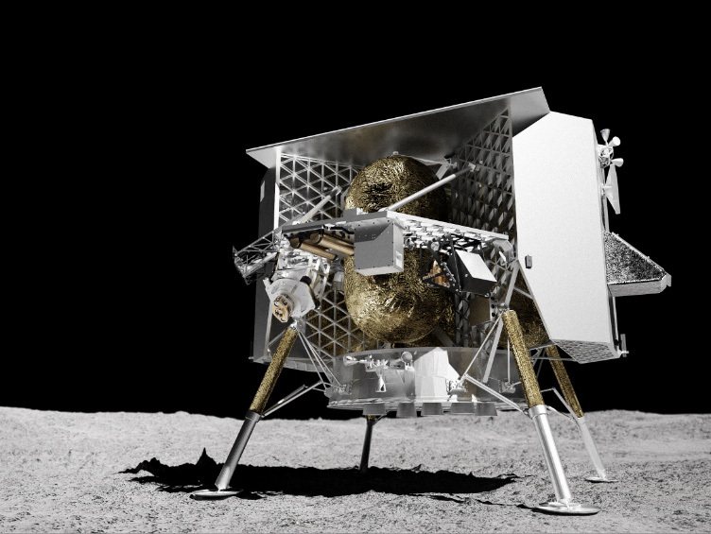
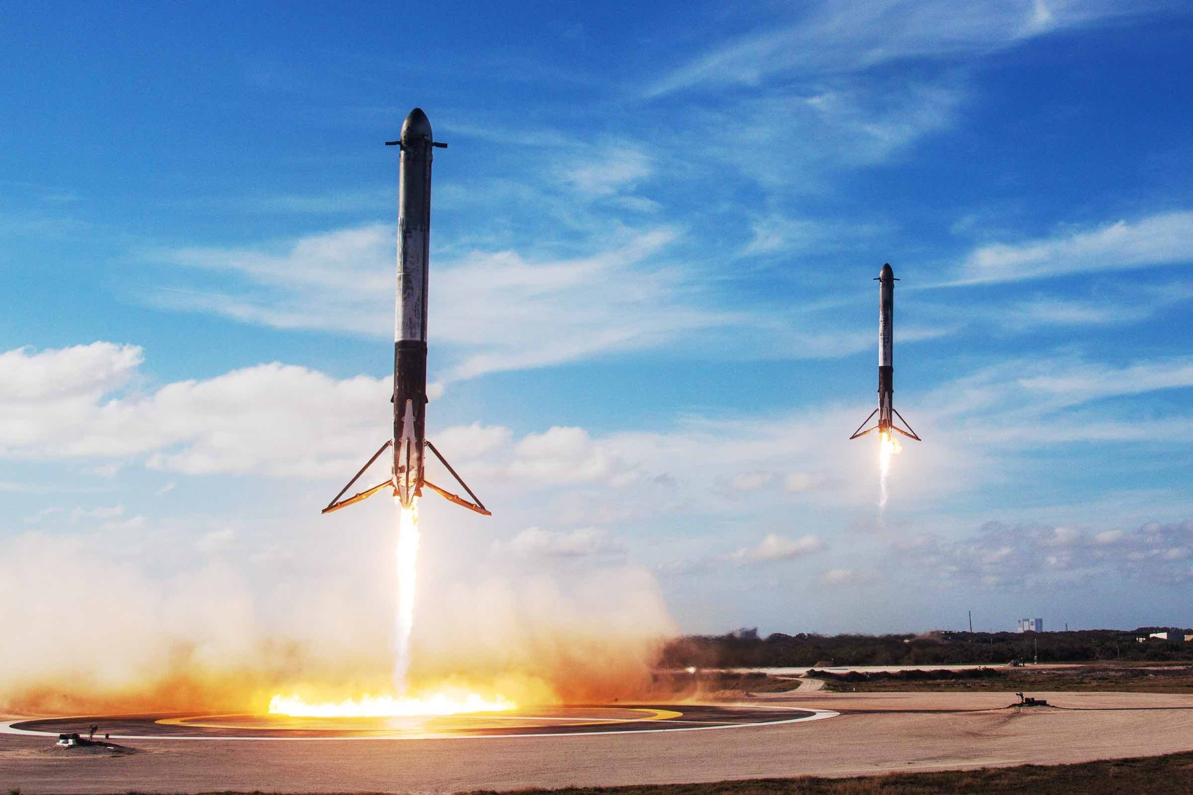
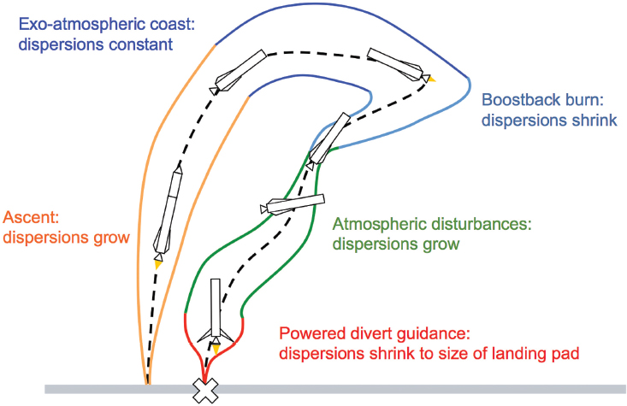
Optimal Control for Autonomous Planner
DARE, Kazu Echigo (347F)
Credit: NASA/JPL
Credit: Astrobotics
Optimal control enables transformative new science missions and reduces operations costs
Credit: SpaceX
[Blackmore 2016]
5
Notes:
For such an autonomous trajectory planner, optimal control is the promising way to make it happen, where you can get a nominal trajectory by solving optimization problems
As you know, we are seeing more use of optimization-based techniques in the real-world aerospace missions.
Landing GNC for astrobotic lander and falcon 9 is a typical example. And also, you can see CADRE, which is an on-going flight project at JPL.
It is going to be a first real world rover mission, where it runs MPC onboard.
Optimal control has some advantages over the traditional practice at aerospace community, such as efficiency and convergence guarantee.
For Small body exploration missions, optimal control is also useful, but we need to add some modifications.

Slide 10


Optimal Control for the Reconnaissance Phase
DARE, Kazu Echigo (347F)
Solution to the optimization problem is the nominal trajectory satisfying all mission constraints
Notes:
However, we still need to consider uncertainty and risk to develop a fully autonomous trajectory planner.

Slide 11
Proposed Idea: Stochastic Optimal Control Approach
DARE, Kazu Echigo (347F)
Uncertainty
Risk Measure
Solution to the stochastic optimization problem is the nominal trajectory satisfying all mission constraints with its deviation (e.g., 3 sigma) also satisfying all safety constraints
10
Notes:
With this in mind, we propose a trajectory planner while considering all constraints and uncertainties. To achieve this, I introduce a stochastic optimal control approach. Stochastic optimal control, the extension of model predictive control, can simultaneously consider the nominal trajectory and uncertainties. The solution to this optimization problem is a nominal trajectory satisfying all mission constraints, with its 3 sigma also satisfying necessary constraints.

Slide 12
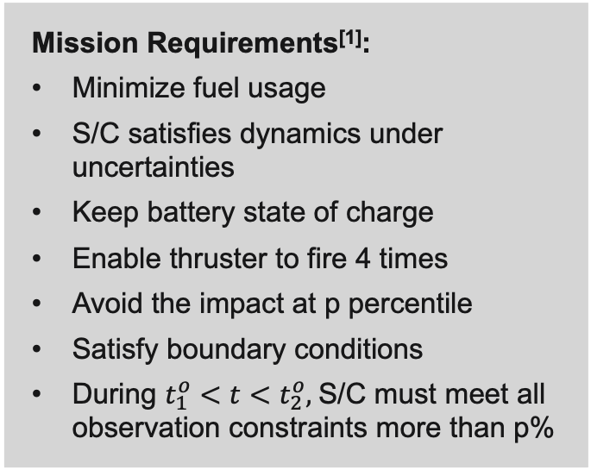
Proposed Idea: Stochastic Optimal Control Approach
DARE, Kazu Echigo (347F)
Mission Requirements^{[1]}:
Minimize fuel usage
S/C satisfies dynamics under uncertainties
Keep battery state of charge
Enable thruster to fire 4 times
Avoid the impact at p percentile
Satisfy boundary conditions
During $t_{1}^{o}<t<t_{2}^{o},$S/C must meet all observation constraints more than p%
[1] Levine et al., “Trajectory Design and Maneuver Performance of the OSIRIS-REx Low-Altitude Reconnaissance of Bennu”
Notes:
Here's the big picture of the reconnaissance mission for DARE, with all mission constraints listed on the right.
With JPL mission experts, we aligned the constraints exactly with those used by the O-REX orbit design team and then tailored them to fit the spacecraft we’re using for the DARE project.
(図の説明)
Please note that DARE is assuming to land on Bennu.
So, in the rest of presentation, all parameters about mission and dynamics came from OSIRIS-Rex and Bennu.
Furthermore, in order to make it close to real world, I only used information gathered prior to the reconnaissance phase of the o-REx mission.

Slide 13
Proposed Idea: Stochastic Optimal Control Approach
DARE, Kazu Echigo (347F)
Mission Requirements^{[1]}:
Minimize fuel usage
S/C satisfies dynamics under uncertainties
Keep battery state of charge
Enable thruster to fire 4 times
Avoid the impact at p percentile
Satisfy boundary conditions
During $t_{1}^{o}<t<t_{2}^{o},$S/C must meet all observation constraints more than p%
[1] Levine et al., “Trajectory Design and Maneuver Performance of the OSIRIS-REx Low-Altitude Reconnaissance of Bennu”
Notes:
Here's the big picture of the reconnaissance mission for DARE, with all mission constraints listed on the right.
With JPL mission experts, we aligned the constraints exactly with those used by the O-REX orbit design team and then tailored them to fit the spacecraft we’re using for the DARE project.
(図の説明)
Please note that DARE is assuming to land on Bennu.
So, in the rest of presentation, all parameters about mission and dynamics came from OSIRIS-Rex and Bennu.
Furthermore, in order to make it close to real world, I only used information gathered prior to the reconnaissance phase of the o-REx mission.

Slide 14
Proposed Idea: Stochastic Optimal Control Approach
DARE, Kazu Echigo (347F)
[1] Levine et al., “Trajectory Design and Maneuver Performance of the OSIRIS-REx Low-Altitude Reconnaissance of Bennu”
Notes:
The detailed version of the list look like this.
Since stochastic optimal control is one of MPCs, we need to mathematically formulate dynamics, uncertainties, and constraints, which may put additional modeling error not captured by the planner. It has been the biggest counter argument when introducing optimization into real-world missions.

Slide 15
Proposed Idea: Stochastic Optimal Control Approach
DARE, Kazu Echigo (347F)
Optimization Approach Requires Models – MuSCAT Assures Sufficient Model Fidelity!
[1] Levine et al., “Trajectory Design and Maneuver Performance of the OSIRIS-REx Low-Altitude Reconnaissance of Bennu”
Notes:
One of my contribution in this work was verifying with the simulator developed at JPL, MuSCAT, that the models listed here are accurate enough for reconnaissance phase.
MuSCAT is a software tool designed for simulating end-to-end mission concepts and testing autonomy with high fidelity.
It was developed at JPL and now it became open source last month.
Also, MuSCAT can monitor all the satellite's subsystems. I used this to mathematically model constraints w.r.t. subsystems.
At the end, it is not just something that looks good on paper; it has been verified in simulators mimicking a real-world.
My another contribution is to make those highly nonlinear stochastic constraints numerically tractable.
But today, I’ll not go into detail about those math stuff.

Slide 16
The Multi-Spacecraft Concept and Autonomy Tool (MuSCAT)
DARE, Kazu Echigo (347F)
We sufficiently validate our modeling assumptions in the MuSCAT simulation (being lower fidelity than MONTE)
MuSCAT provides an integrated platform to assess the mission need for autonomy and other general architecture / model trades.
Notes:
Let me talk about the big picture of MuSCAT.
it’s an integrated platform where you can test different spacecraft subsystems at the same time. You can see that MuSCAT can simulate subsystems like navigation, power, communication, thermal control, science instruments, and attitudeGNC.
Also on the right, you can see the concept spacecraft model for DARE implemented in MuSCAT
We are flying this concept model in all the upcoming simulations to get data.

Slide 17

Content Overview
DARE, Kazu Echigo (347F)
DARE Project
Trajectory Planner with Model V&V
Numerical Sims
Notes:
Now, let me briefly walk through the overview of the planner and some part of numerical verifications using MuSCAT.

Slide 18
Why Autonomous Planner under Uncertainty ?
DARE, Kazu Echigo (347F)
Science Team
Science Team
Autonomous Planner
Analytical
Planning
Monte Carlo
Verification
Verification
It reduces operations costs and is scalable for other missions
Notes:
We got back to the slide motivating autonomy.

Slide 19
Proposed Framework
DARE, Kazu Echigo (347F)
We automate the process to make 3DOF trajectory with optimization while considering all of mission constraints^{[1,2]}
Design Firing Timings and an Attitude Mode Profile
Design Firing Timings and an Attitude Mode Profile
Trajectory Optimization Process
Initial Guess
Design an Attitude Profile
Design an Attitude Profile
[1] Levine et al., “Trajectory Design and Maneuver Performance of the OSIRIS-REx Low-Altitude Reconnaissance of Bennu”
[2] Williams et al., “OSIRIS-REx Flight Dynamics and Navigation Design”
Notes:
Why we believe we can decouple attitude?
Because
Attitude GNC is accurate enough because we can form a closed loop system with multiple sensors, whereas we must form almost open loop system for position GNC.

Slide 20
Proposed Framework
DARE, Kazu Echigo (347F)
We automate the process to make 3DOF trajectory with optimization while considering all of mission constraints^{[1,2]}
Design Firing Timings and an Attitude Mode Profile
Trajectory Optimization Process
Initial Guess
Design an Attitude Profile
[1] Levine et al., “Trajectory Design and Maneuver Performance of the OSIRIS-REx Low-Altitude Reconnaissance of Bennu”
Notes:
I verified model fidelity with MuSCAT. From now I’m gonna show you some of numerical V&V with MuSCAT.

Slide 21
Proposed Optimization Problem
DARE, Kazu Echigo (347F)
Notes:
With this in mind, we propose a trajectory planner while considering all constraints and uncertainties. To achieve this, I introduce a stochastic optimal control approach. Stochastic optimal control, the extension of model predictive control, can simultaneously consider the nominal trajectory and uncertainties. The solution to this optimization problem is a nominal trajectory satisfying all mission constraints, with its 3 sigma also satisfying necessary constraints.
Here's the big picture of the reconnaissance mission for DARE, with all mission constraints listed on the right.
Please note that I’m assuming to land on Bennu using a small satellite for DARE.
So, in the rest of presentation, all parameters about mission and dynamics came from OSIRIS-Rex and Bennu.
(図の説明)

Slide 22
Verifying Model Fidelity 1: Dynamics
DARE, Kazu Echigo (347F)
Dynamics Model Fidelity
Nominal Model: Continuous model + N-Plate + J8
Conclusion: Impulsive model + Cannonball Model + J2 is accurate enough for this phase
Reviewed and approved for public distribution via URS #329541.
Notes:
Thruster model discrepositon is needed

Slide 23
Proposed Optimization Problem
DARE, Kazu Echigo (347F)
Notes:
With this in mind, we propose a trajectory planner while considering all constraints and uncertainties. To achieve this, I introduce a stochastic optimal control approach. Stochastic optimal control, the extension of model predictive control, can simultaneously consider the nominal trajectory and uncertainties. The solution to this optimization problem is a nominal trajectory satisfying all mission constraints, with its 3 sigma also satisfying necessary constraints.
Here's the big picture of the reconnaissance mission for DARE, with all mission constraints listed on the right.
Please note that I’m assuming to land on Bennu using a small satellite for DARE.
So, in the rest of presentation, all parameters about mission and dynamics came from OSIRIS-Rex and Bennu.
(図の説明)

Slide 24
Verifying Model Fidelity 2: Uncertainty Quantification
DARE, Kazu Echigo (347F)
Uncertainty Quantification
Initial State Uncertainty and Thruster Uncertainty are the main sources of dispersion
Reviewed and approved for public distribution via URS #329541.
Notes:
Thruster model discrepositon is needed

Slide 25
Proposed Optimization Problem
DARE, Kazu Echigo (347F)
Notes:
With this in mind, we propose a trajectory planner while considering all constraints and uncertainties. To achieve this, I introduce a stochastic optimal control approach. Stochastic optimal control, the extension of model predictive control, can simultaneously consider the nominal trajectory and uncertainties. The solution to this optimization problem is a nominal trajectory satisfying all mission constraints, with its 3 sigma also satisfying necessary constraints.
Here's the big picture of the reconnaissance mission for DARE, with all mission constraints listed on the right.
Please note that I’m assuming to land on Bennu using a small satellite for DARE.
So, in the rest of presentation, all parameters about mission and dynamics came from OSIRIS-Rex and Bennu.
(図の説明)

Slide 26
Modeling Uncertainty Propagation
DARE, Kazu Echigo (347F)
Quantile-Quantile Plots of the state at the end
State uncertainty can be reasonably modeled as Gaussian
Reviewed and approved for public distribution via URS #329541.
Notes:
Make it label and make it bigger reducing redundant words

Slide 27
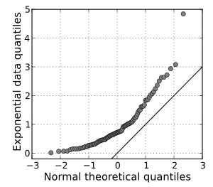
Modeling Uncertainty Propagation
DARE, Kazu Echigo (347F)
Quantile-Quantile Plots of the state at the end
State uncertainty can be reasonably modeled as Gaussian
Reviewed and approved for public distribution via URS #329541.
Notes:
Make it label and make it bigger reducing redundant words

Slide 28
Modeling Uncertainty Propagation
DARE, Kazu Echigo (347F)
Quantile-Quantile Plots of the state at the end
State uncertainty can be reasonably modeled as Gaussian
Reviewed and approved for public distribution via URS #329541.
Notes:
Make it label and make it bigger reducing redundant words

Slide 29
Proposed Optimization Problem
DARE, Kazu Echigo (347F)

Slide 30
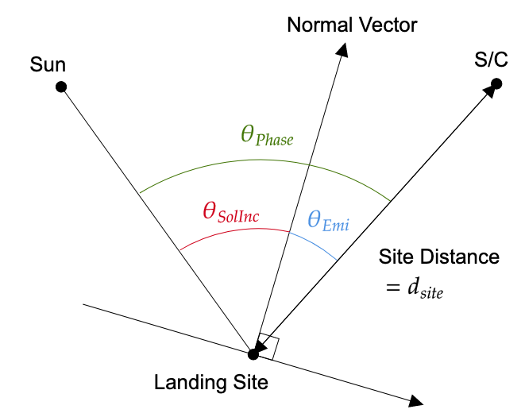
Observation Constraints for the Reconnaissance Phase
DARE, Kazu Echigo (347F)
They are provided to the trajectory design team during multiple reconnaissance phases in the O-REx mission^{[1]}
t_{LST} and θ_{si} are independent of the spacecraft’s position, thus its intersection determine an observation time window.
[1] Levine et al., “Trajectory Design and Maneuver Performance of the OSIRIS-REx Low-Altitude Reconnaissance of Bennu”
Reviewed and approved for public distribution via URS #329541.

Slide 31
Math Behind the Proposed Framework
Reviewed and approved for public distribution via URS #329541.

Slide 32
Mathematical Representation of the Proposed Problem
DARE, Kazu Echigo (347F)
In order to solve a stochastic optimization problem, we must transform it into a deterministic one.
Reviewed and approved for public distribution via URS #329541.

Slide 33
Mathematical Representation of the Proposed Problem
DARE, Kazu Echigo (347F)
In order to solve a stochastic optimization problem, we must transform it into a deterministic one.
Reviewed and approved for public distribution via URS #329541.

Slide 34
Mathematical Representation of the Proposed Problem
DARE, Kazu Echigo (347F)
In order to solve a stochastic optimization problem, we must transform it into a deterministic one.
Reviewed and approved for public distribution via URS #329541.

Slide 35

Mathematical Representation of the Proposed Problem
DARE, Kazu Echigo (347F)
In order to solve a stochastic optimization problem, we must transform it into a deterministic one.
Reviewed and approved for public distribution via URS #329541.

Slide 36
Mathematical Representation of the State Constraints 1
DARE, Kazu Echigo (347F)
The constraints can be expressed as one of the following two types of chance-constraints.
We can not transform it into a deterministic one directly – we introduce a relaxation
Reviewed and approved for public distribution via URS #329541.

Slide 37
Mathematical Representation of the State Constraints 2
DARE, Kazu Echigo (347F)
If x follows a Gaussian, $Pr⁡(Ax+b≤0)$ is transformed into a SOCP constraint w.r.t. a covariance and mean of x.
Reviewed and approved for public distribution via URS #329541.

Slide 38
Content Overview
DARE, Kazu Echigo (347F)
DARE Project
Trajectory Planner with Model V&V
Numerical Sims
Reviewed and approved for public distribution via URS #329541.
Notes:
Text with cartoon

Slide 39
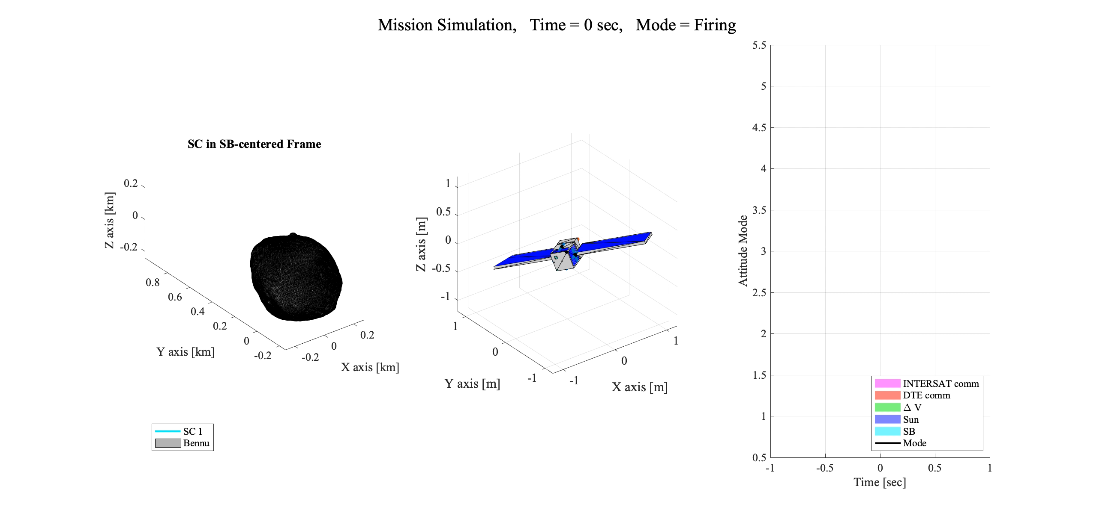
DEMO using MuSCAT
DARE, Kazu Echigo (347F)
Reviewed and approved for public distribution via URS #329541.
Notes:
Here is the demo using MuSCAT to show the capability of the proposed method. So the nominal trajectory and control profile are automatically computed.
Explain DEMO

Slide 40
Resulting Trajectory (Recon B for Nightingale)
DARE, Kazu Echigo (347F)
The result of the proposed planner with “warm start”: using the O-REx as-flown trajectory as an initial guess for the planner
Reviewed and approved for public distribution via URS #329541.
Notes:
Here is the numerical comparison between the current practice and the proposed method.
For the recon B phase of OSIRIS-REx,
I computed a trajectory using the proposed method
For each sample, we measured the number of seconds successfully observed out of the given observation time of 3397 seconds.

Slide 41
Resulting Trajectory (Recon B for Nightingale)
DARE, Kazu Echigo (347F)
The result of the proposed planner with “warm start”: using the O-REx as-flown trajectory as an initial guess for the planner
Reviewed and approved for public distribution via URS #329541.
Notes:
Here is the numerical comparison between the current practice and the proposed method.
For the recon B phase of OSIRIS-REx,
I computed a trajectory using the proposed method
For each sample, we measured the number of seconds successfully observed out of the given observation time of 3397 seconds.

Slide 42
Constraints Satisfaction (Recon B for Nightingale)
DARE, Kazu Echigo (347F)
The result of the proposed planner with “warm start”: using the O-REx as-flown trajectory as an initial guess for the planner
Reviewed and approved for public distribution via URS #329541.
Notes:
Here is the numerical comparison between the current practice and the proposed method.
For the recon B phase of OSIRIS-REx,
I computed a trajectory using the proposed method
For each sample, we measured the number of seconds successfully observed out of the given observation time of 3397 seconds.

Slide 43
Constraints Satisfaction (Recon B for Nightingale)
DARE, Kazu Echigo (347F)
The result of the proposed planner with “warm start”: using the O-REx as-flown trajectory as an initial guess for the planner
Reviewed and approved for public distribution via URS #329541.
Notes:
Here is the numerical comparison between the current practice and the proposed method.
For the recon B phase of OSIRIS-REx,
I computed a trajectory using the proposed method
For each sample, we measured the number of seconds successfully observed out of the given observation time of 3397 seconds.

Slide 44
Attitude and Battery SoC Profile (Recon B for Nightingale)
DARE, Kazu Echigo (347F)
The result of the proposed planner with “warm start”: using the O-REx as-flown trajectory as an initial guess for the planner
Reviewed and approved for public distribution via URS #329541.
Notes:
Here is the numerical comparison between the current practice and the proposed method.
For the recon B phase of OSIRIS-REx,
I computed a trajectory using the proposed method
For each sample, we measured the number of seconds successfully observed out of the given observation time of 3397 seconds.

Slide 45
Autonomous Planner Outperforms the Current Practice
(OSIRIS-Rex, Recon B phase)
DARE, Kazu Echigo (347F)
Warm Start: using the O-REx as-flown trajectory as an initial guess for the planner
Cold Start: not using any previous knowledge
Reviewed and approved for public distribution via URS #329541.
Notes:
Here is the numerical comparison between the current practice and the proposed method.
For the recon B phase of OSIRIS-REx,
I computed a trajectory using the proposed method
For each sample, we measured the number of seconds successfully observed out of the given observation time of 3397 seconds.

Slide 46
Takeaways
DARE, Kazu Echigo (347F)
Stochastic optimal control has a key role to play in future exploration with low costs and more flexibility.
The proposed approach outperforms the state-of-the-practice benchmark used for representative missions.
Reviewed and approved for public distribution via URS #329541.
Notes:
Add Future work t_f
Mention we submitted AIAA SciTech and plan for JGCD extension

Slide 47
Papers
DARE, Kazu Echigo (347F)
K. Echigo, A. Cauligi, S. Bandyopadhyay, D. Sharf, G. Lantone, B. Açikmeşe, and I. D. Nesnas, ``HARP: Hierarchical Asteroid Reconnaissance Planner via Stochastic Optimization,’’ for Journal of Guidance, Control, and Dynamics (under review)
K. Echigo, A. Cauligi, S. Bandyopadhyay, D. Sharf, G. Lantone, B. Açikmeşe, and I. D. Nesnas, ``Autonomy in the Real-World: Autonomous Trajectory Planning for Asteroid Reconnaissance via Stochastic Optimization,’’ for AIAA SciTech Forum, 2024.
Reviewed and approved for public distribution via URS #329541.
Notes:
Add Future work t_f
Mention we submitted AIAA SciTech and plan for JGCD extension

Slide 48
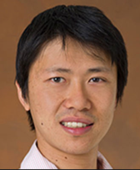
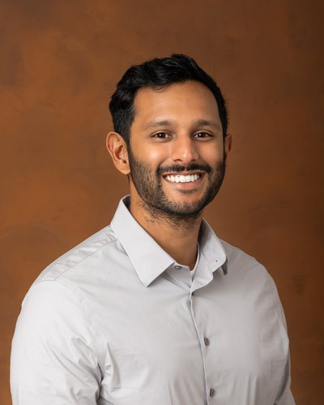


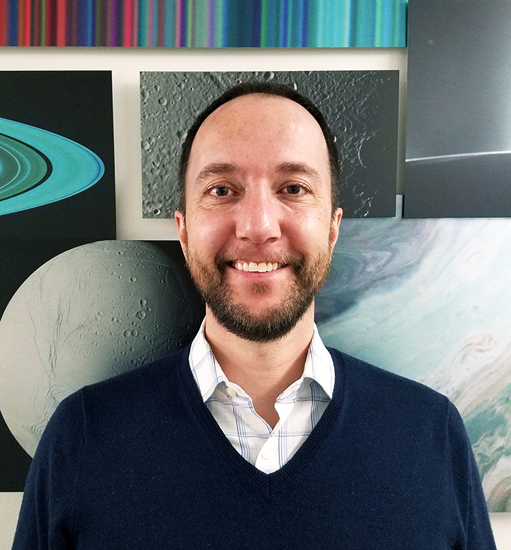
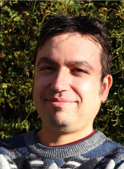
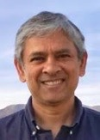
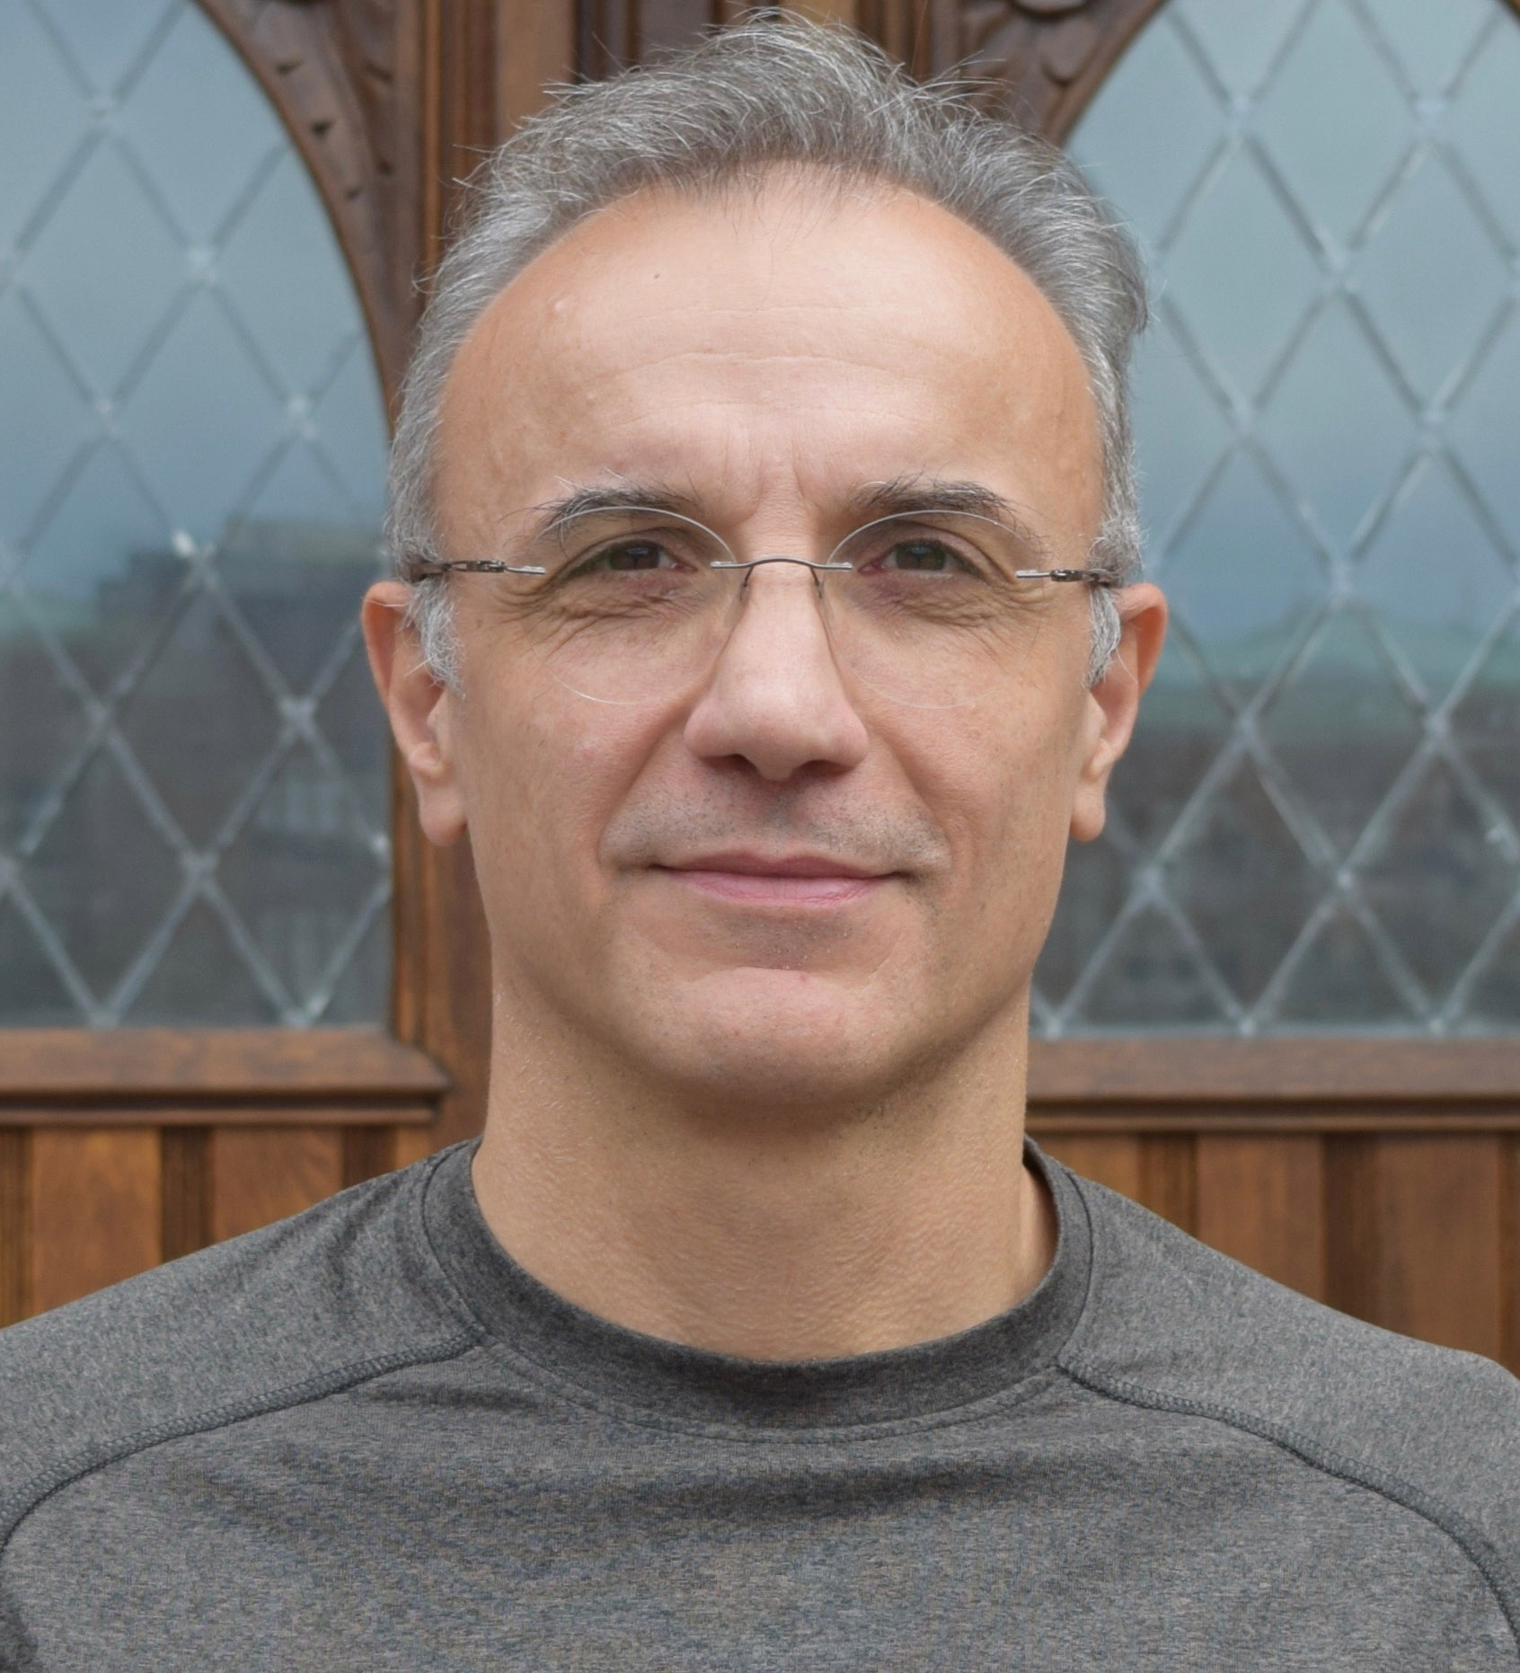
Acknowledgements
DARE, Kazu Echigo (347F)
Abhishek Cauligi
Saptarshi Bandyopadhyay
Issa Nesnas
Hiro Ono
Dan P. Sharf
Gregory Lantoine
Shyam
Bhaskaran
Behçet Açikmeşe
Reviewed and approved for public distribution via URS #329541.

Slide 49
Appendix
Reviewed and approved for public distribution via URS #329541.
Notes:
Sumamry Slide with potential future work
Greg / Sham
Acknowledgement picture with

Slide 50


Proposed Framework
DARE, Kazu Echigo (347F)
∆t_{attitude} and ∆t_{heat} was set to the expected time to reach a steady state under the worst case scenario
Design Firing Timings and an Attitude Mode Profile
Trajectory Optimization Process
$$Δt_{attitude}+Δt_{heat}$$
Initial Guess
$$Δt_{attitude}$$
Design an Attitude Profile
We could reasonably schedule firing timings and modes satisfying all constraints before the computation.
Reviewed and approved for public distribution via URS #329541.
Notes:
We could reasonably place t_1 and t_2 such that it is faraway from each of events more than 1 hours.

Slide 51
Proposed Optimization Problem
DARE, Kazu Echigo (347F)
Reviewed and approved for public distribution via URS #329541.
Notes:
With this in mind, we propose a trajectory planner while considering all constraints and uncertainties. To achieve this, I introduce a stochastic optimal control approach. Stochastic optimal control, the extension of model predictive control, can simultaneously consider the nominal trajectory and uncertainties. The solution to this optimization problem is a nominal trajectory satisfying all mission constraints, with its 3 sigma also satisfying necessary constraints.
Here's the big picture of the reconnaissance mission for DARE, with all mission constraints listed on the right.
Please note that I’m assuming to land on Bennu using a small satellite for DARE.
So, in the rest of presentation, all parameters about mission and dynamics came from OSIRIS-Rex and Bennu.
(図の説明)

Slide 52
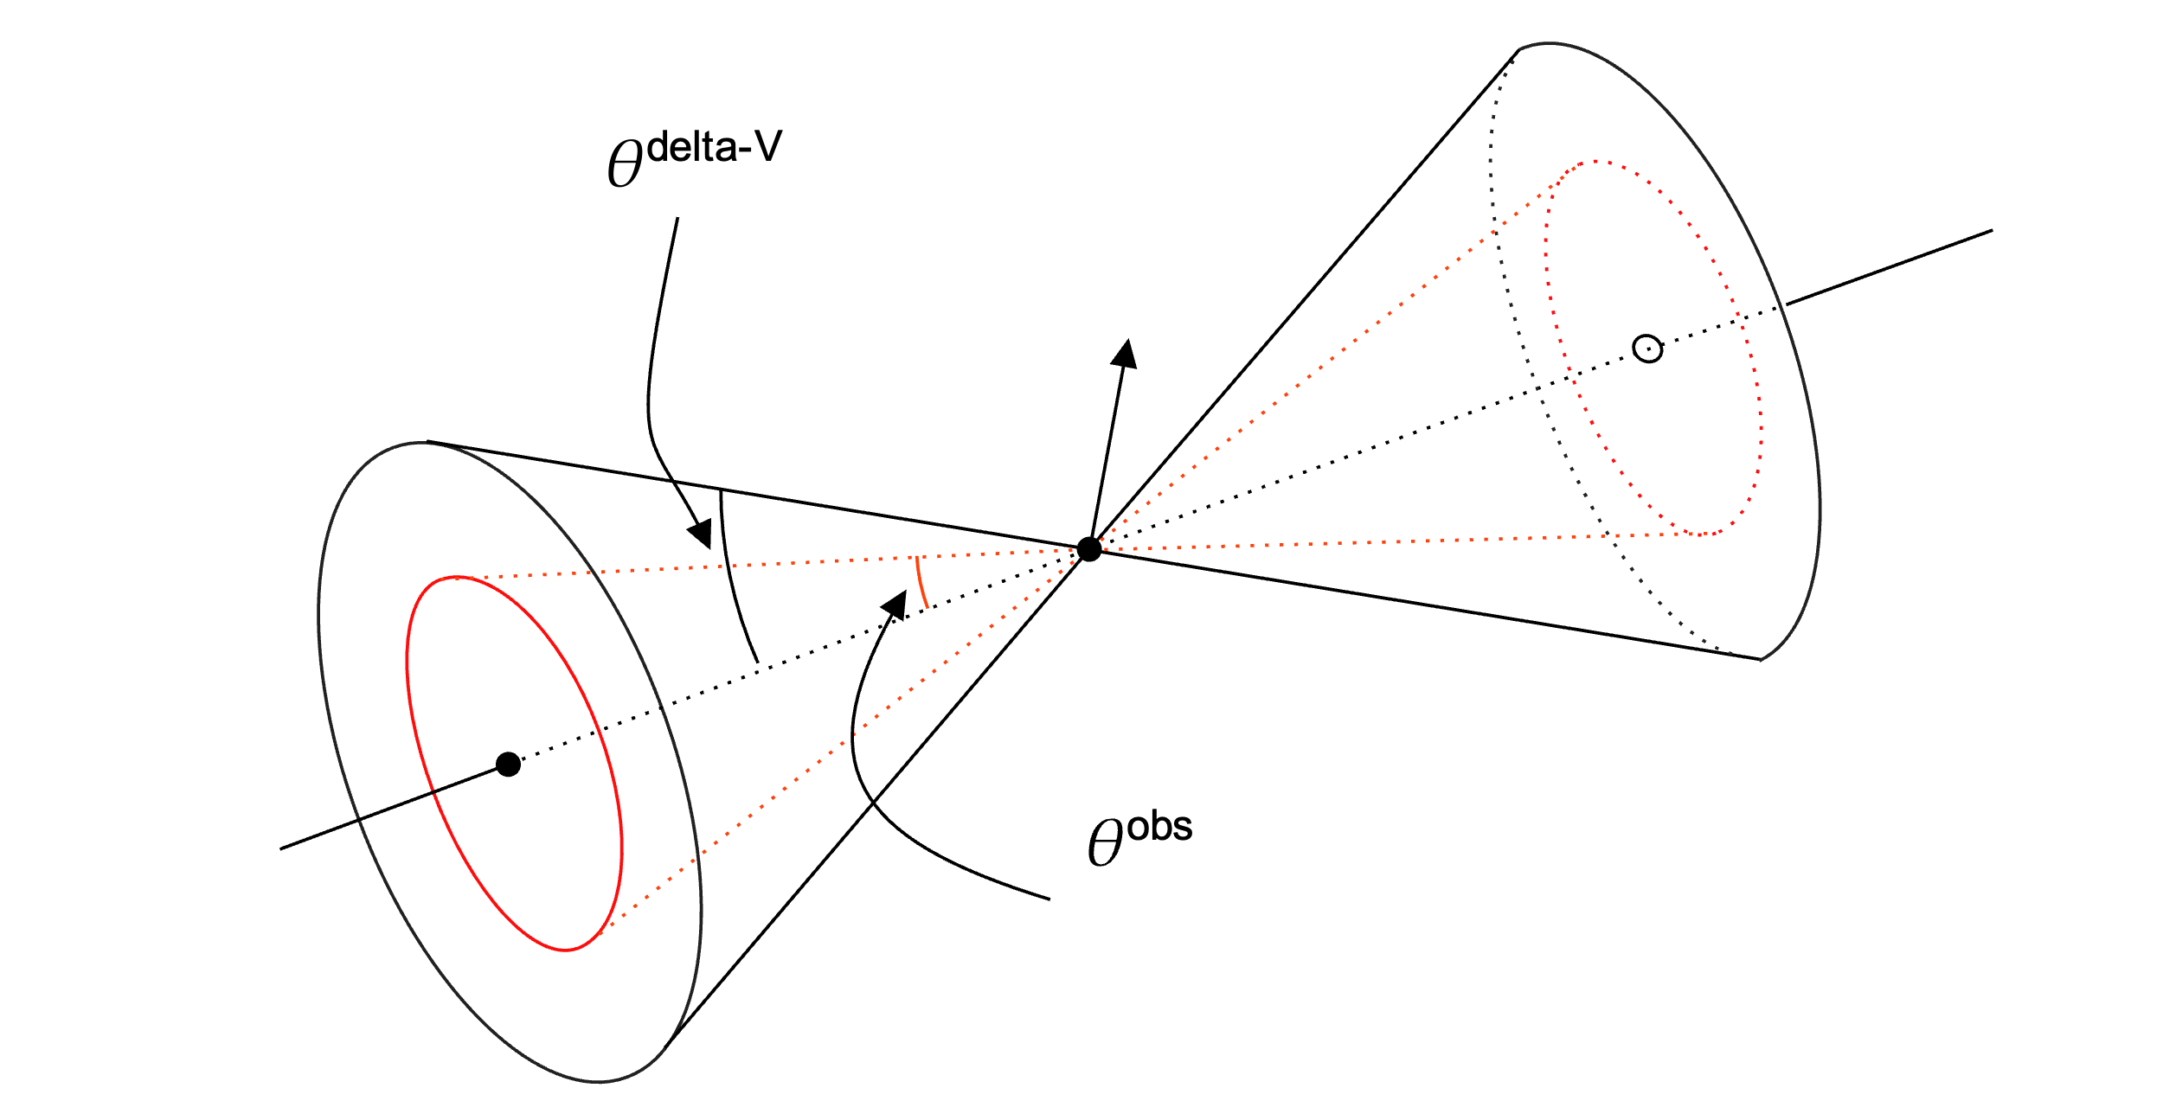
Example of Model Verifications – Decoupling Battery
DARE, Kazu Echigo (347F)
During the ∆v mode (top), the power generation must be larger than 90 [W], whereas it must be larger than 115 [W] during the observation mode (bottom).
As long as S/C’s position is outside of a dual cone, battery SoC constraint is satisfied.
Reviewed and approved for public distribution via URS #329541.

Slide 53
Modeling Uncertainty Propagation
DARE, Kazu Echigo (347F)
Left: QQ Plots of control uncertainty, Right: QQ Plots of state uncertainty
State uncertainty can be reasonably modeled as Gaussian
Reviewed and approved for public distribution via URS #329541.
Notes:
Make it label and make it bigger reducing redundant words

Slide 54
Constraints Satisfaction
DARE, Kazu Echigo (347F)
The result of the proposed planner with “warm start”: using the O-REx as-flown trajectory as an initial guess for the planner
Reviewed and approved for public distribution via URS #329541.
Notes:
Here is the numerical comparison between the current practice and the proposed method.
For the recon B phase of OSIRIS-REx,
I computed a trajectory using the proposed method
For each sample, we measured the number of seconds successfully observed out of the given observation time of 3397 seconds.

Slide 55
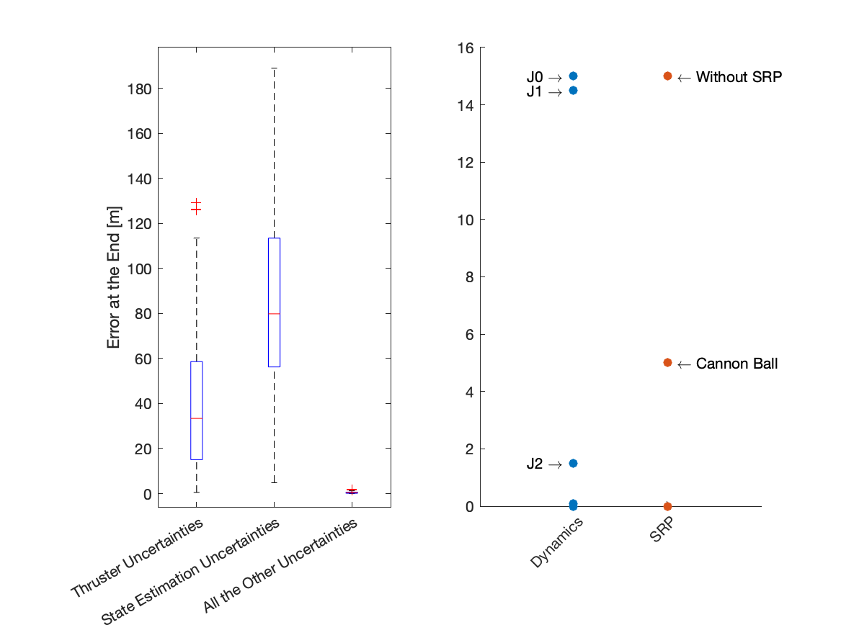
Model Assurance using MuSCAT
DARE, Kazu Echigo (347F)
Summary
Thruster error and initial state estimation error are the main sources of uncertainties
Considering J2 / SRP with cannon ball model is sufficient
Reviewed and approved for public distribution via URS #329541.
Notes:
Let me show you some examples. The left picture summarizes how various uncertainties affect the dispersion at the end of the orbit.
MuSCAT can handle various uncertainties appeared in missions. I calculated the impact of these uncertainties on the orbit. The conclusion is that thruster uncertainties and errors in initial position estimation dominate.
(Explain the 2nd figure)

Slide 56
Problem Formulation
DARE, Kazu Echigo (347F)
In order to solve a stochastic optimization problem, we must transform it into a deterministic one.
Reviewed and approved for public distribution via URS #329541.

Slide 57
Motivation
Reviewed and approved for public distribution via URS #329541.

Slide 58
Demonstrating the Proposed Planner
Reviewed and approved for public distribution via URS #329541.

Slide 59
Modeling Planner with Verification
Reviewed and approved for public distribution via URS #329541.

Slide 60
Mathematical Representation of the Proposed Problem
DARE, Kazu Echigo (347F)
In order to solve a stochastic optimization problem, we must transform it into a deterministic one.
Reviewed and approved for public distribution via URS #329541.

Slide 61
Mathematical Representation of the Proposed Problem
DARE, Kazu Echigo (347F)
In order to solve a stochastic optimization problem, we must transform it into a deterministic one.
Reviewed and approved for public distribution via URS #329541.

Slide 62
Mathematical Representation of the Proposed Problem
DARE, Kazu Echigo (347F)
In order to solve a stochastic optimization problem, we must transform it into a deterministic one.
Reviewed and approved for public distribution via URS #329541.

Slide 63
Mathematical Representation of the Proposed Problem
DARE, Kazu Echigo (347F)
In order to solve a stochastic optimization problem, we must transform it into a deterministic one.
Reviewed and approved for public distribution via URS #329541.

Slide 64
Proposed Idea: Stochastic Optimal Control Approach
DARE, Kazu Echigo (347F)
Solution to the stochastic optimization problem is the nominal trajectory satisfying all mission constraints with its deviation (e.g., 3 sigma) also satisfying all safety constraints
Reviewed and approved for public distribution via URS #329541.
5
Notes:
Mention CADRE here on the dact MPC is run on board
JPL has a history of MPC
Nonlinear trajectory planning
Dare MPC

Slide 65
Proposed Idea: Stochastic Optimal Control Approach
DARE, Kazu Echigo (347F)
Solution to the stochastic optimization problem is the nominal trajectory satisfying all mission constraints with its deviation (e.g., 3 sigma) also satisfying all safety constraints
Reviewed and approved for public distribution via URS #329541.
5
Notes:
Mention CADRE here on the dact MPC is run on board
JPL has a history of MPC
Nonlinear trajectory planning
Dare MPC

Slide 66
Proposed Idea: Stochastic Optimal Control Approach
DARE, Kazu Echigo (347F)
Solution to the stochastic optimization problem is the nominal trajectory satisfying all mission constraints with its deviation (e.g., 3 sigma) also satisfying all safety constraints
Reviewed and approved for public distribution via URS #329541.
Notes:
Mention CADRE here on the dact MPC is run on board
JPL has a history of MPC
Nonlinear trajectory planning
Dare MPC

Slide 67
Proposed Idea: Stochastic Optimal Control Approach
DARE, Kazu Echigo (347F)
Uncertainty
Risk Measure
Solution to the stochastic optimization problem is the nominal trajectory satisfying all mission constraints with its deviation (e.g., 3 sigma) also satisfying all safety constraints
Reviewed and approved for public distribution via URS #329541.
5
Notes:
Throughout my JPL journey, I’ve been working at the DARE project, an asteroid landing project using small satellites, led by Issa.
After providing an overview of the project, I will propose a method for an autonomous trajectory planner for the recon phase.
Then, I will demonstrate the capability of the proposed method through a comparison between ours and the current practice at JPL using a data from OSIRIS-REx.

Slide 68
Why Autonomous Planner under Uncertainty ?
DARE, Kazu Echigo (347F)
Science Team
Science Team
Monte Carlo
Autonomous Planner
Analytical
Planning
Verification
Verification
It reduces operations costs and is scalable for other missions
Reviewed and approved for public distribution via URS #329541.
Notes:
Flipped with animation

Slide 69
Why Autonomous Planner under Uncertainty ?
DARE, Kazu Echigo (347F)
Science Team
Science Team
Monte Carlo
Autonomous Planner
Analytical
Planning
Verification
Verification
It reduces operations costs and is scalable for other missions
Reviewed and approved for public distribution via URS #329541.
Notes:
Don’t assert too much
Too big discussion
Mission to mission
Double loops and second step as a function
For broad class of space exploration missions
Small body exploration missions
6-7 can be polished with more slides

Slide 70
Why Autonomous Planner under Uncertainty ?
DARE, Kazu Echigo (347F)
Science Team
Science Team
Autonomous Planner
Analytical
Planning
Monte Carlo
Verification
Verification
It reduces operations costs and is scalable for other missions
Reviewed and approved for public distribution via URS #329541.
Notes:
Flipped with animation

Slide 71
Paper Plans & Future Works
DARE, Kazu Echigo (347F)
Submitted 25p paper to SciTech -> JGCD extension in this August
More Numerical Examples (ex. DROID)
Make TOF variables
Reviewed and approved for public distribution via URS #329541.
Notes:
Add Future work t_f
Mention we submitted AIAA SciTech and plan for JGCD extension

Slide 72
Reviewed and approved for public distribution via URS #329541.

