Slide 1
STS-Vision
Camera Pose Ground Truth Tool
Jorge Enriquez
Mentors:
Philip Bailey, Tu-Hoa Pham
Jet Propulsion Laboratory, California Institute of Technology
Pre-Decisional Information – For Planning and Discussion Purposes Only
Reviewed and determined not to contain CUI

Slide 2
Abstract
Ground Truth is often acquired through external means (Vicon balls, April tags)
The Ground Truth Tool (GTT) allows ground truth to be generated in otherwise unreliable or unattainable circumstances.
Allows 2D selection of points, which are fed into a Perspective N Point algorithm

Slide 3
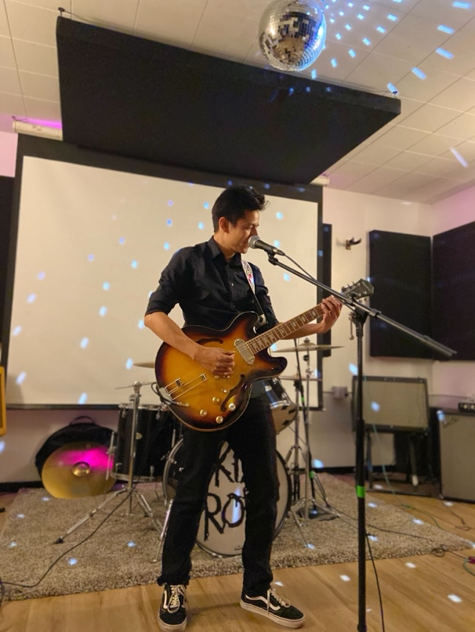
Bio
Graduated CSU Northridge
B.S in Computer Science
Undergraduate Research Assistant
Image Classification using EfficientNet, DaVit, MobileOne
Compiler for Hierarchical State Machine language (Proteus)

Slide 4
Acronyms [1]
PnP: Perspective N Point
Algorithm that takes a subset of 2d points in the image, 3d points in the world, and a camera model, calculating a best fit camera position that allows those rays to coincide
RANSAC: Random Sample Consensus
Sampling method that randomly selects a small subset of 2d points, just large enough to run PnP (about 3 points)
Creates a model and checks how many inliers fit in the estimated model.
Iterates over a parametrized number (10,000)
Inliers / Outliers
After calculating a camera pose, all 3d test coordinates are reprojected into the image such and compared to their corresponding 2d coordinate
The error in pixels between the resulting projected 2d point and the original input 2d point is compared against a parameterizable reprojection error defined in pixels.
Points that have a delta of less than the reprojection error are considered Inliers, and the rest are considered Outliers

Slide 5
Acronyms [2]
TSM: Template Synthesis (and) Matching
The current primary localization algorithm for SRL’s STS Vision System that takes in a 3d model, renders an image of said model in the expected current pose relative to the camera, then locally searches for predefined patches (templates) from the rendered image in a larger area in the test image
Template 2d coordinates on the rendered image, have a corresponding 3d depth value provided by the renderer. These 2d (Test Image) to 3d (Rendered Image) correspondences are fed to PnP to generate a pose

Slide 6
Overview [1]
TSM works on simulated images incredibly well
Pose Error:
0.009 mm Normal Translational
0.09 mm Lateral Translational
0.1 mrad in-plane rotation
1 mrad out-of-plane rotation
Notes:
Normal – Perpendicular to the axis o

Slide 7
Overview [2]
TSM on Douglass Dock visually runs well, however, with respect to the ground truth, shows large margin of error
Pose Error:
2 mm Normal Translation
5.3 mm Lateral Translation
2.2 mrad in-plane rotation
9.3 mrad out of plane rotation
Notes:
Normal – Perpendicular to the axis o

Slide 8
Design [1]
Notes:
First Design

Slide 9
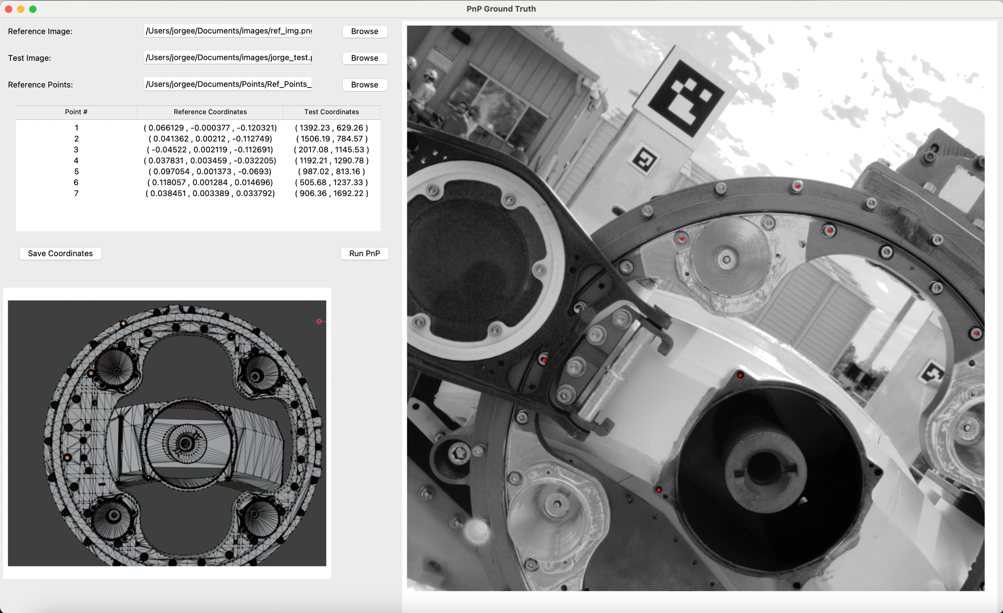
Design [2]
Notes:
First Design with Functionality

Slide 10
Design [3]
Notes:
Current Design

Slide 11
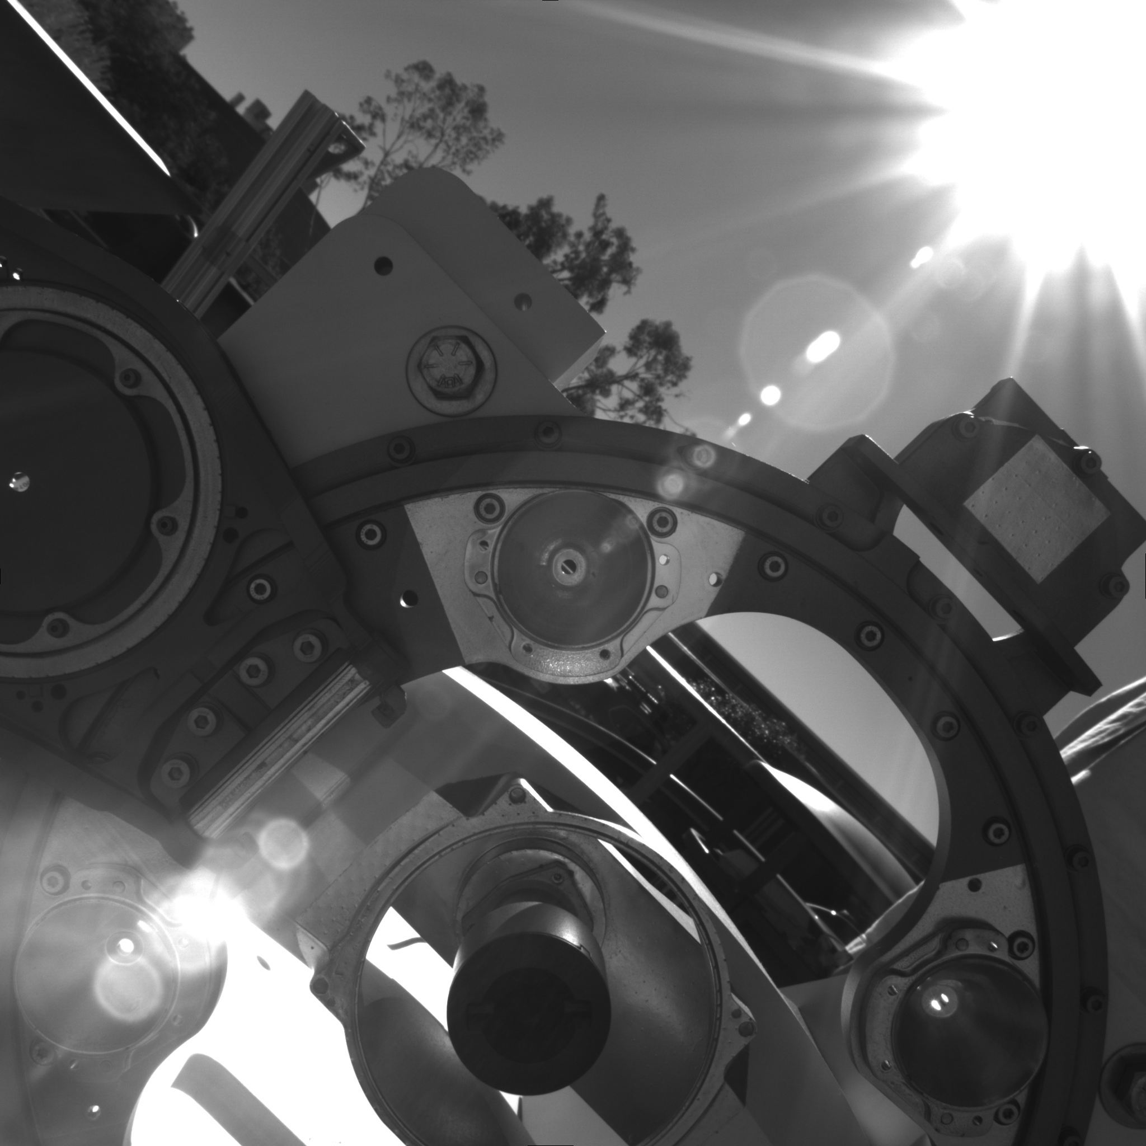
Features [1]
Render Images
If a rasterizer tool is present, GTT can send commands to generate image
Rendered Image can be toggled, displaying the original image and the rendered image like a gif.
Rendered Image is automatically saved with original image

Slide 12
Features [2]
Slider Tool
Takes two images and overlays them in a way that a slider can blend seamlessly
Needs rasterizer to produce a rendered image if utilized within the GTT
Can run independently
Pre-Decisional Information – For Planning and Discussion Purposes Only
Reviewed and determined not to contain CUI

Slide 13
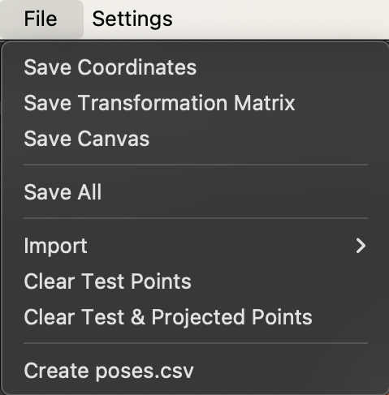
Features [3]
Save Files
Saves points (Reference, Test, Projected)
Saves the transformation matrix generated by PnP
Saves the current canvas on display

Slide 14
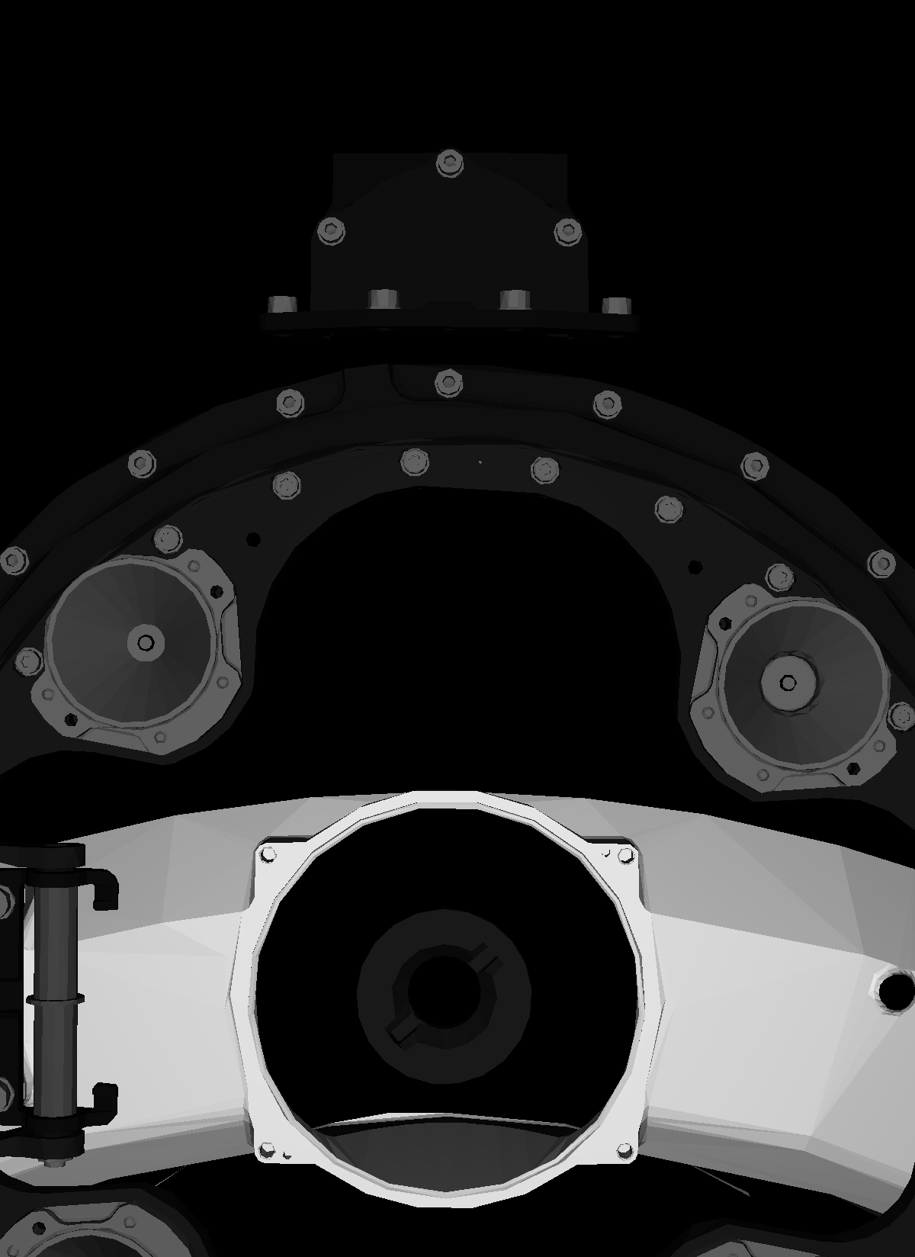
Results [1]
Douglass
Mars 2020
0.3 mm normal error; 2 mm lateral; 28 mrad in out of plane
Another round of testing with more points and lower reprojection error threshold is warranted
Due to the close FOV of the camera, points bunch up, introducing bias
Images with a farther FOV lack the quality to correctly quantify error
Reviewed and determined not to contain CUI

Slide 15
Results [2]
Hi-Fidelity Douglass
Reviewed and determined not to contain CUI

Slide 16
Whats next
Get a job!
Computer Vision
ML / AI
Compilers
Study for the GRE
Get Masters
???
Return to JPL!
Reviewed and determined not to contain CUI

Slide 17
Thank You!
Special Thanks
Phil Bailey
Tu-Hoa Pham
Philip Twu
Todd Litwin
Austin Kwon
Federico Pizarro
And to everyone else, Thank You!
Reviewed and determined not to contain CUI

Slide 18
Reviewed and determined not to contain CUI

Slide 19
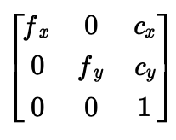
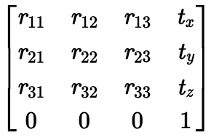
Prerequisites
Perspective N Point
Camera Matrix:
3D Points (w/r the world):
2D Points (w/r the frame):
Rotation / Translation Matrix:
Pinhole Camera
Given by CAD Model (3D Reference Points)
Given by GTT (2D Test Points)
Goal
Reviewed and determined not to contain CUI

Slide 20
Requirements
Reviewed and determined not to contain CUI
Notes:
Normal – Perpendicular to the axis o

Slide 21
Other Images
Reviewed and determined not to contain CUI

Slide 22
Other Images
Reviewed and determined not to contain CUI

