Slide 1
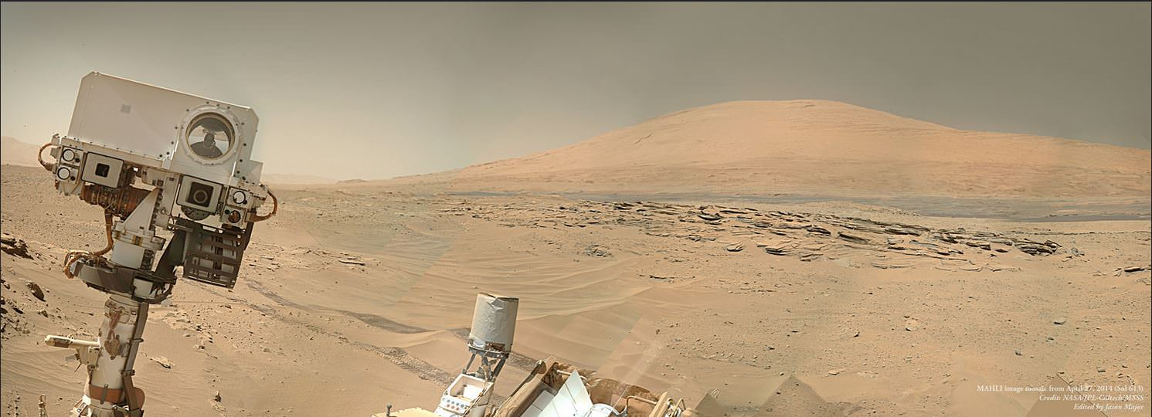
These Wheels Are Made For Arc-ing: Two New Mobility Commands to Reduce Wheel Wear
Neil Abcouwer, Mark Maimone, Freddy Wang, Evan Hilgemann, Alexandra Holloway, Anna Sabel, Nik Patel Jet Propulsion Laboratory, California Institute of Technology
This document DOES NOT contain export-controlled information

Slide 2
Agenda
Mark Maimone | Background – MSL mobility and wheel wear; how we move the rover; how the rover moves itself
Neil Abcouwer | Implementation – The math behind the two new commands
Freddy Wang | Verification and validation – How we tested the new mobility commands
Alexandra Holloway | Conclusions

Slide 3
How to move a rover
Mark Maimone
Notes:
MSL mobility and wheel wear
Commanding mobility on MSL
And how the rover can make intelligent decisions in its own mobility

Slide 4
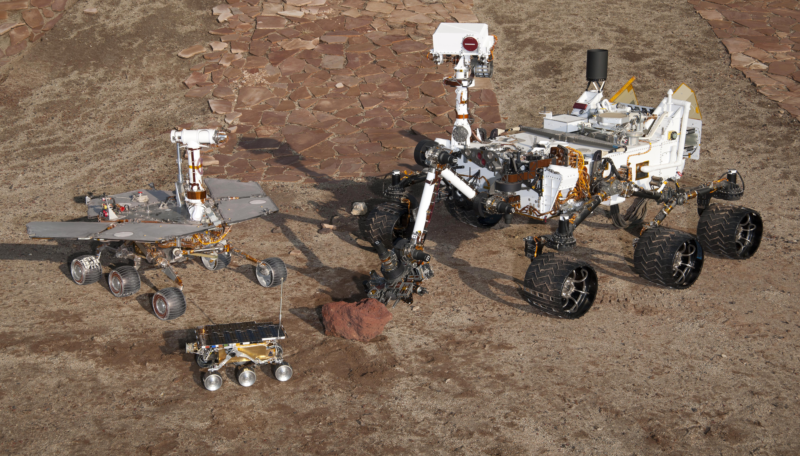
Background: MSL Mobility & Wheel Wear
NASA/JPL-Caltech
Sol 490
Sol 2030
Notes:
Curiosity is a third-generation 6-wheeled Mars rover with rocker/bogie suspension, following in the footsteps of Sojourner and Spirit and Opportunity.
Curiosity has been exploring Mars since August 2012, and is likely to continue to operate for many more years.
But an unexpected amount of degradation of the wheels was first noticed after just 490 sols (nearly a year and a half). That led to several mitigation strategies:
SHORT TERM: all drives < 20 meters, classifying every step in the nearby terrain for wheel safety (not tenable for long-term operations)
MEDIUM TERM: new strategic drive path prompted by science team observations (led to greatly reduced wear rates)
LONG TERM: Terrain-adaptive Wheel Speed Control FSW update, and new FSW commands explained in this talk.

Slide 5
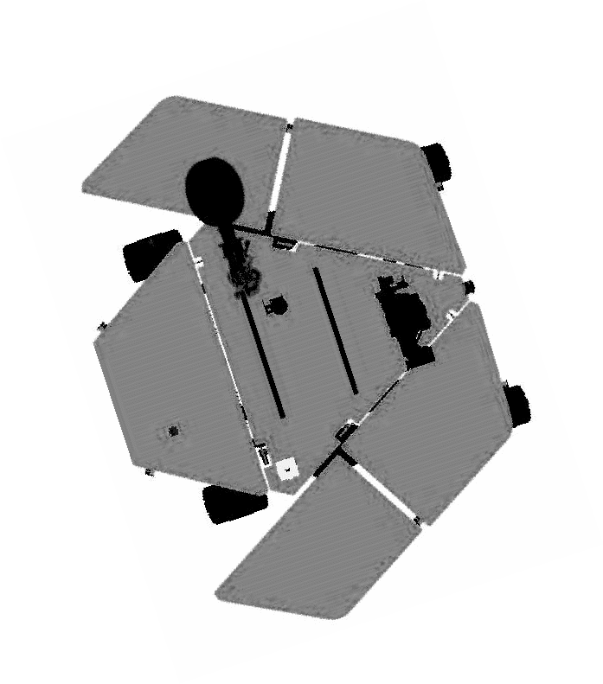
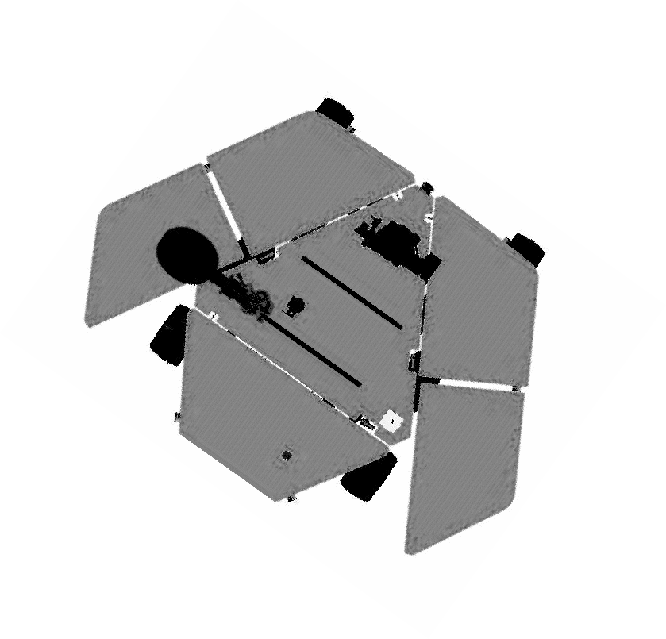
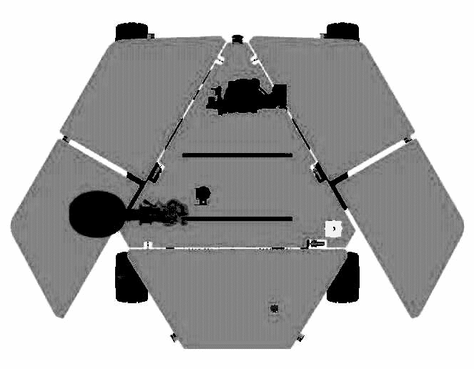
Rover Mobility Command Types
Basic Mobility
Autonomous Navigation
Arc (distance, delta-heading, mode, timeout)
Turn_absolute (angle, mode, timeout)
Turn_relative (angle, mode, timeout)
Turn_to (x,y, offset, mode, timeout)
Goto (x, y, tolerance, mode, timeout)
tolerance
(x , y)
New Position (x₁ , y₁)
(x , y)
Prescribed Arc
X
S
θ
X’
+X
R
Xs
Y
θ
Ys
+Y
Y’
Xs
Site Frame
X
Initial Position (x₀ , y₀)
Ys
Site Frame
Y
Move along circular arc or straight line path of commanded length - Open-loop relative to on-board position/heading estimate
Turn in-place about rover center to commanded heading - Closed-loop around IMU based heading estimate
Autonomous traverse toward a commanded waypoint with on-board hazard detection using stereo vision - Closed-loop around position and heading, but no fine positioning
Notes:
NASA’s Spirit and Opportunity rovers initially used a simple mobility commanding framework, with two main types:
BASIC mobility commands typically follow a pre-specified path RELATIVE to the current position; commanding an Arc must include a fixed distance and heading change, specified by human planners.
AUTONOMOUS mobility lets the rover choose its path based on current information.

Slide 6
Blurring the lines – Updating Basic Mobility
Operational needs on Mars eventually led the MER team to add a new ARC_UNTIL command:
Humans specify the maximum distance and fixed delta heading
Rover only follows that arc UNTIL it would cross a pre-specified goal line.
Any additional ARC_UNTILs would result in no motion, since the goal had been reached already.
A TURN_TO followed by this command became the preferred way to perform a precision approach to a particular drive goal for MER, and remains the preferred way for MSL and M2020 to arrive at a waypoint
y
Navigation Goal
Max Commanded Distance
x
Goal Line
θ
Notes:
Operational needs on Mars eventually led the Spirit and Opportunity teams to add a new ARC_UNTIL mobility command. This command looks a lot like an ARC command, (you specify a distance and the heading change), but the command will stop early once the navigation goal location (or a goal line containing it) has been reached.
In fact, using a TURN_TO command followed by this command actually became the preferred way to perform a precision APPROACH to a particular drive location for Spirit and Opportunity. And that strategy, turning to face the goal and using several ARC_UNTILs to drive toward it, remains the preferred strategy for Curiosity and Perseverance.

Slide 7
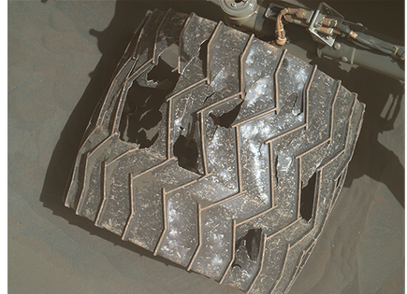
Blurring the lines – Adapting Arc Curvature
HOWEVER, this command only lets the rover adjust the drive DISTANCE, not the delta heading toward the goal point.
Such a change was considered for MER, but the extra complexity and uncertainty of allowing the rover to choose its steering in a basic “primitive” drive command led the team to choose not to implement it.
BUT on MSL, Wheel Wear considerations forced us to reconsider.
Notes:
However, the ARC_UNTIL command only lets the rover adjust the drive DISTANCE, not the delta heading toward the goal. Such a change was considered for Spirit and Opportunity, but the extra complexity and uncertainty of allowing the rover to choose its steering led the team to choose not to implement it in a basic primitive drive command.
But on Curiosity, Wheel Wear considerations forced us to reconsider that decision.

Slide 8
Rover Chooses its Heading
The current precision approach performs a turn in place (steering the corner wheels to nearly 45 degrees, driving, steering the corner wheels back) followed by straight line motion.
But that additional steering and turning adds more opportunities to accumulate wheel wear damage.
Allowing the rover to choose its own arc delta heading would minimize steering and reduce turn-in-place forces on the wheels.
So we have implemented two new commands:
ARC_TO calculates delta heading and performs an arc that points the rover at a goal without exceeding a specified path length
ARC_UNTIL_TO drives along a specified arc, truncating once the rover points at the specified navigation goal, enters a waydisk, or meets the other truncation criteria of an arc_until.
Notes:
Recall that our current precision approach strategy performs a turn in place followed by straight line motion. That turn in place can add significant wheel motion, steering each corner wheel up to 90 degress to enter a turn-in-place configuration and return to straight-ahead. Instead, allowing the rover to choose its own arc would minimize steering, and therefore reduce those forces.
So we have implemented two new commands:
The ARC_TO command calculates the delta heading argument autonomously, based on the relative location of the current navigation goal. It will then drive the rover toward that goal, without exceeding a specified path length.
The ARC_UNTIL_TO command requires a particular arc to be specified, but will stop driving once the rover points at the current navigation goal, or meets other ARC_UNTIL stopping criteria.

Slide 9
Benefits
The ARC_TO command autonomously calculates Arc Curvature (delta heading), which minimizes the steering change needed to reach a goal.
The ARC_UNTIL_TO command autonomously truncates the command once the goal is aligned with the rover, which gives high precision in pointing at a goal.
Earlier ARC commands are all “open loop”, meaning they do not rely on sensing to determine when to stop.
But in ARC_UNTIL_TO, that rover heading (yaw) is measured by the RIMU, so this can give us better performance in aiming toward a goal. TURN_TO does this too, but ARC_UNTIL_TO eliminates the need to steer to and from turn-in-place angles.
The combination of ARC_UNTIL_TO / ARC_TO can potentially replace TURN_TO / ARC_UNTIL as a means of reaching a waypoint goal, while minimizing steering.
This can be helpful for reducing wheel wear in certain terrains.
Expected to be deployed by mid-2022 in the R13 version of MSL Flight Software
Notes:
What are the benefits of these new commands?
ARC_TO will minimize the steering change needed to reach a goal.
ARC_UNTIL_TO will give us high precision in pointing at a goal. This is in contrast to the original basic arc commands which are all "open loop", and do not guarantee anything about the rover's final heading or position. ARC_UNTIL_TO measures the rover heading using the IMU and therefore can help achieve precise pointing without ever entering a turn-in-place configuration.
In combination, ARC_UNTIL_TO and ARC_TO can potentially replace the current pattern as a means of reaching a waypoint goal. This new combination can achieve a similar result, using much less steering and no turn-in-place commanding. This is the benefit we see toward reducing wheel wear.
These new commands have been implemented in the R13 version of MSL Flight software, which is expected to be deployed on Mars by mid-2022.

Slide 10
Implementation
Neil Abcouwer

Slide 11
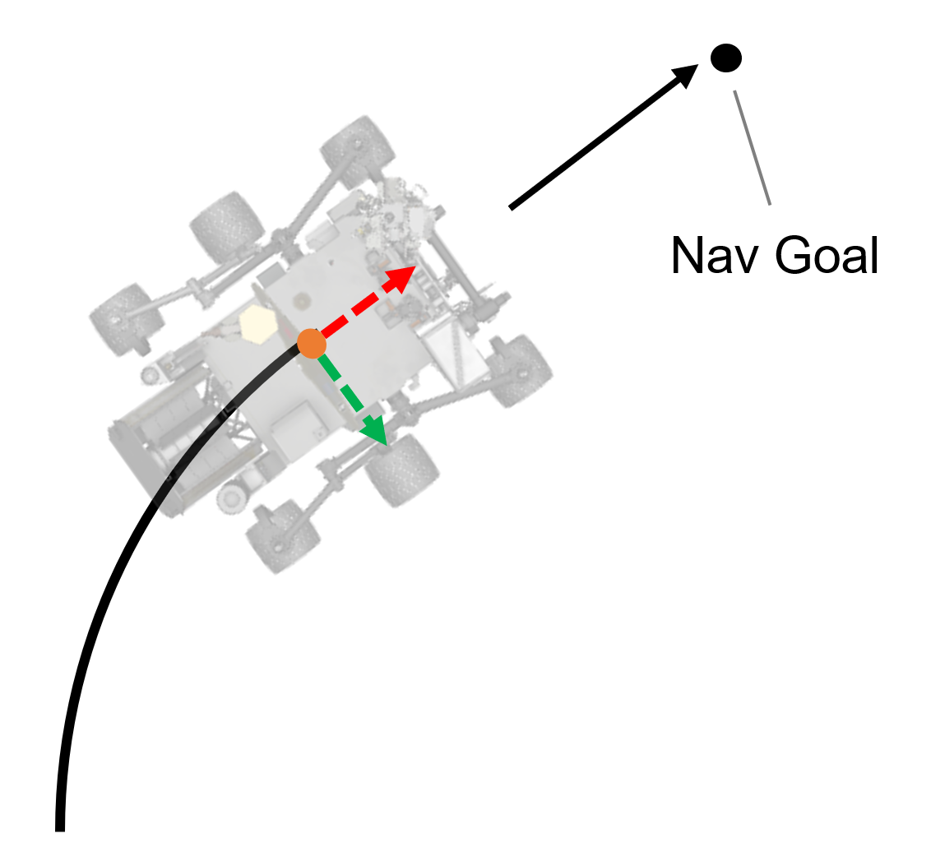
ARC_TO
Notes:
The first command for which we will derive the underlying mathematics is ARC_TO. ARC_TO commands the rover to perform an arc that will point the rover's front or rear at the navigation goal. The inputs to ARC_TO are the goal position, the desired signed arc length, and the waydisc radius. The waydisc is a disc around the navigation goal that the rover should not enter. The outputs are the change in heading, and if the rover would meet the waydisc, the shortened arc length d.

Slide 12
ARC_TO – assuming rover meets waydisc
Notes:
First we find the change in heading, theta_Delta and signed arc length d that will move the rover such that it simultaneously meets the waydisc and points at the navigation goal. In this case, the final position is rover is bound by both the equation of an arc, so x final = d / theta * sin theta, and is also bound by the waydisc radius and the heading at that point, so x final = x goal – w times cosine theta . Below x are the equivalent equations for y. Both of these equations can be solved for d, the arc length. Then the arc length equations can be set equal and solved for theta, the change in heading (which can then be substituted back in).
If the solution for arc length is less than or equal to the commanded arc length, then a solution has been found where the rover meets the waydisc. Otherwise…

Slide 13
ARC_TO – rover does not meet waydisc
If previous solution for $d$ is less than commanded distance, rover will not reach waydisc ($w$ unknown)
No closed-form solution (we think). Loop over potential values of $θ_{Δi}$ until the following value changes signs.
Zero-crossing is in the interval ${[θ}_{Δi−1},θ_{Δi}]$. Use Bisection search to narrow the interval.
Notes:
Otherwise the rover cannot meet the waydisc and point at the goal. In this case, d will be the commanded arc length, and the change in heading must be found. Using the vector from the final position to the goal, we can describe the change in heading as an arc tangent, but this is also a function of the change in heading. We have not found a closed-form solution for theta, but we can use bisection search to find the zero crossing of the equation. First loop over values of theta until a reasonable interval is found. Then use bisection search to narrow the interval to a reasonably-accurate value.

Slide 14
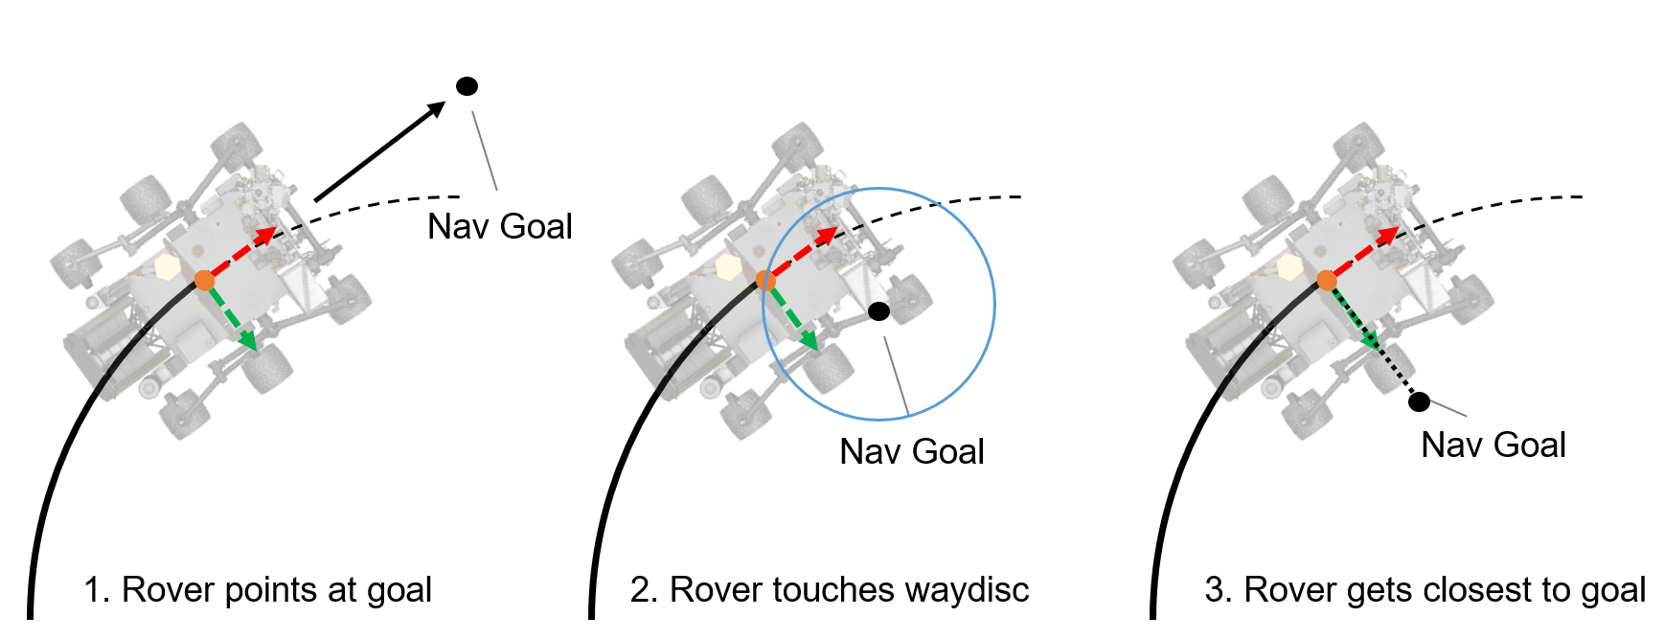
ARC_UNTIL_TO
Notes:
The first command is arc until to. Arc until to performs an arc of given length and change in heading, until one of several ending conditions are met. We would like to end the arc when pointed at the goal, but we would also like to prevent entering the way disc and getting to close to the goal, or traveling away from the goal. We will find the fractions of the commanded arc that meet each of the conditions (if at all), and the smallest found fraction will be the fraction of the arc that is returned.

Slide 15
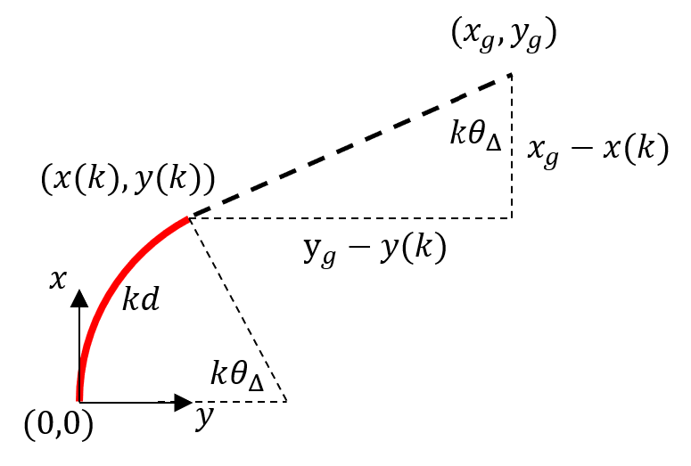
ARC_UNTIL_TO – rover pointing at goal
Trigonometric identities, linear combination of sinusoids, leads to…
Notes:
First, we find the fraction of the arc that will point at the goal. This is similar to the previous problem, but the radius of the arc is fixed, leading to a closed-form solution to the relation between the goal and rover positions. Using trig identities and the linear combination of sinusoids, we find the solution for k at the bottom.
Several insights come from the solution. From left to right, the plus minus relates to how there are two solutions along the circle corresponding to the arc, one for pointing the front of the rover and one for pointing the back. If the input to arccosine has magnitude greater than 1, there is no solution. This is the case if the goal is within the arc and the rover will never point at the goal, similarly, if the input to arctan is invalid, the goal is at the center of the arc, and again there is no solution. The 2 pi n relates to the fact that the rover could theoretically travel in circles again and again, pointing at the goal each cycle. We must loop over values of n to find the smallest positive solutions for k.

Slide 16
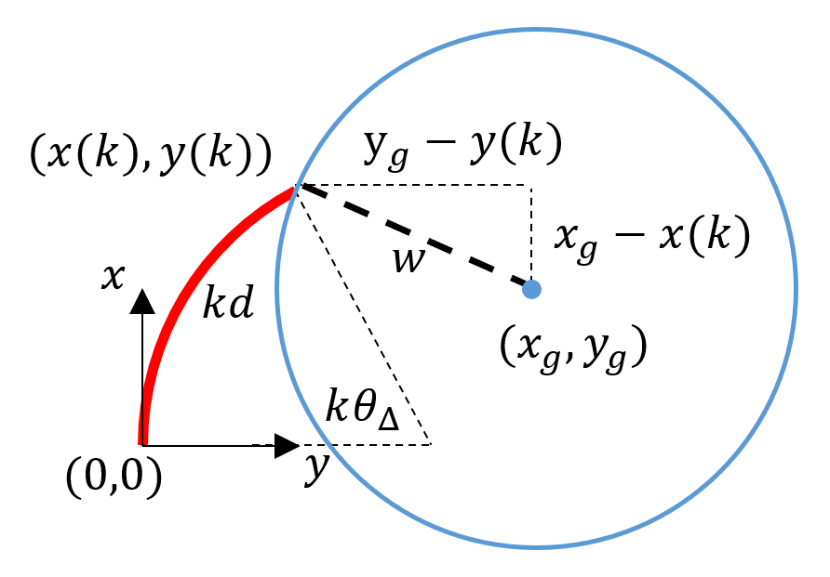
ARC_UNTIL_TO – rover meeting waydisc
Notes:
Next we find the fractions of the arc that intersect with the waydisc, using the Pythagorean theorem to relate the waydisc radius to the rover position. The solution for k also uses linear combination of sinusoids for similar reasons. The plus minus relates to how the arc can intersect with the waydisc twice. If the input to arccos has magnitude greater than 1, there is no solution because arc will never intersect the waydisc. And lastly the 2 pi n shows how the rover can circle and intersect the waydisc again and again.

Slide 17
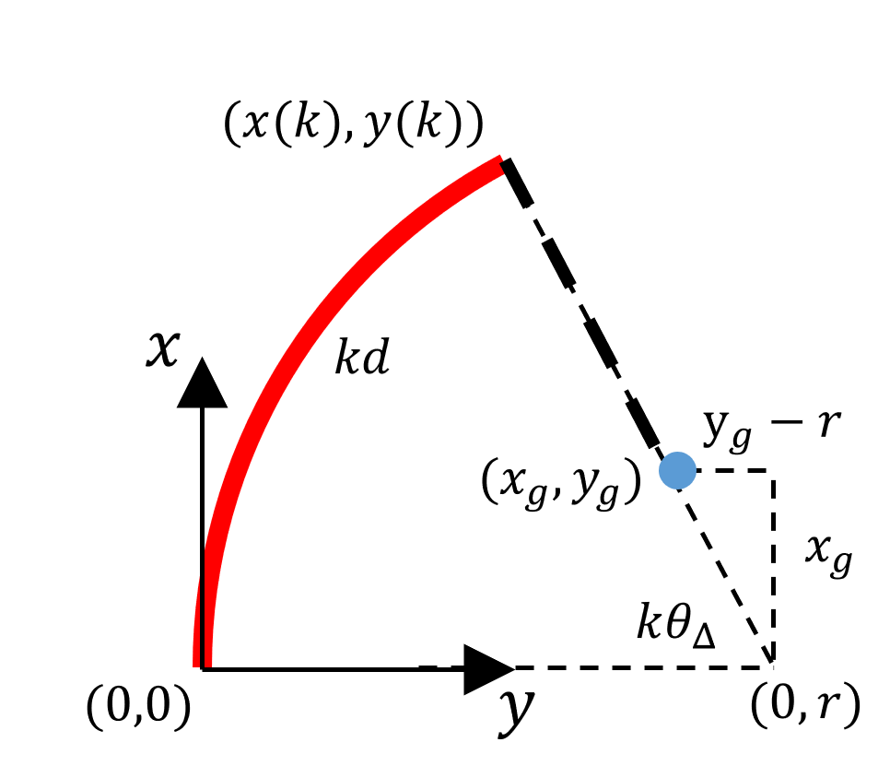
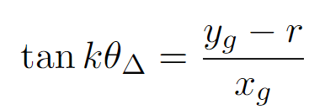
ARC_UNTIL_TO – rover’s closest approach to goal
Notes:
Finally we would like to prevent moving away from the goal by finding the position along the arc that is the closest to the goal. We can show that the closest point of the arc is the one the line defined by the goal position and the center of the arc which is at coordinates 0,r. Use the tangent relationship to find the fraction of the arc that meets the matching angle. This formulation only fails if the goal is at the exact center of the arc.

Slide 18
Verification and Validation (Testing plan)
Freddy Wang

Slide 19
V&V Strategy
Test cases exercise nominal functions, as well as off-nominal usage
Show that the commands work as intended
Use them in ways that are not intended
V&V flow starts with simulations, run for record in the real world
Simulations used during procedure development
Understand the behaviors of the commands better
Baseline expected outcomes
Run for record on the Vehicle System Testbed (VSTB)
Functionally identical twin of the Curiosity rover on Mars
Gives higher confidence for usage in flight
Selected test conditions from arbitrarily infinite paths and positions
Methodology based on early-mission testing of mobility commands
All possible paths/positions simplified into 9 goal cases
8 basic directions + 1 close to or at rover origin
Goals expressed in generic Cartesian coordinates
Actual goal coordinates depend on the specific test case
Diagram showing the 9 simplified goal coordinates
Notes:
The test cases developed to verify and validate the new commands exercise nominal functions, as well as off-nominal usage.
We want to show that the commands work as intended, and also use them in ways that are not intended.
The V&V flow starts with simulations, then run for record in the real world.
Simulations are used during procedure development to understand the behaviors of the commands better and to baseline expected outcomes.
The run for record takes place on the Vehicle System Testbed (the VSTB for short), which is the functionally identical twin of the Curiosity rover on Mars.
Doing so gives higher confidence for usage in flight.
The test conditions were selected from arbitrarily infinite paths and positions,
using methodology based on early-mission testing of mobility commands.
All possible paths and positions are simplified into 9 goal cases,
8 basic directions such as straight forward or diagonally back and left, and 1 close to or at the rover origin.
The goals are expressed in generic Cartesian coordinates, but the actual goal coordinates depend on the specific test case

Slide 20
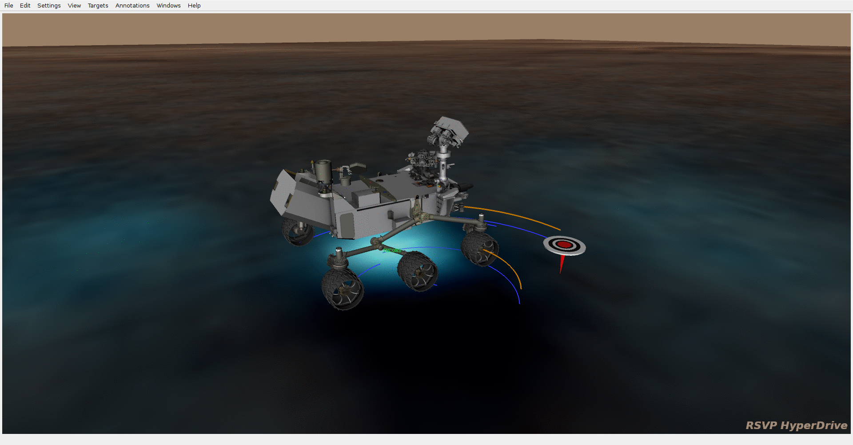
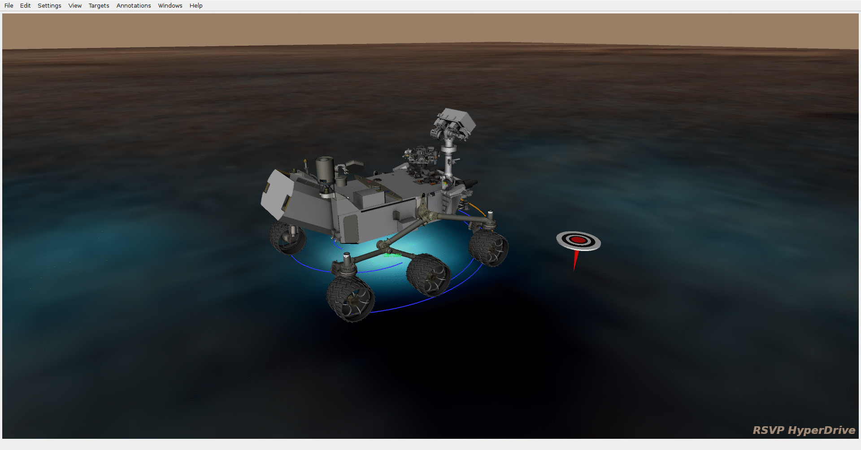
V&V Test Case Examples
ARC_TO pointing the front at +X,+Y
ARC_TO pointing the rear at +X,+Y
Rover path
Rover pointing
Goal
Notes:
Here are two examples of test cases.
Both have the same goal at (+X, +Y) using forward drives.
In the first case the rover decides on a forward arc right so that the front of the rover points at the goal.
This would be nominal usage in flight.
In the second case the rover decides on a forward arc to the left so the rear of the rover points at the goal.
We can’t think of any good reasons to do this in flight, but by V&Ving this case we build confidence that our commands work as expected across the domain of possible accepted inputs.

Slide 21
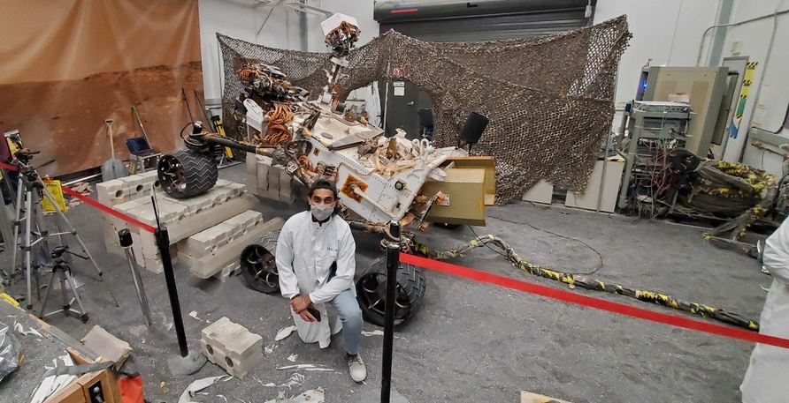
Factors Impacting V&V Development
VSTB location and availability
VSTB was in a tiny sandbox
Goal coordinates chosen to minimize motion
Procedure included test cases that could not be done in the sandbox
Conflicting project needs for the VSTB caused test delays
Understanding of command behavior
Initial understanding of the commands was mostly correct (but wrong in many ways)
Expected outcomes of ARC_TO were different due to nuances that weren’t fully described in the command description
Simulating test cases corrected expected outcomes and created new cases
Left: VSTB in the sandbox
Photo credit: Neel Patel
Notes:
There were several factors impacting the development of V&V for these new commands.
The biggest influences were the location and the availability of the VSTB.
At the start of V&V development it was in a tiny sandbox for the foreseeable future,
so goal coordinates were intentionally chosen to minimize motion in the confined space.
There were still cases written in the procedure that could not be tested in the sandbox,
but were to be done when the testbed was relocated to the open ranges of the JPL Mars Yard.
Additionally, conflicting needs by the MSL project for the testbed caused delays in V&V.
The other factor impacting development was the mobility V&V developer’s understanding of the command behaviors.
The initial understanding was mostly correct but wrong in many ways, particularly with rover-determined arcs using ARC_TO.
Nuances with how the rover computed paths that were not readily apparent from the command description caused subtle differences in expected outcomes.
But by simulating the test cases we corrected the expected outcomes, developed a better understanding of the command behaviors, and have more confidence going into the high-fidelity physical tests on the VSTB.

Slide 22
Conclusions
Ten years into its two-year mission, MSL continues to update Flight Software in pursuit of improved capabilities.
Commands that were considered too complex for earlier missions became useful to help mitigate with unexpected wheel wear.
These new mobility commands will be incorporated into drive planning as a new way to reach waypoint goals while minimizing steering.
Expected to be deployed by mid-2022 in the R13 version of MSL Flight Software.

