Slide 1
Rover Relocalization for Mars Sample Return by Virtual Template Synthesis and Matching
-
Experimental Results
Tu-Hoa Pham, Barry Ridge, William Seto, Jeremy Nash, Sydney Do
May 4th, 2021
The decision to implement Mars Sample Return will not be finalized until NASA’s completion of the National Environmental Policy Act (NEPA) process. This document is being made available for information purposes only.
© 2024. California Institute of Technology. Government sponsorship acknowledged.

Slide 2
Overview
Over the past years, JPL has developed machine vision capabilities related to a potential Sample Fetch Rover (SFR), that had only been tested in isolation
We developed a test campaign to inform the Mars Sample Return campaign on:
Performance of vision algorithms in a representative setting
System-wide challenges, e.g., integration, component interactions
Requirements on M2020 to enable tube retrieval by SFR
Our study demonstrated the feasibility of vision-guided sample retrieval while being robust to images captured in different environment conditions, possibly degraded over time by wind, dust and rover operations
Paper: “Rover Relocalization for Mars Sample Return by Virtual Template Synthesis and Matching”, T.-H. Pham et al., IEEE Robotics and Automation Letters, 2021.

Slide 3
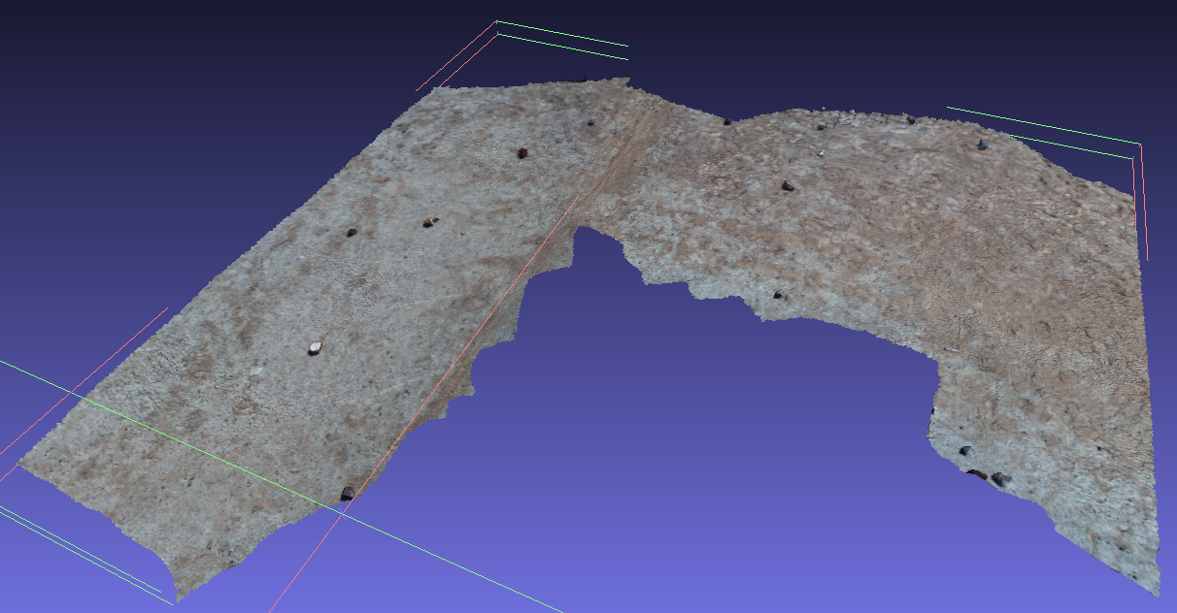
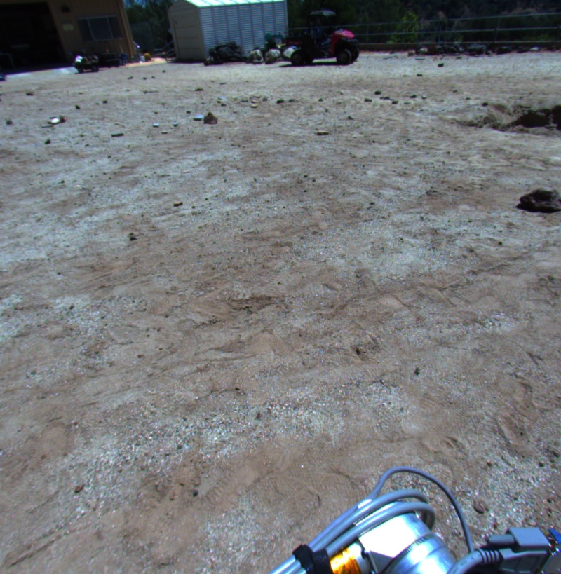
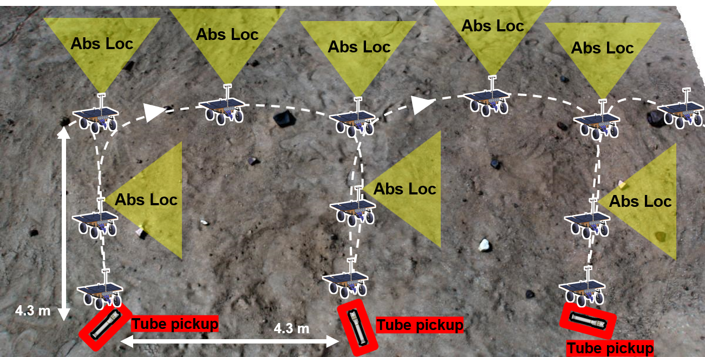
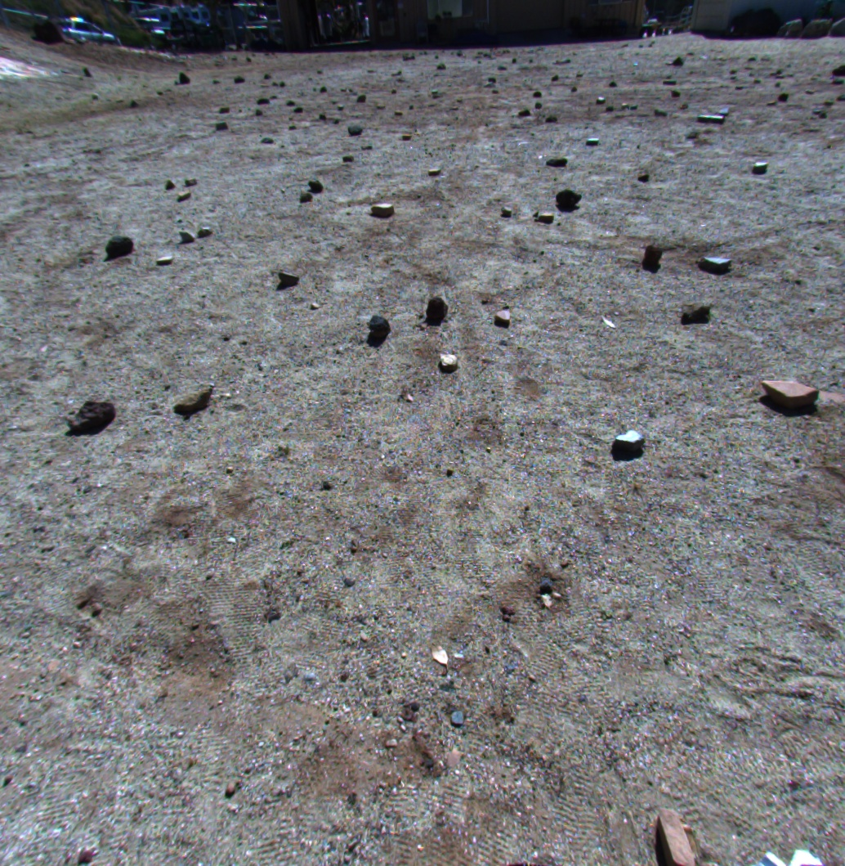
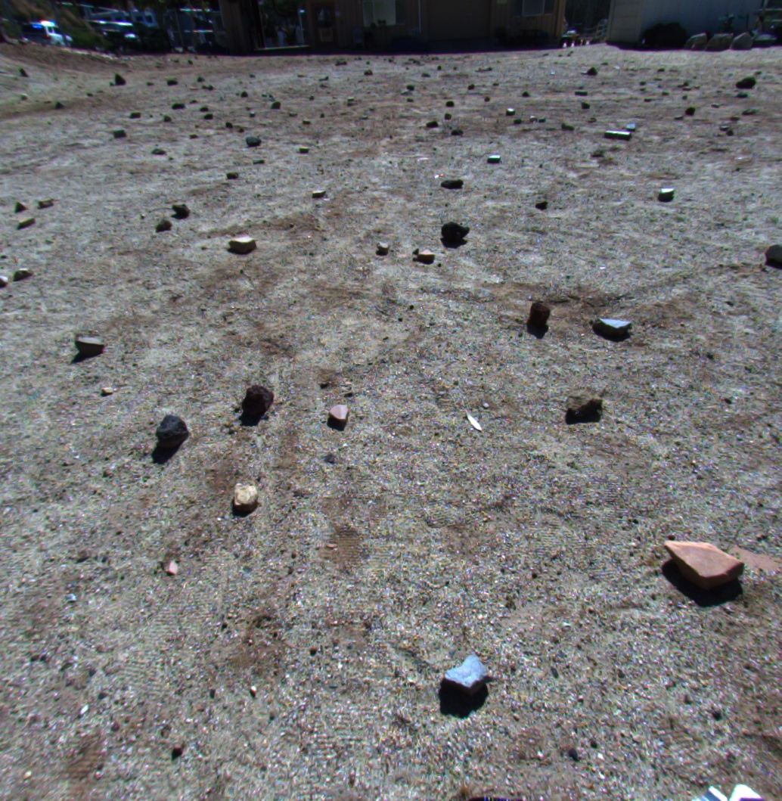
Vision components and concept of operations
Absolute localization (yellow triangles)
M2020 map + SFR images → absolute pose
Visual odometry (white dashed line)
Consecutive SFR images → relative motion
Tube detection (red box)
SFR image → tube pose

Slide 4
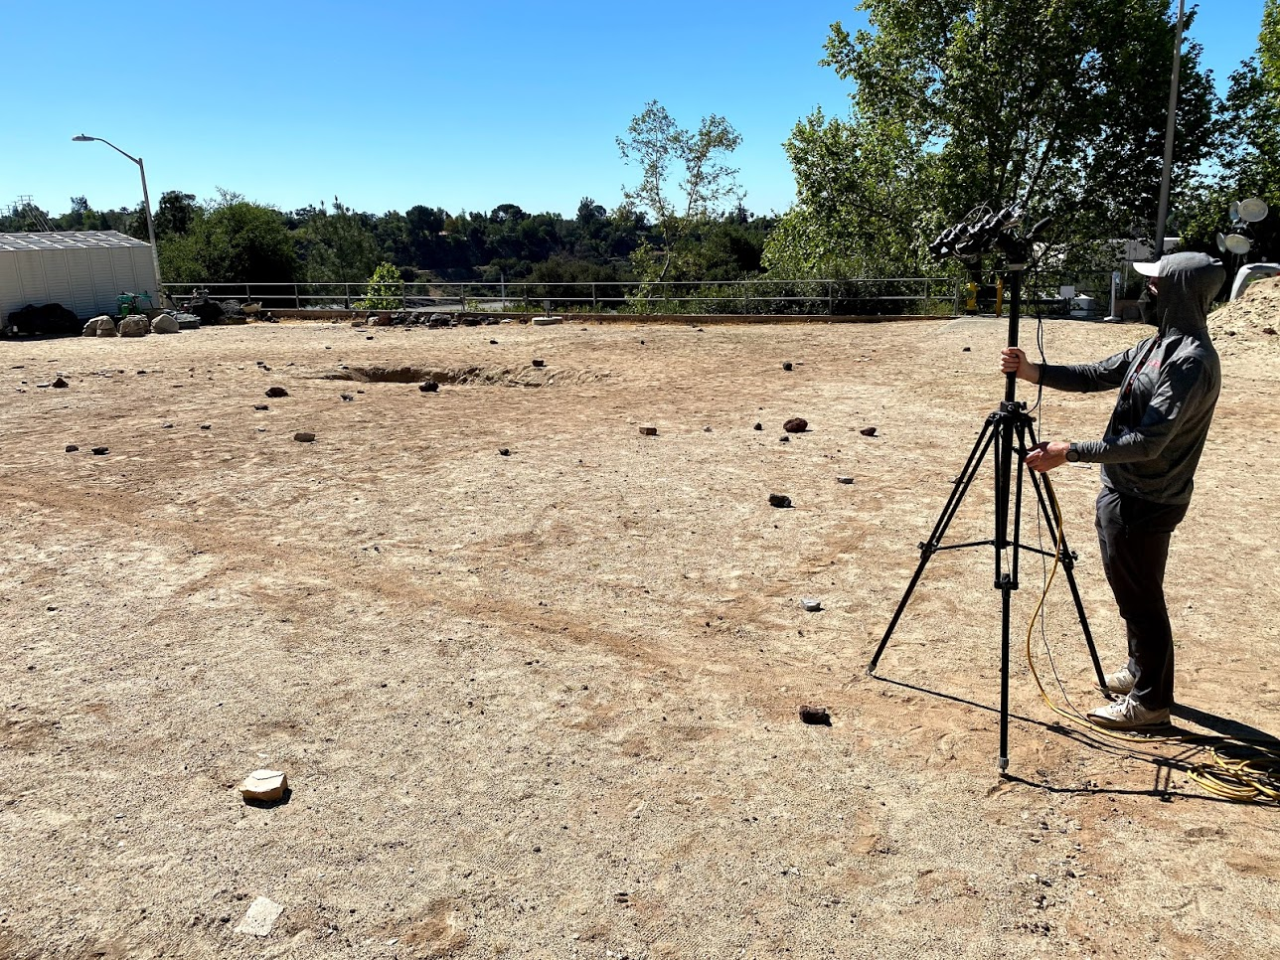
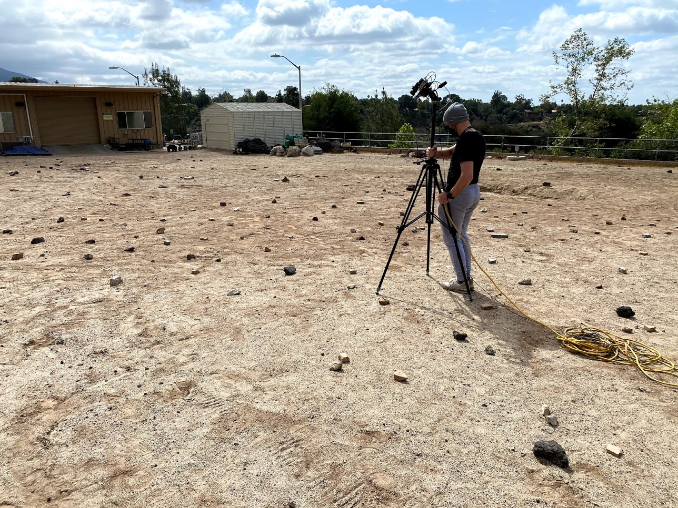
Depot construction
On the Mars Yard, we reproduced terrains representative of possible depot construction sites at CFA 2% and 6% and placed tubes with different levels of dust coverage / occlusions

Slide 5
Depot mapping: imaging in the morning

Slide 6
Navigation and pickup under changing conditions

Slide 7
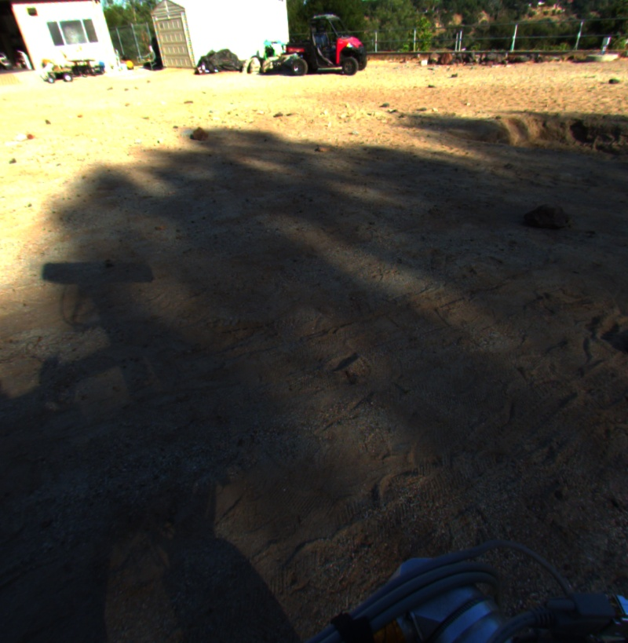
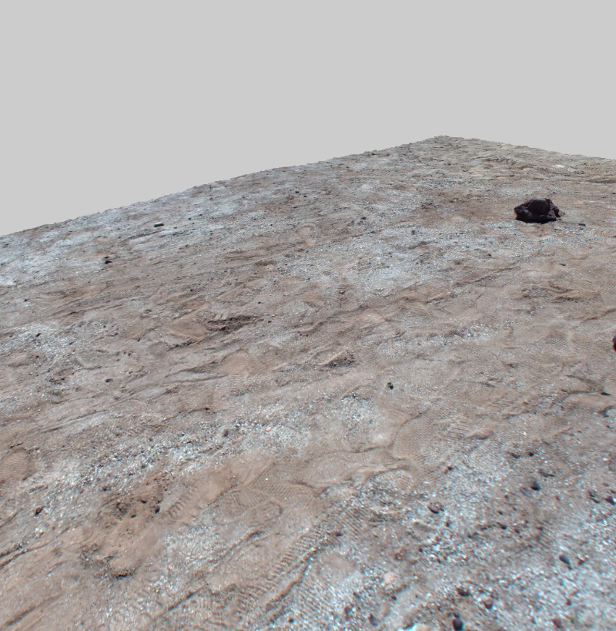
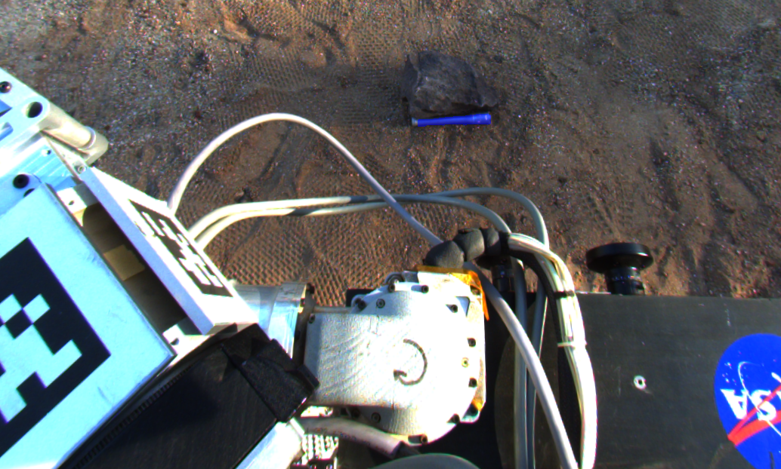
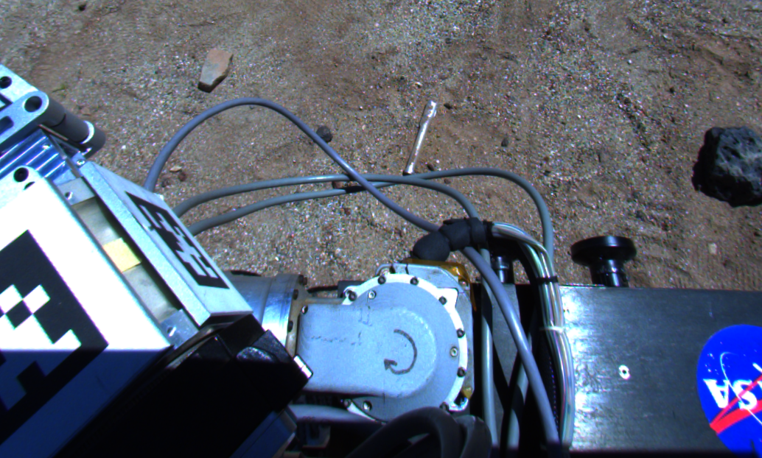
Conclusion
Vision components behaved as expected over test campaigns on both terrains
Absolute localization showed to be robust to low presence of salient features, strong lighting differences and changes in terrain due to wheel tracks
Tube detection was robust to partial occlusions by light dust or rocks, but not to heavy dust coverage
Real image successfully aligned with depot map captured under other lighting condition

